Slide 1
Bn

Slide 2
Topic 1 Introduction
Blurry Screen Slide 1
Notes:
If using slide 1 as the first activity talk about how voting can be blurry, too.

Slide 3
Date of your presentation
Presented by:
(your name and picture here)
Notes:
Date of your presentation
Presented by: (your name and picture here)

Slide 4
Purpose of the Training
Register to vote
How you can vote in your state
How to choose candidates
How to get around Voting problems
Get Involved: Build a Voting Community
Notes:
You may know little or a lot about voting

Slide 5
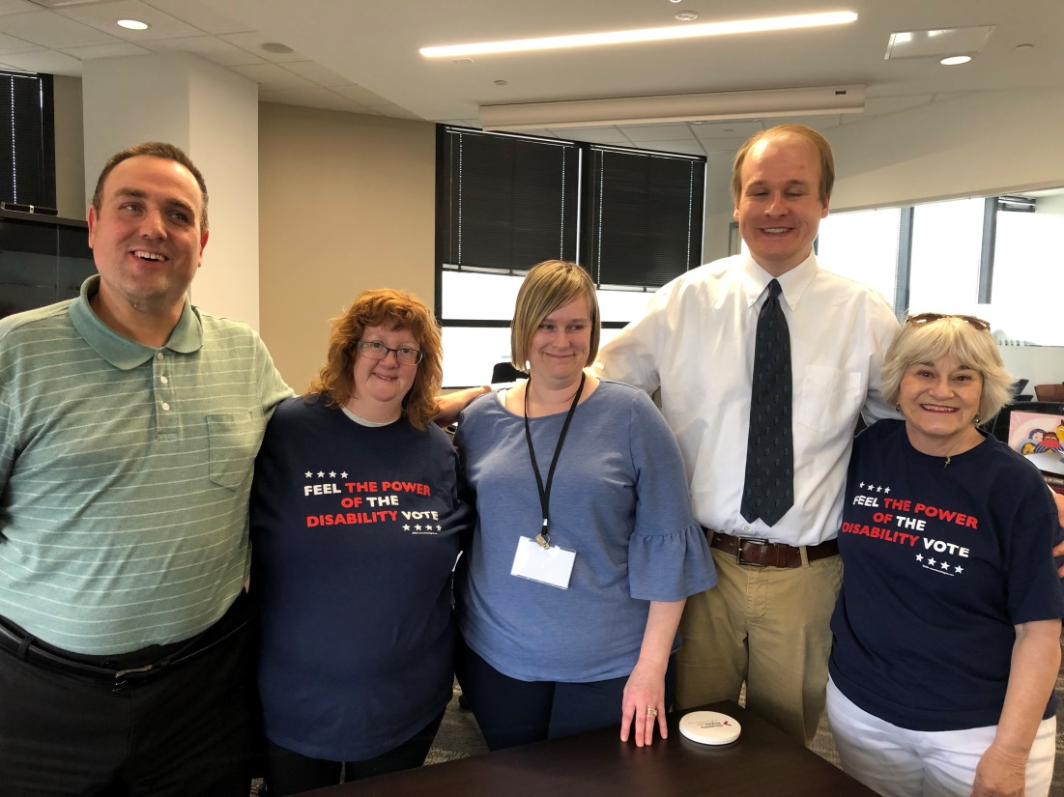
Topic 1 Introduction
Notes:
We are going to do an activity that will help us get to know each other better.

Slide 6
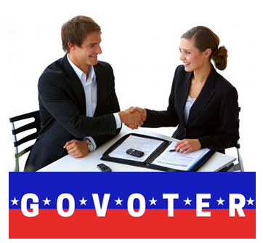
Get to Know Each Other Activity
Instructions: Use these questions to interview someone you do not know.
Ask your partner:
What is your name?
Where are you from?
If you were not at this class, what would you be doing?
My biggest voting question is…?
Notes:
Write out biggest voting question on big paper and at the end of training see if all questions are answered.

Slide 7
Survey time
Do you think poll workers should give you candy with your “I voted” sticker? Y N

