Slide 1
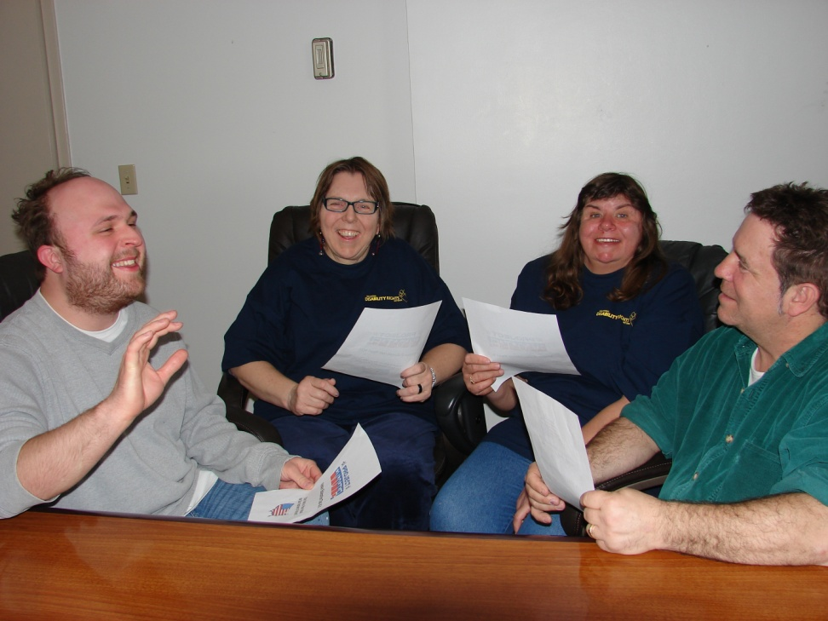
Topic 9
Best Practices
For Partnering

Slide 2
It is all about relationships!
“In order to work together to improve the lives of people with disabilities, professional organizations and self advocacy groups must have relationships that are based on understanding, respect and trust.”
Tia Nelis, former President of SABE

Slide 3
Our Voting Partnership Video Hamilton County, Ohio
Sherry Poland, Director Hamilton County Board of Elections
Diana Mairose, Advocacy Advisor Hamilton County DD Services and SABE GoVoter Advisory Member

Slide 4
Why Working Together is Important?
Working with P&As:
We Speak in one voice
We Provide legal back-up
We Share Information
We Strengthen our work with legislators
We Add credibility(value truth, and honor each other)
Collaboration (work on voting issues and more)
Notes:
Self advocate read this slide

Slide 5
Why Working Together Is Important?
Working with self advocates:
We Speak in one voice
We can speak up and do things the P&A can’t
We share information
We Strengthen our work with legislators
We Add credibility(value truth, and honor each other)
Collaboration (work on voting issues and more)
Notes:
P&A read this slide

Slide 6
Your first meeting with the potential partner
Schedule a meeting time
Make sure everyone is invited
Create an agenda
Talk about your group
Choose a note taker and a group leader for the following discussion

Slide 7
Use these questions for your discussion
What is the name of your group?
What is the purpose of the group?
What are the group goals?
What are somethings the group is involved in: examples of projects and events?

Slide 8
Develop an Action Plan
Choose activities to partner
Identify obstacles that might make the partnership challenging
How can we support each other
Find solutions together

Slide 9
Survey time

Slide 10
Best Practices For Partnering
Grow Your Relationship
Slide 76

Slide 11
Grow Your Relationship
Relationships take work, it is more than just on this project
Go to each other’s events
Support each other with volunteers, grant writing, and grants
Get to know the leaders of each group
Use straight forward language and materials

Slide 12
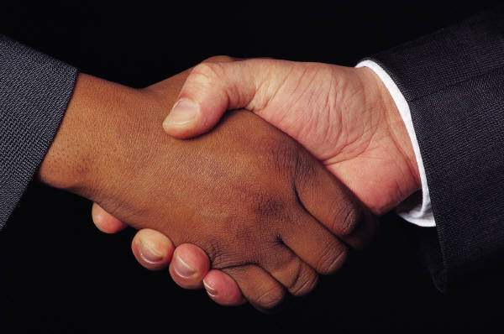
Best Practices For Partnering
Make a Formal Agreement
Slide 77

Slide 13
Make a Formal Agreement
Write out agreements of projects (who will do what)
Never put each other on projects without asking
Never add each other on policies or issue statements without asking

Slide 14
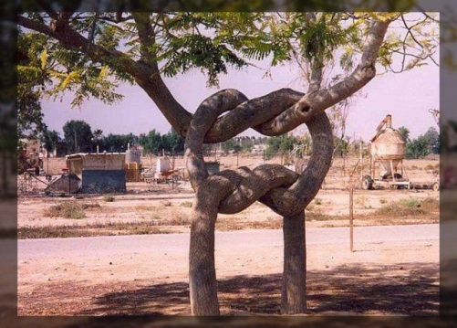
Best Practices For Partnering
Build Your Partnership Over Time
Slide 78

Slide 15
Build your partnership over time
Respect the role of your partner
Never take each other for granted
Respect how each organization works
Respect the culture of the group or organization
Think about the accommodation, available technology, location and time when you want to set up a meeting

Slide 16
Best Practices For Partnering
Help Each Other Build Bridges
Slide 79

Slide 17
Help each other build bridges
Always treat each other like you are on the same team
Look for opportunities to work together
Do not say “Yes,” if cannot do it
Do not burn you bridges

Slide 18
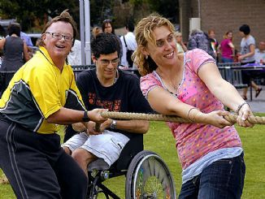
Best Practices For Partnering
Don't Give Up
Slide 80

Slide 19
Do not give up
Continue building your relationship
Continue to reach out to people
Try to give constructive help not destructive talk
Think positively

Slide 20
Is this partnership working?
Ask ourselves:
What is Working Better
What’s Still Not Working
What Are the New Opportunities
Slide 82

Slide 21
Evaluation

