Slide 1
Topic 6 Ways to Learn About Candidates and Issues

Slide 2
Ways to Learn About Candidates and Issues
Have a Legislative Day
Call for an appointment with your legislator
Look up candidates voting records
Read your local newspaper

Slide 3
Ways to Learn About Candidates and Issues
Read your Sample Ballot
Ask someone you trust to review the Sample Ballot with you
Talk with family and friends
Listen to the radio, TV and talk shows

Slide 4
Ways to Learn About Candidates and Issues
Tell stories and share your voting experiences with others
Make a checklist of what is important to you and check if the candidates share your idea
Interview Candidates on where they stand on disability issues

Slide 5
Ways to Learn About Candidates and Issues
Educate and work with parents, self advocates and staff
Invite someone from the League of Woman Voters
Invite an elected officials to speak with your group
What are some of the other ways you can learn about the candidates and issues?

Slide 6
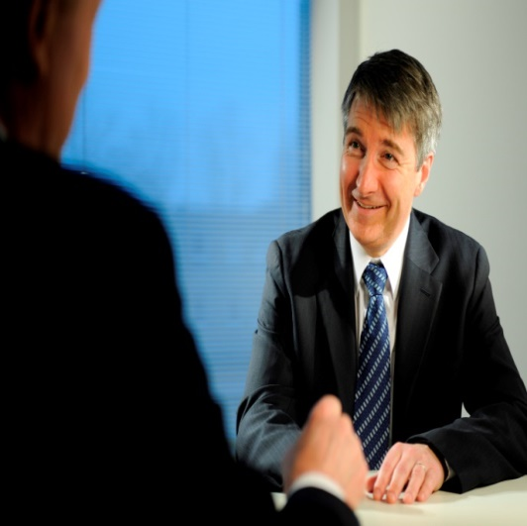
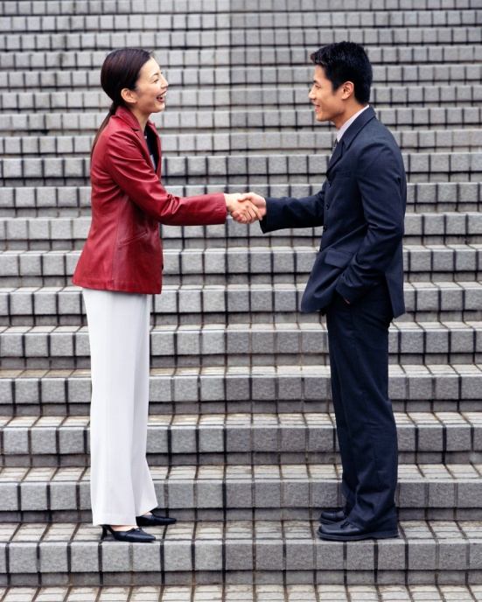
Role Play: Meeting Candidates

Slide 7
How to Select Candidate Activities
Activity 1: Meeting Candidates
Activity 2: Interview Candidates

Slide 8
Activity 1: Meeting Candidates
Give the three members who agreed to help with the role play their character cards and props.
Introduce them as:
Sally/Sam Socialite
Carrie/Carl Community
Lilly/Leo Legislator
Give each candidate character 3-5 minutes to talk to the group about why they are the best candidate to vote for.

Slide 9
Sally/Sam Socialite
Have you ever had someone treat you like you were a baby? This is how Sally talks to others in the training.
Things you can do:
Pass out candy
Pat people on the head

Slide 10
Sally/Sam Socialite
Things you can say:
“Do you like my suit?”
“Lets have our picture taken together. I love photo ops.”
“We are special friends.”
“I can’t answer any questions now because I have an important appointment to get my hair done.”
“I know what’s best for my special friends”

Slide 11
Carrie/Carl Community
Have you ever had someone really listen to you and think that your ideas are interesting? This is how Carrie/ Carl talks to others in the training.
Things you can do:
Shake hands with people
Listen to what people have to say

Slide 12
Carrie/Carl Community
Things you can say:
“Do you remember me? I came to your meeting last month.”
“I voted on issues about closing institutions.”
“I spent time with your group when you had legislative day.”
“I believe that people with disabilities are People First so I always use People First language.”
“I voted so that people with disabilities could have community jobs.”
“Call me at 1-800-CARRIE (or CARL).”

Slide 13
Lilly/Leo Legislator
Have you ever had someone that talks to you but doesn’t give you any information? This is how Lilly/Leo talks to others in the training.
Things you can do:
Shake people’s hands

Slide 14
Lilly/Leo Legislator
Things you can say:
“I think I know your issues.”
“I’m really busy and working very hard for you”
“I am on the board of traditional sheltered workshops and have gotten donations from nursing home groups.”
“I care about the people in my district. I am really busy doing really good work for everyone.”
“I am sorry, my staff will have to get back to you on that issue.”

Slide 15
Activity 1: Meeting Candidate questions
Questions to ask the group:
Who would you vote for?
Why did you vote for them?
What would change your mind about them?

Slide 16
Activity 2: Candidate Debate
3 members to role play
Interviewer
Candidate 1
Candidate 2

Slide 17
Activity 2: Candidate Debate
Possible questions to ask about disability issues:
Should people working in workshop settings be paid minimum wage?
How can voting be more accessible for people with disabilities?
What are your thoughts on the marriage penalty against people with disabilities?
Are you in support of Medicaid waiver funds being used to purchase assistive technology?

Slide 18
Activity 2: Candidate Debate
After each question, ask the participants which candidate they agreed with on that answer
The person who has the most questions answered the way the participant’s like, is the winner

Slide 19
Survey time
Have you ever attended an election results party?
Yes
No

