Slide 1
Topic 4 Rights and Responsibilities

Slide 2
Voting Rights The Help America Vote Act
(HAVA) is a federal law that makes voting accessible and says states must:
Make sure that everyone can vote privately and independently
Set up a statewide system to give people provisional ballots if there is a question about whether they can vote
Create statewide computerized voter lists
Makes sure polling places are accessible

Slide 3
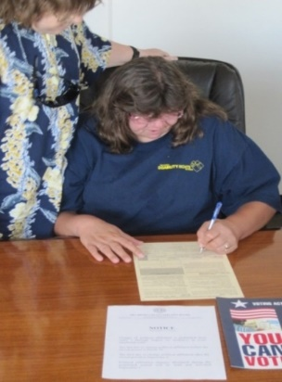
Voting Rights
You can bring someone you trust to help you vote:
poll workers can not deny you this support person
There are some people who can not help you vote:
-Your boss
-Union officer from your job
-Candidate who is on the ballot

Slide 4
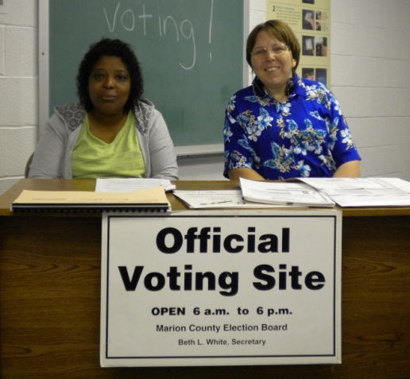
Voting Rights
You can ask for help from election officials from 2 different parties.
Poll workers can help you with the voting process. Poll workers can not tell you who to vote for or explain the issues in simpler terms.

Slide 5
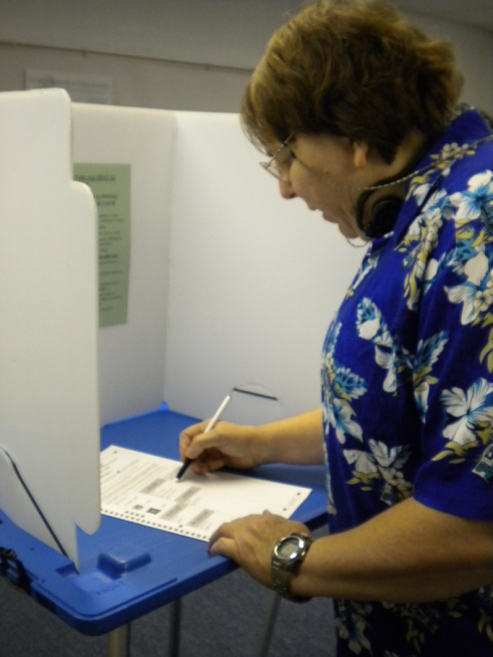
Voting Rights
You can get a new ballot if you make a mistake
Everyone makes mistakes sometimes and it is your right to be given a new ballot if you make a mistake on your first one. You can get up to two replacement ballot.

Slide 6
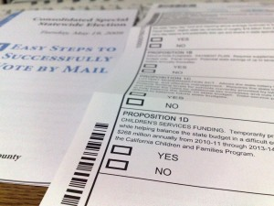
Voting Rights
You can ask for a provisional ballot if you are told that you can’t vote for some reason.
It is best to ask them to show proof of why you cannot vote before asking for a provisional ballot.

Slide 7
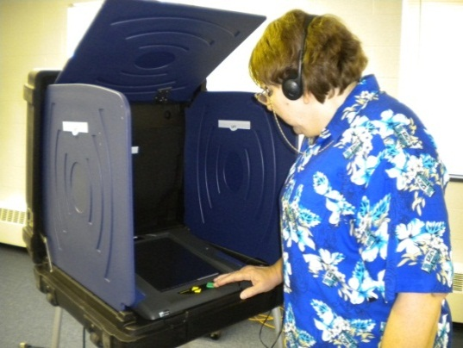
Voting Rights
You do not need to have a disability to use these machines.
The Help America Vote Act (HAVA) says that every polling place must have an accessible voting booth to help people vote privately and independently.

Slide 8
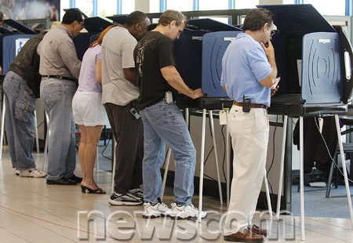
Voting Responsibilities
Make sure you are registered to vote
Know the issues and candidates
Ask questions if you need some help

Slide 9
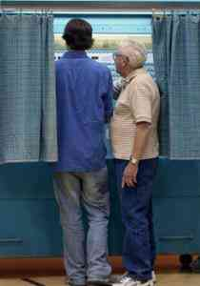
Voting Responsibilities
Be a role model as an informed voter. Get out and vote!
Help someone else to learn how to vote
Celebrate your choice and your voice

Slide 10
Voting Responsibilities
Get involved, in other ways, with voting and elections.
Call your Election Board to find out where you can register to vote and vote on Election Day.

Slide 11
Voting Responsibilities
Ask a poll worker for voting information in Braille, in large print, or in other accessible formats.
The League of Woman Voters is available to support you in getting information on candidates and issues. In some states they make an “easy to read” voters guide.

Slide 12
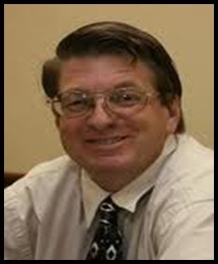
My Vote Jeff Ridgeway
They say I can’t vote
They say the decision is not mine
They say I don’t understand
I guess they think they are being kind
I wonder what they would say or think
if they only knew

Slide 13
That when they call the President “Our President”,
I want to call him mine too.
If I never get the chance to vote, pulling the lever, punching the card or writing his name down.
I stay the same, dumb, misinformed, unchanged,
un-empowered.
That is what this world expects me to be.
But I want so much more.

Slide 14
I want to be the most educated, the most informed, the most totally changed, the most totally empowered person that I can be when I vote.
I can make a difference and then I can say with pride, “Not yours, not theirs, but my President, because I put him there.”

Slide 15
Survey time
Have you ever passed out candidate information?
Yes
No

