Slide 1
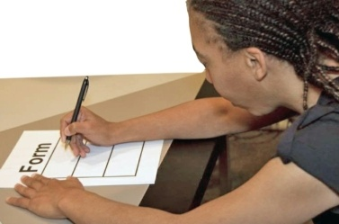
Topic 3 Registering to Vote

Slide 2
Who Can Register to Vote in the USA?
Basic federal rules to be able to register to vote:
You must be a citizen of the United States
You must be 18 years old to vote
Notes:
Read the slide
Get ready to present: Get information about how many days ahead of time.
18 year to vote however, you can be 17 years old to register.

Slide 3
Who Can Register?
Put Your State Map Here
To register to vote in our state:
Our state says you must be registered to vote __ (how many) days before Election Day to vote.
Notes:
Michigan
North Carolina
Illinois
Get ready to present: Get information about jail, felonies, declared incompetent to vote, and our state ID rules to vote

Slide 4
Who Can Register?
Put Your State Map Here
To register to vote in our state:
Our state says that you need this identification information to register:
- (add ID information, example: driver’s license or state ID)
- (add ID information)
in order to register to vote?
Notes:
Michigan
North Carolina
Illinois
If people have more questions, use the election department contact information

Slide 5
Who Can Register?
Put Your State Map Here
To register to vote in your state:
What does your state say about Guardianship and voting?
Does your state say about Supported Decision-Making?
Notes:
Michigan
North Carolina
Illinois
Get ready to present: Get information about jail, felonies, declared incompetent to vote, and our state ID rules to vote

Slide 6
Who Can Register?
Put Your State Map Here
To register to vote in your state:
What does your state say about being convicted of a crime?
Notes:
Michigan
North Carolina
Illinois
Get ready to present: Get information about jail, felonies, declared incompetent to vote, and our state ID rules to vote

Slide 7
Places People Can Register to Vote Locally
Post office
Libraries
Department of Public Health
Medicaid Agency
Department of Rehab Services–Voc Rehab
Election Board

Slide 8
Places People Can Register to Vote Statewide
Some Universities and Colleges
Where you get your state id
On-line on the Secretary of State website or
Go to govoter.org, click on your state, then click on your state for your Secretary of State’s information about voting

Slide 9
Places People Can Register to Vote
Are there any other ways that people can register to vote?

Slide 10
Support OTHERS to Register
Voter Registration Drive
To host a voter registration drive our state does/does not ask you to take a class?
You need to turn in registration forms by _____ add date here
Add any other information about Your State registration here

Slide 11
Survey time
Do you feel prepared to vote?
Yes
No

