Slide 1
Topic 2 How Voting Fits into Your Life
Notes:
How voting fits into your life
This topic is an overview of the history and key laws that changed the lives of people with disabilities, but there is also the opportunity to have personal stories right in your home community that you participated on like transportation, school boards, taxes to change community and our state to make them better.

Slide 2
Lets talk about how laws have made a big difference in the lives of people with disabilities
Notes:
Talk about state laws that support this legislation
Every state has different laws
Next we are going to share rights laws that impact people with disabilities. Each of them probably started as an idea and went through the process of voting before becoming a law.

Slide 3
1973 Rehabilitation Act
1973: Makes it illegal for federal agencies, public universities, and other public institutions receiving any federal funds to discriminate on the basis disability
Notes:
1st of many disability laws for accessibility for people with disabilities

Slide 4
Americans with Disabilities Act (ADA)
1990: The ADA does not allow discrimination on the basis of disability in:
Employment
Building accessibility
Transportation
Telecommunications
Notes:
Presenter: ADA was passed in1990. This is the one that most people know. It has the most impact on voting.
Presenter 1: Another rights laws that impacts the lives of people with disabilities is the ADA. You might need to explain what telecommunication means (phones, TTY, fax, ATMs, computers, apps, GPS)

Slide 5
DD Act of 2000
2000: Says that individuals with developmental disabilities and their families have access to:
Community services
Individualized supports
Self-determination
Independence
Inclusion in community life
Notes:
Presenter: The next rights law that impacts the life of people with developmental disabilities. SABE had given many of the ideas to this Act.
Funding for DD Councils (state planning and grants), P&A (legal supports on state disability issues), UCEEDs (diagnoistic services and professional training) to support people with disabilities and families
Community Services include: Therapies, education, serving on community boards or attending board meetings

Slide 6
Lets talk about how our state laws have made a big difference in the lives of people with disabilities
Notes:
Talk about state laws that support this legislation
Every state has different laws
Next we are going to share rights laws that impact people with disabilities. Each of them probably started as an idea and went through the process of voting before becoming a law.

Slide 7
Add your current Legislation
State and County examples of Legislation:
People First Language – eliminate MR
Supported Decision-Making – SDM
Medicaid laws that increase services – durable equipment, employment services
Notes:
Add comments on how your state has adopted new laws

Slide 8
Survey time
Do you think Election Day should be a holiday that everyone gets off?
Yes
No

Slide 9
Question: How has voting made a difference in your life?
Notes:
Big paper
As instructors, be prepared to share
Trainers opportunity to give examples of different ways it has affected people lives
Ask participating states to think about some ideas of how voting has change a community, transportation, taxes, give them 5 minutes to discuss and then share (mute states)

Slide 10
People you can Vote for
President
Senator
Representative
Governor
Mayor
City Council Members
School Board Members
Notes:
Ask any more:
Judges
Utility OR County Commissioner
Auditors
SOS

Slide 11
Things to Vote On
Bonds
Taxes
Propositions
Issues
Measures

Slide 12
Voting Activity Introduction
You make choices every day of your life. Each time you use your self advocacy skills.
Picking out what you wear
Spending your money
Eating at a restaurant
Watching a movie
Notes:
Presenter: (Read the slide) How is this slide info connected to voting? We asked self advocates “Why don’t you vote?” The answer they said the most. “I am not smart enough to vote”.
We use this activity to help them. All of us use the skills needed to vote every day. One skill is choosing an item from a group or a list.
An example: Picking out what you wear? You have many shirts in your closet. For a job interview you pick out a button up shirt. This shirt does not wrinkle. (Ask the participants) How do you know it does not wrinkle? (possible answers) The label says it is “wrinkle free.” Do you always believe the label? You like how it looks. Buy it, and try it. It still looks great, you wear it all the time.
Now think about candidates. A candidate says they help people with disabilities. How do you know they help people? You ask for help to look up the candidates voting record. The Voting Record shows 2 bills they supported. Some voters may stop here and support the candidate. But you as a self advocate, you want more proof. Ask supports you trust to show you how to do an internet search. During the search you find out that they had a chance to fund DD services. But, they held the bill in committee and it did not get voted on. This vote could have ended the waiting list. Are you disappointed? (Ask the participants to share)
*Some of you changed your support for this candidate. Others continued to support them.*

Slide 13
Let’s practice voting
Choices are like decisions. Decision are just like voting.
You know what you like and do not like
You know how you choose who you are going to trust
Sometimes you are look for a person like you (hard worker, good values)
Over time you know who is good, what is worth the money
Sometimes you like things are expensive because they last longer
Sometimes you do not have the money
Do your home and do your research
Ask other people
What questions do you ask yourself when you are getting ready to make a big decision
You make the final decision
What other activities can we do?
Notes:
Page 23 of the toolkit

Slide 14
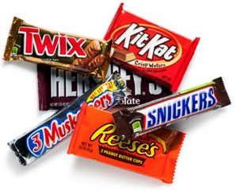
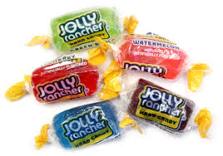
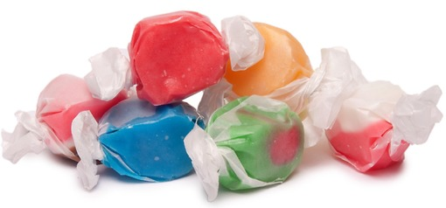
Vote For Your Favorite Candy
Chocolate Candy Bars
Jolly Ranchers
Taffy “sugar free”
Notes:
You will need to find 3 reasons why your state says you cannot count a ballot.
2 presenters are needed in front of group, team will help hand out Candy Ballots and pens. Then collect Ballots, and hand out candy at the end.
Presenter 1: We are going to do an activity that may seem simple. It will show you how important your vote can be. Please Handout Candy Ballots
Presenter 2: Now we’re going to have some fun. We have handed out ballots. Everyone please vote for your favorite candy. We will share the candy that gets the most votes. Presenter 1: Please collect the Candy Ballots.
(Presenter 2: Sort each candy into a stack. Stack the ballots with errors and blank ballots of people who did vote.)
Presenter 2: (Count the ballots) Early results show chocolate is winning…
(The candy with the most votes say)
Presenter 1: “Oh no!” while counting the ballots we found some mistakes. Everyone who voted for ___ “forgot to update your address to vote.” (rip up the ballots)
(The candy with the 2nd most votes you can say)
Presenter 1: “Oh no!” Everyone who voted for ___ “forgot to sign their mail in Ballot Envelope.” (rip up the ballots)
(The candy with the least votes. You count the ballots out loud)
Presenter 1: “1, 2,3,4… Congratulations everyone who voted for ___ the results are in. You win! Everyone you get winning candy. (Hand out candy that won ONLY)

Slide 15
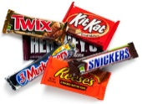
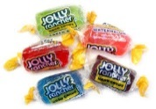
Results of the Vote
In the early results, what did it feel like to have your candy winning?
What did it feel like to have that win taken away?
What did it feel like to end up with the with the candy you did not want?
Notes:
Presenter takes over the presentation
Presenter 1: What? The rest of you seem disappointed. You don’t like that a small number of votes decided what type of candy everyone is going to get?
Presenter 1: In the early results, what did it feel like to have your candy winning? (Pause for audience to answer)
Presenter 2: But everybody else was sad.
Presenter 1: What did it feel like to have that win taken away?
Presenter 2: But everybody else was good.
Presenter 1: What did it feel like to end up with the with the candy you did not want?
Presenter 2: Only that group was happy with the results.

Slide 16
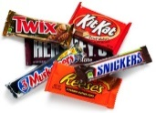
Vote Facts
Many people do not vote because they do not think one vote matters.
In the real world, only 6 out of every 10 people with disabilities actually get out and vote.
If you don’t vote then you are going to get what other people decide is best.
Notes:
Presenter
(If you had blank ballots, say this) We had ___ # of ballots. If you did not vote, you could be taking a very big risk.
(If you did not have blank ballots, read the slide title first)
(Read) Many people do not vote because they do not think one vote matters.
(Say) In history there have been elections where a candidate won by one vote. Every vote counts.
(Read) In the real world, only 6 out of every 10 people with disabilities actually get out and vote.
(Say) Or mail in their ballot.
(Read) If you don’t vote then you are going to get what other people decide is best.
(Say) What do you think about that? (Take a few comments from the participants.)
Presenter 2: Are there any questions or comments about how the choice to vote fits into our lives? (pause)
Presenter 1: (Announce) “We are all winners in this group you can have any candy you want now.” If you have health issues with sugar we have .”

Slide 17
Reason to Vote
We used this as a fun way to talk about voting because people think they cannot vote. We want them to know they are smart enough to make decisions in their lives.
What if something more important was being voted on. You could use this example to lead the discussion.

