Slide 1
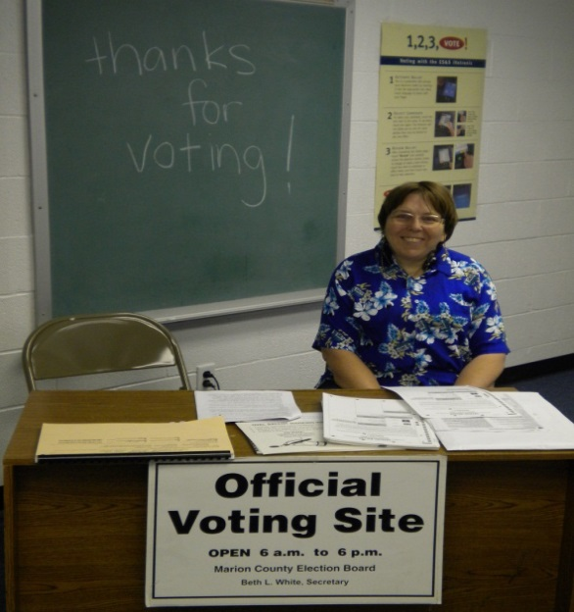
How Do You Vote?
Slide 34

Slide 2
How Do You Vote?
Mail in my ballot
With a touch-screen voting machine at a polling place
With a paper ballot at a polling place
Mail in or absentee ballot
Early voting at the polling place
What are other ways that people can vote?
“I’m talking to you”

Slide 3
Mail in Ballots
Mailed to you weeks ahead with your Voter’s Manual
You can drop off your ballot at any polling place if you forget to mail it on time

Slide 4
Paper ballot at polling place
Ballots will be given to you at the polling place
You can bring your Voter’s Manual mailed to you
You can have someone you trust go with you
You can request for help from 2 poll workers

Slide 5
Voting Machines
List types of voting machines
Add address for your secretary of state website
Add where people can find info about your state voting machines
Add picture or video here about your state voting machine. Or a map of which counties use different voting machines.

Slide 6
How will you vote?
XX

Slide 7
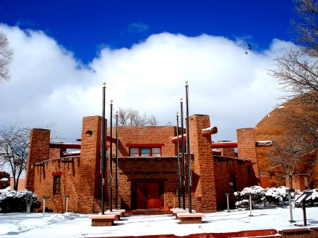
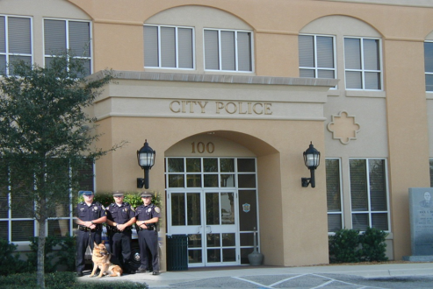
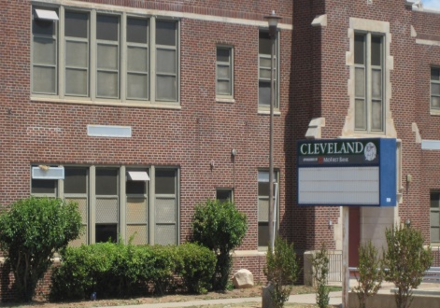
Possible Polling Places
library
House of worship
Chapter house
Police department
school

Slide 8
Possible Polling Places
Courthouse
Recreational or community center
City Hall
Private home
Restaurant
Fire station
What are other possible polling places?

Slide 9
Planning out your Vote day
Call ahead of time to have accessible materials
Address of polling place
Transportation plan

Slide 10
Survey time
Have you ever been a Poll Worker?
Yes
No

