Slide 1
Self Advocate Leadership Training
Presenters: Dee Banta
Kelly Zaikis
Tomas Davis
Nancy Ward
Notes:
Welcome to the first training the trainer class for the Self-Advocacy Leadership Training material.
A committee of self-advocates worked alongside staff from the Center for Learning and Leadership to develop this training.
You have an agenda in front of you and we need to keep to the time of each activity.

Slide 2
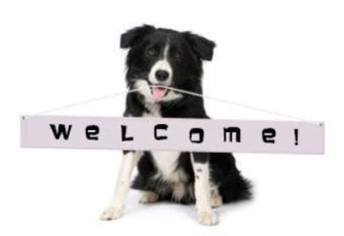
to
Self-Advocate Leadership Training

Slide 3
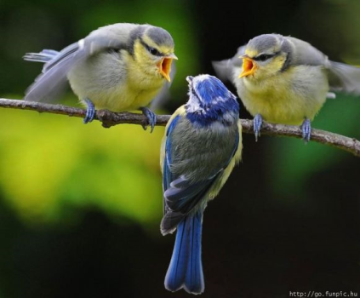
Ground Rules & General Information
Notes:
Have a sheet of paper on the wall to write ground rules.
Cell phones on vibrate and NO texting
Misery is optional
Listen when others speak and don’t interrupt
One person speaking at a time
All questions are valid

Slide 4
Purpose of the Training
To develop the skills that will assist in helping you become:
leaders in your chapter and community;
better advocates; and
better partners.
You’re here to learn. Please respect your trainers and other participants.
Notes:
The purpose of this training is to provide a learning experience for people who want to become leaders in the field of disabilities and in your community. The skills taught in this class will help you be a better leader, advocate, partner, more effective speaker, mentor to other people, and more responsible member of advisory councils, committees or task forces

Slide 5
Day 1: Overview of the Training
History of the Disability Movement
Advocacy
Leadership
Partnerships
Mentoring
Communication
Public speaking
Running a successful meeting

Slide 6
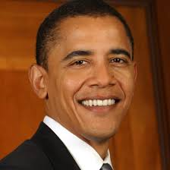
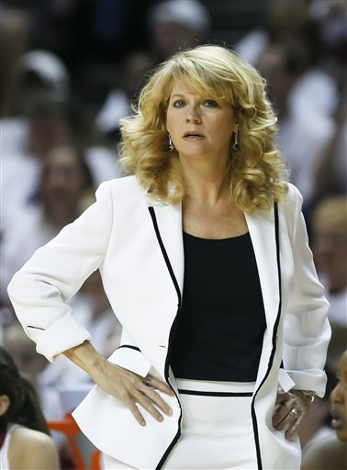
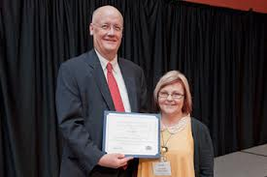
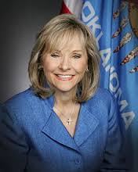
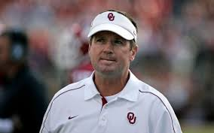
What Does Leadership Mean to You?
Notes:
Leadership can look different to everyone. It also happens in every different job. These individuals all have some leadership qualities, what are they? Concentration game (JR), Prioritize leadership qualities, Chocolate river (JR)

Slide 7
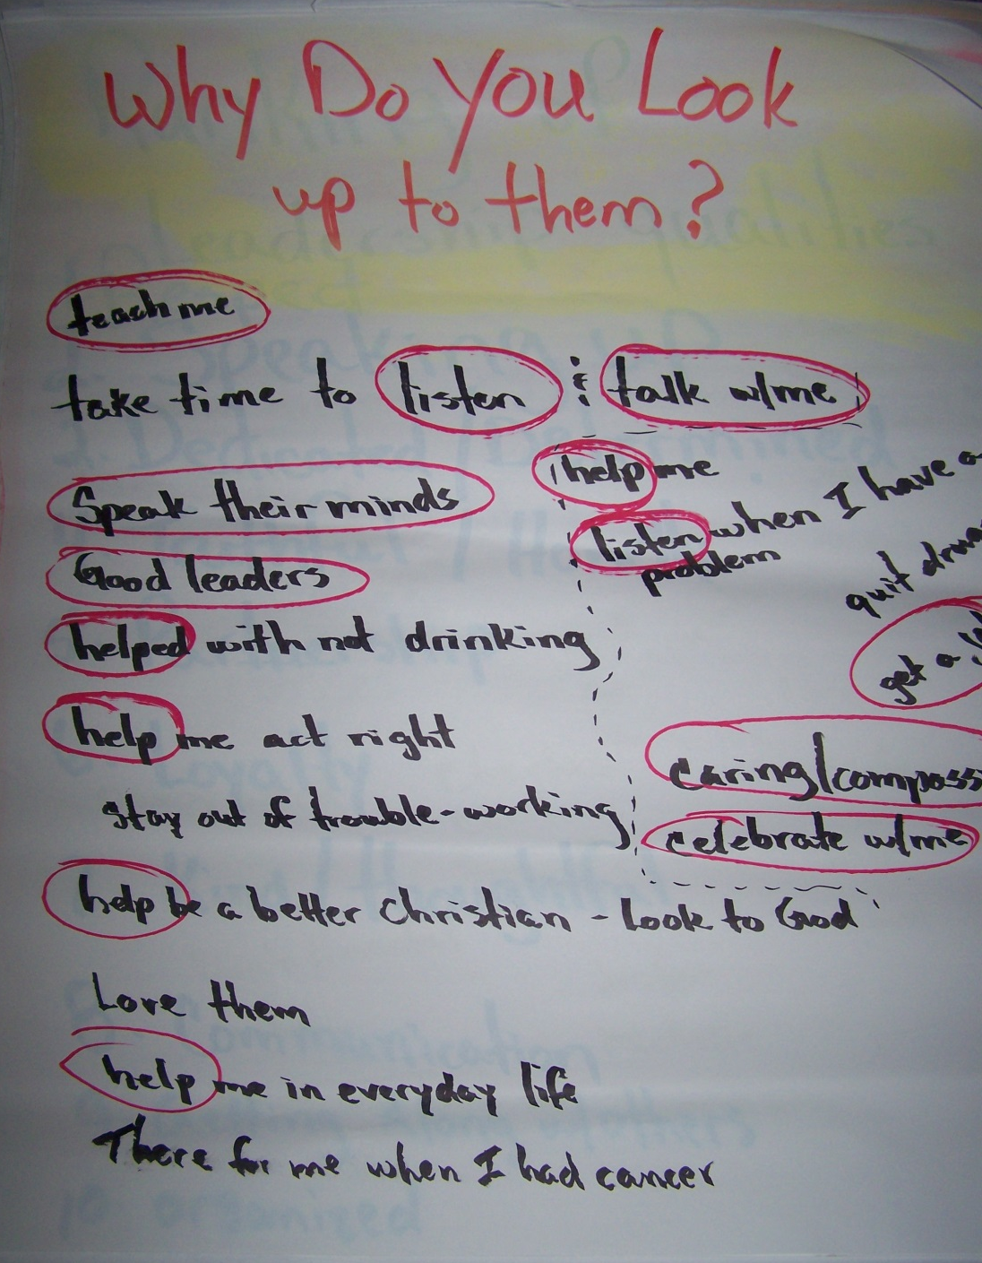
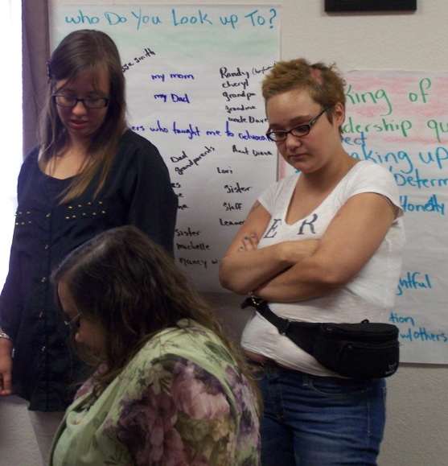

Slide 8
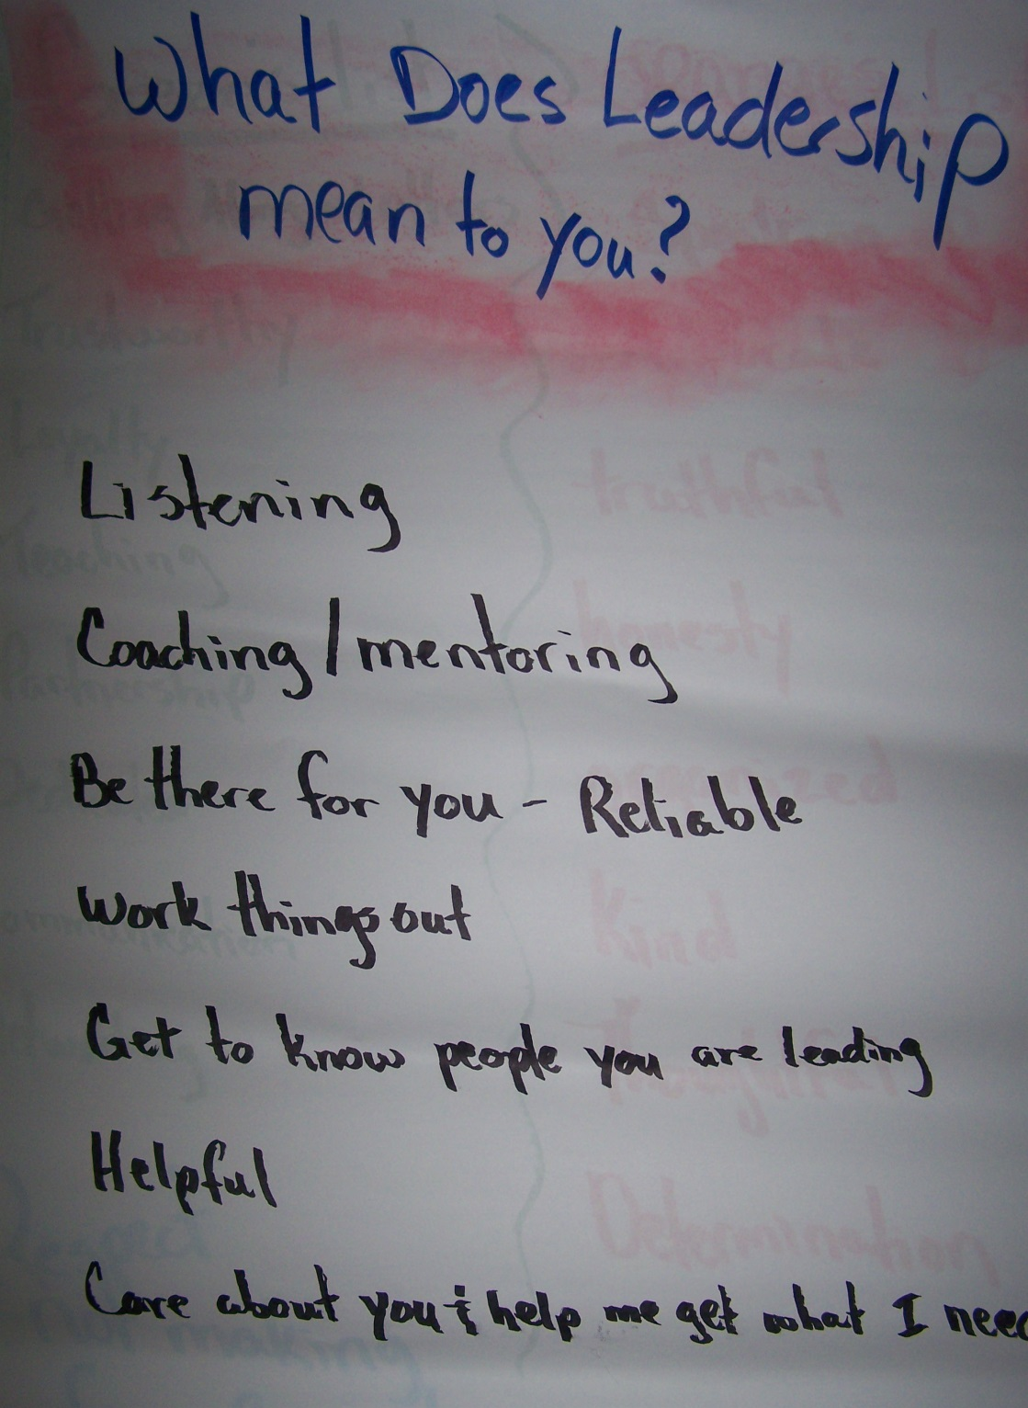

Slide 9
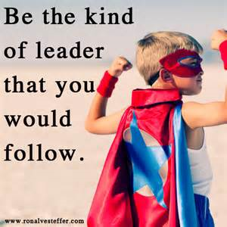
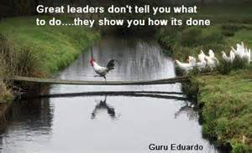
Prioritizing Leadership Characteristics & Skills

Slide 10
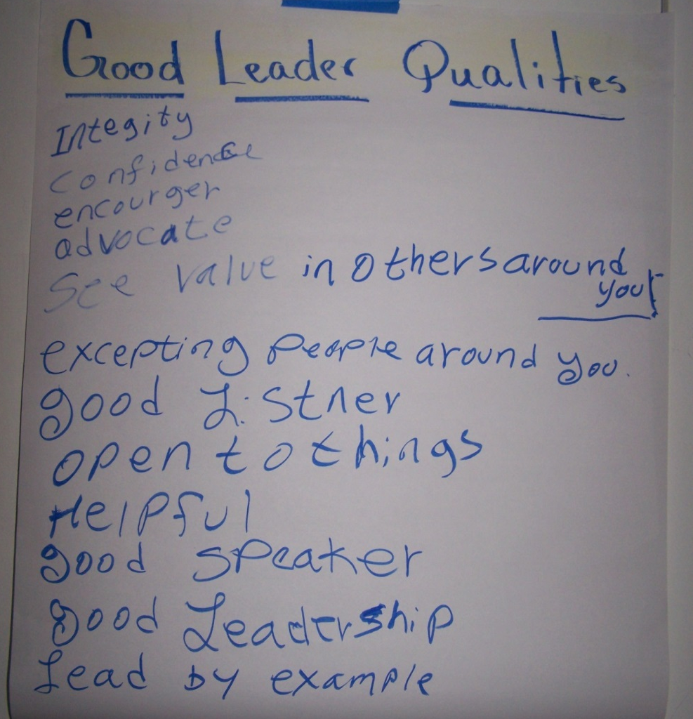
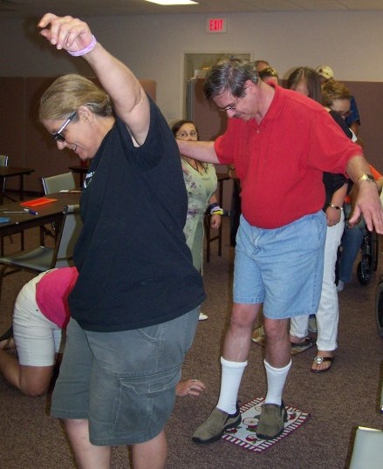
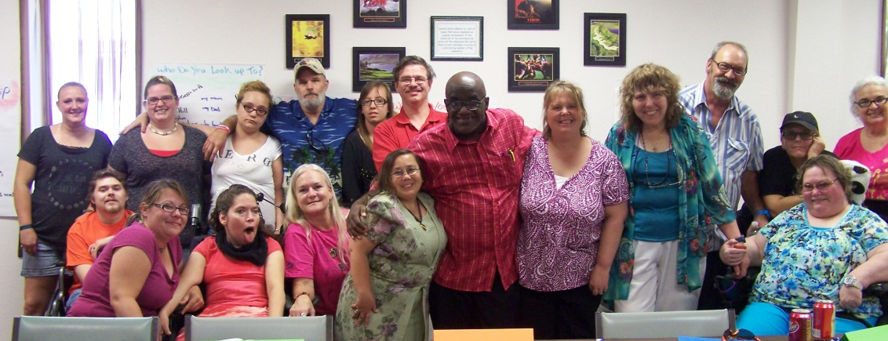
CONCENTRATION GAME

Slide 11
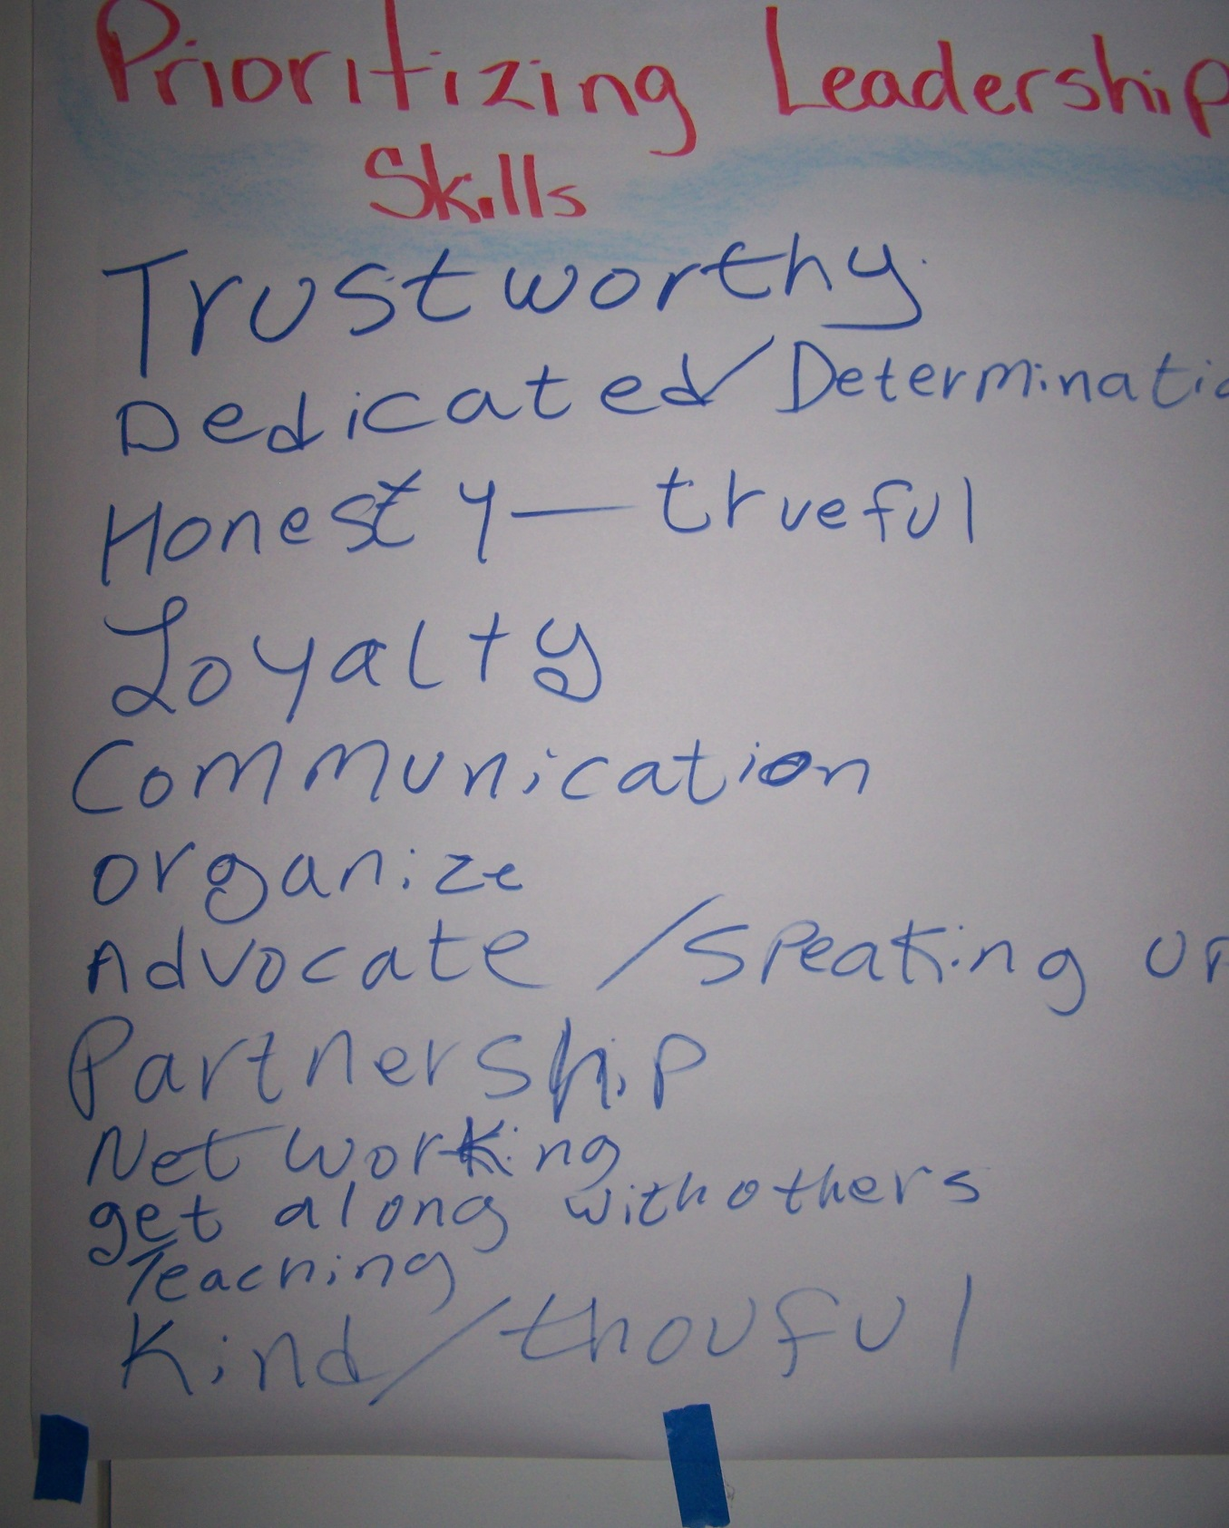
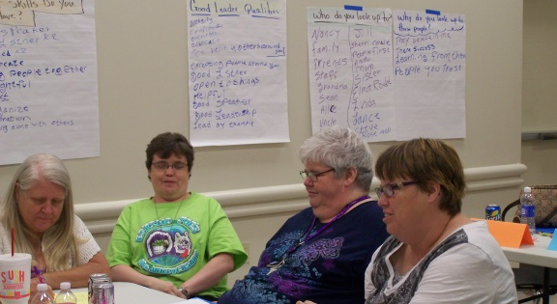

Slide 13
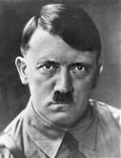
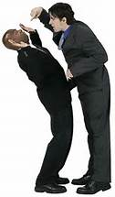
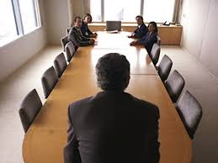
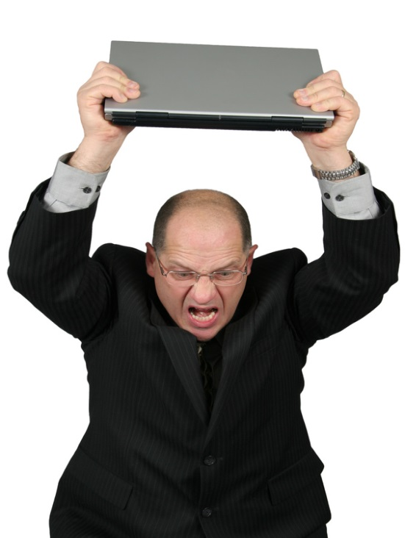
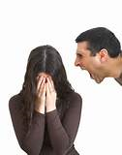
Good Leaders are not….
Notes:
This picture shows the leader being far apart from the followers. Why is this a problem? (examples: poor communication, doesn’t allow collaboration)

Slide 14
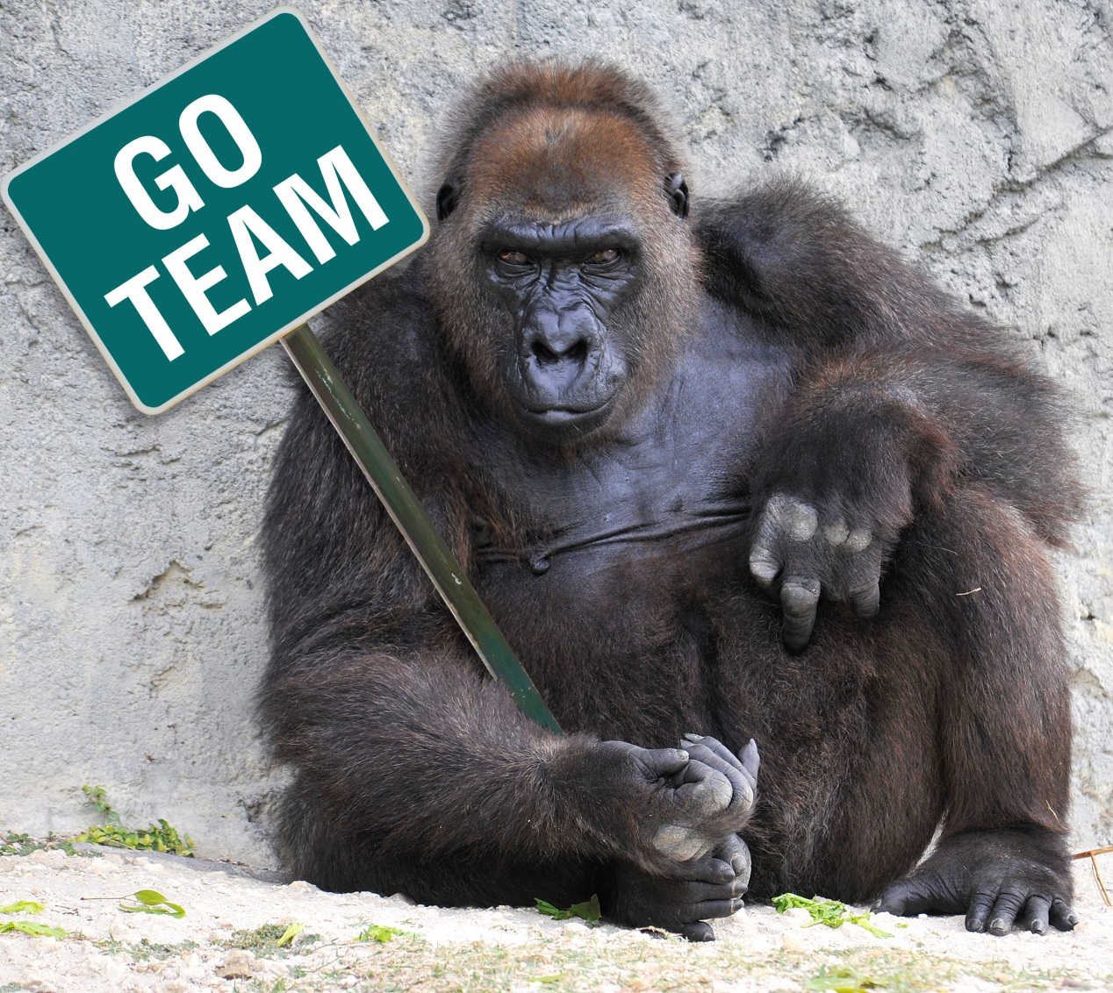
How Do We Become a Good Leader?
Partner
Network
Mentor
Notes:
Pervious slide – talked about different leadership skills and styles. The best leaders work others or network with others to help turn weaknesses into strengths. This creates a partnership or when people or groups work together to complete a common goal. Mentors help people or a group develop skills. Good leaders work with others to help them develop. By mentoring others, leaders are strengthening the group.

Slide 15
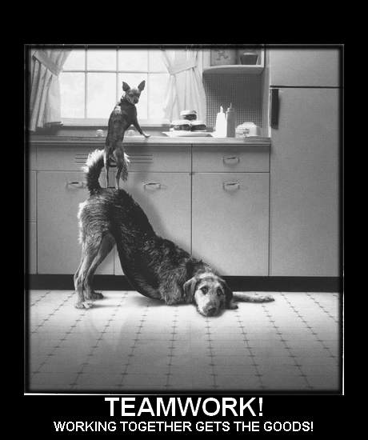
Why Do We Partner?
Two heads are better than one
Have trust and respect – safe to say what you want
More ideas
Learn give and take
Share information
Share resources
Share ideas
Funding opportunities
Notes:
Part of creating good partnerships is understanding people and that they take in information and react to things differently. The true colors activity will help you understand how you process that information and how to communicate with others that take in information differently than you. (ie. Me versus Rose Ann)

Slide 16
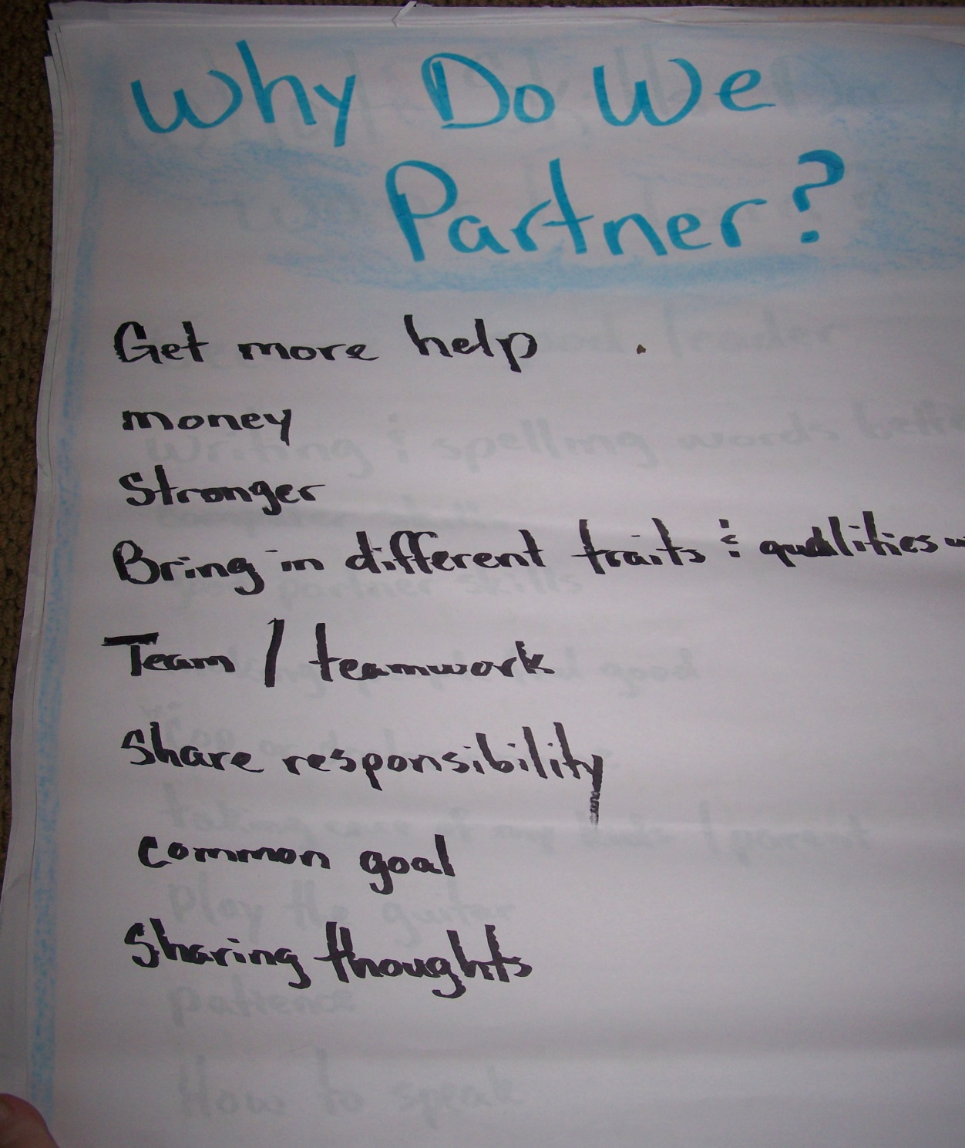

Slide 17
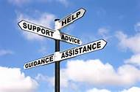
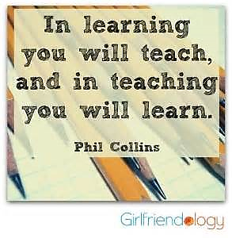
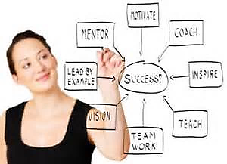
Mentoring

Slide 18
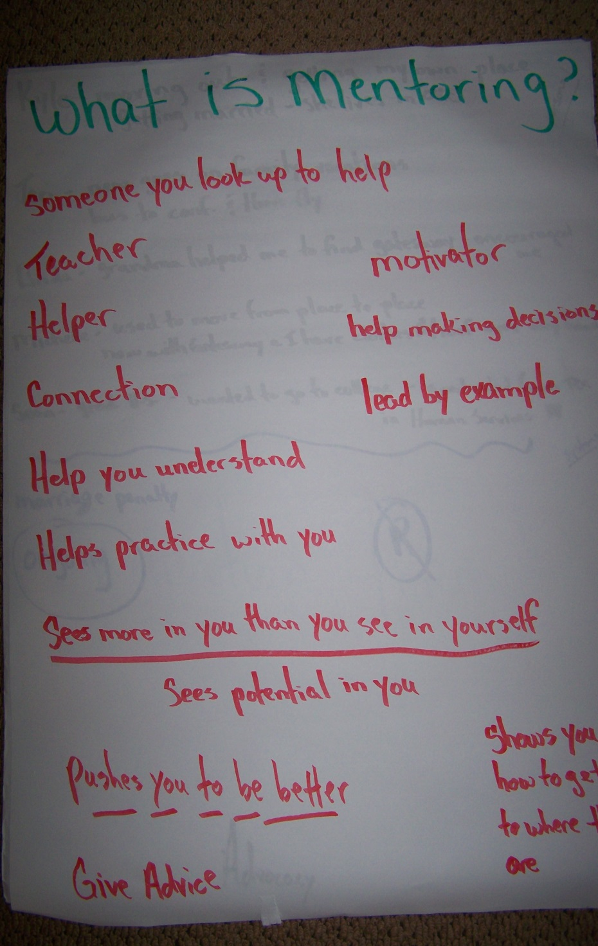
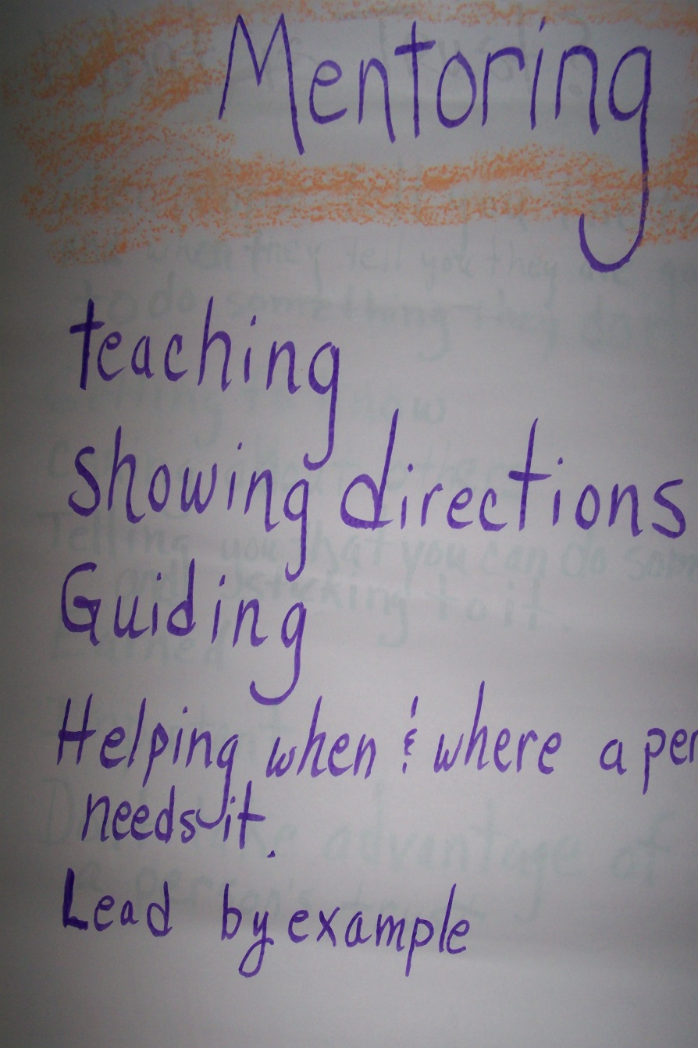

Slide 19
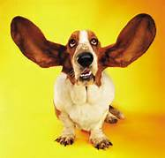
Communication
Why is communication important to a leader?
As homework from the first day, we have people prepare a short speech which they have to give on the morning of the second day.
Many people have never had to speak in front of a crowd.

Slide 20
What did we learn about LEADERSHIP

Slide 21
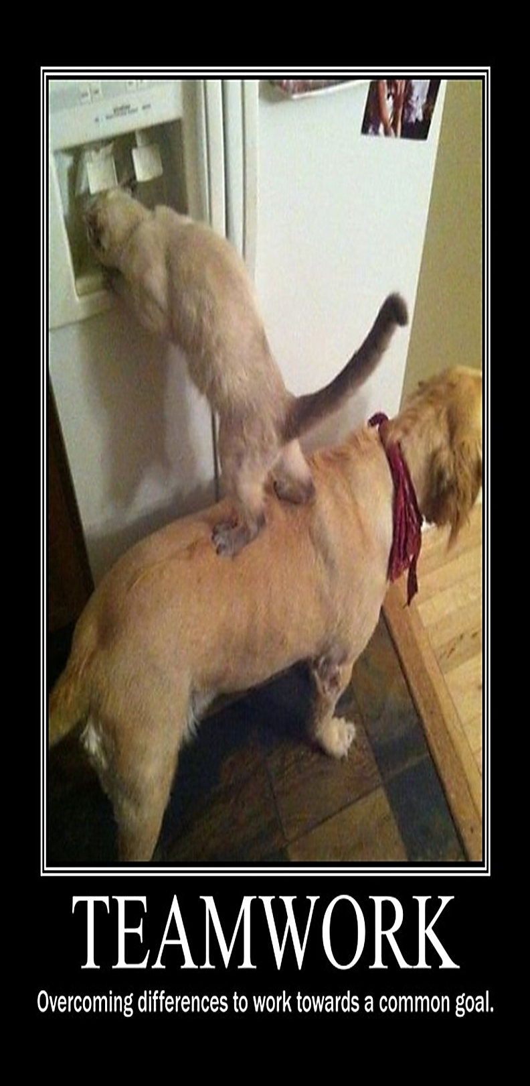

Slide 24
Thank you for coming to our session.
For more information contact:
Lance Davis, Executive Director
Oklahoma People First, Inc.
okpeoplefirst@coxinet.net
405- 701-2077
Rose Ann Percival, Community Partnerships Coordinator
Center for Learning and Leadership
Roseann-percival@ouhsc.edu
405-255-6533

Slide 25
This project would not have been possible without the support of the following:
Notes:
WE WANT TO THANK OUR PARTNERS WHO HELPED WITH FUNDING AND SUPPORT TO MAKE THIS TRAINING HAPPEN.
OKLAHOMA PEOPLE FIRST
OKLAHOMA SELF-ADVOCATE NETWORK
OKLAHOMA DEVELOPMENTAL DISABILITIES COUNCIL
CENTER FOR LEARNING AND LEADERSHIP – OKLAHOMA’S UCEDD
OKLAHOMA DISABILITY LAW CENTER

