Slide 1
Social Media Getting our message out! Blogging, Vlogging and other Tips
Presented by
NEAT: Peer to Peer
The Pacific Alliance on Disability Self Advocacy
SABE: Our Community Standing Strong

Slide 2
Introductions

Slide 3
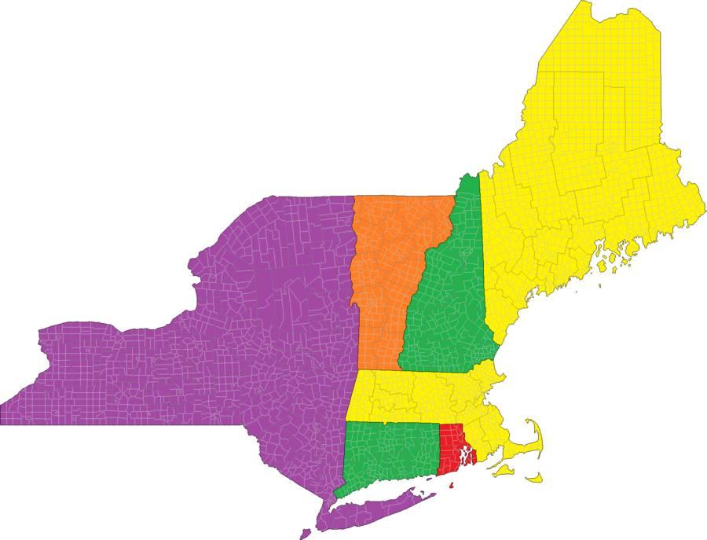
Regional Self Advocacy Technical Assistance Centers: Introductions
NEAT: Peer To Peer
Hilary Clark
Skye Peeples
Notes:
Chaqueta will introduce us.

Slide 4
Regional Self Advocacy Technical Assistance Centers: Introductions
Pacific Alliance
Julia Bransom
Notes:
Chaqueta will introduce us.

Slide 5
Regional Self Advocacy Technical Assistance Centers: Introductions
SABE: Our Community Standing Strong
Chaqueta Stuckey
Eric Treat
Teresa Moore
Notes:
Chaqueta will introduce us.

Slide 6
What we have done
Progress in year 1

Slide 7
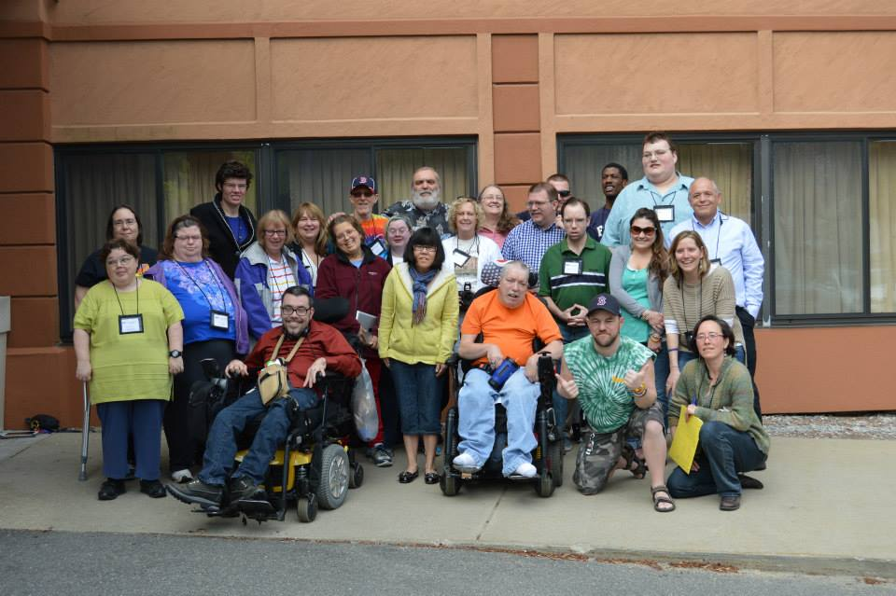
Regional Self Advocacy Technical Assistance Centers: Introductions
NEAT: Peer To Peer
Notes:
Chaqueta will introduce us.

Slide 8
How have we used Social Media in our projects?
NEAT: Peer To Peer
Notes:
Each project will talk about their project and how they have used of social media and the their Vlogs . Show a vlog and talk about other tools, like the TA

Slide 9
Regional Self Advocacy Technical Assistance Centers: Introductions
Pacific Alliance
Julia Bransom
Notes:
Chaqueta will introduce us.

Slide 10
How have we used Social Media in our projects?
Pacific Alliance
Notes:
Each project will talk about their project and how they have used of social media and the their Vlogs . Show a vlog and talk about other tools, like the TA

Slide 11
Regional Self Advocacy Technical Assistance Centers: Introductions
SABE: Our Community Standing Strong
Notes:
Chaqueta will introduce us.

Slide 12
How have we used Social Media in our projects?
SABE: Our Community Standing Strong
Notes:
Each project will talk about their project and how they have used of social media and the their Vlogs . Show a vlog and talk about other tools, like the TA

Slide 13
How have we used Social Media in our projects?
SABE: Technology Handbook
Notes:
Each project will talk about their project and how they have used of social media and the their Vlogs . Show a vlog and talk about other tools, like the TA

Slide 14
Self Advocates Becoming Empowered
SABE: Technology Handbook Advisory Committee
Notes:
Chaqueta will introduce us.

Slide 15
How to Vlog
Today’s tips

Slide 16
Tips for Vlogging
Decide on an issue
Make a list of questions
Make a list of answers
Notes:
Talk about the issues that your vlogs have addressed.

Slide 17
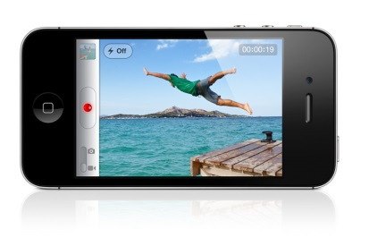
Tips for Vlogging
Equipment
Video Camera
Smart Phone
Tablet: iPad, Samsung, Windows, HP
Notes:
Talk about the issues that your vlogs have addressed.

Slide 18
Tips for Vlogging
Length
3-5 minutes best
No more that 10 minutes
Notes:
Talk about the issues that your vlogs have addressed.

Slide 19
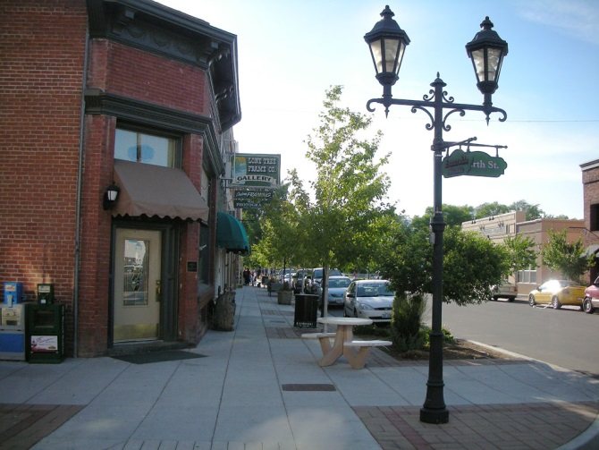
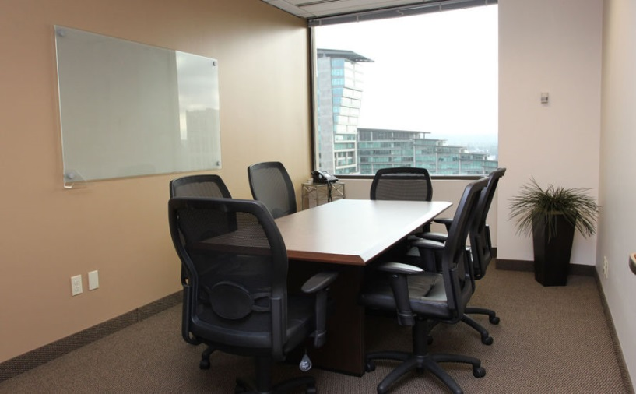
Tips continue
Select a location to record
Organization office
Conference setting
Community: Parks, downtown

Slide 20
Now Lets Practice making a Vlog
Our topic for today: the SABE 2014 Conference
We are recording our Vlog from the 2014 National Self Advocacy Conference in Oklahoma City, Oklahoma.
We are going to ask participants some questions about their experiences at the SABE 2014 Conference.
Notes:
Chaqueta will introduce the Vlog topic.
Julia, Chaqueta and Eric will ask two people in the audience each question. Juliana and/ or Skye will record.

Slide 21
Now Lets Practice making a Vlog
Questions we will ask the participants are:
How is the conference going?
What have you learned so far?
What information are you going to take back to your state?
What is your favorite activity at the conference?
Notes:
Chaqueta will introduce the Vlog topic.
Julia, Chaqueta and Eric will ask two people in the audience each question. Juliana and/ or Skye will record.

Slide 22
What do we do after we have recorded our Vlog?
Edit the Vlog
iMovie if recorded on iPad or iPhone
Windows Live Moviemaker for PC
Notes:
Skye will demonstrate uploading the video to you tube. Juliana will link to SABE station.

Slide 23
What do we do after we have recorded our Vlog?
Upload to You Tube
Post on Facebook
Send out Twitter feed
Notes:
Skye will demonstrate uploading the video to you tube. Juliana will link to SABE station.

Slide 24
Thank you!
Projects funded by

