Slide 1


September 17, 2015

Slide 2

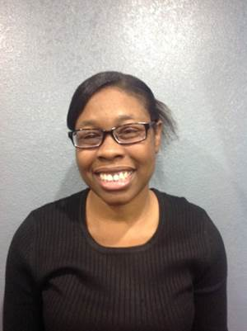

Slide 3
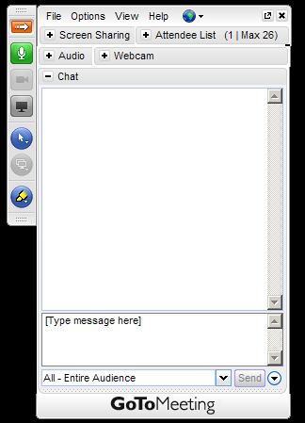
WELCOME
Reminders:
Please mute your device once you join the call
Remember to raise your hands for questions or write a message in text box
We will give everyone a chance to ask questions at the end of the presentation
Notes:
Chaqueta

Slide 4

WELCOME
Reminders:
If you are using more than one device for this meeting, please do not place next to each other, to reduce echoing or feedback.
Make sure your speakers are turned on.
Notes:
Chaqueta

Slide 5

THE PURPOSE OF THIS MEETING
Welcome to Mississippi
Each State will review the progress on their plan for June 2015-to date
Vlogs
Share ideas for hot topics for webinars for next year

Slide 6
THE PURPOSE OF THIS MEETING
Provide names of advisory members and allies who will attend Atlanta Meeting October 10-11, 2015
Regional Project
Dates to remember

Slide 7

STATE QUESTIONS
Please highlight your accomplishments for the fourth quarter based on your plan activities
  Number of people participating in Webinar: Steps in Organizing around an issue
  Local or State Events
  Vlog Topics
  New grants obtained during the quarter
  New work with Partners
  Other state plan activities that you are proud of

Slide 8
STATE QUESTIONS
Vlogs
Share ideas for hot topics for webinars for next year

Slide 9
ALABAMA
Organizing Webinar- Susan
Events-
SABE Voter event in Tuscaloosa
Presenting Partnerships Webinar
Presenting on Closing Institutions
Attended Bullying presentation
Interviewed
Talked to Tuscaloosa chapter
Crossing points in Tuscaloosa Youth Leadership
YEL workshop 6 in Walker Co/Board of ED with students
YEL grant first Saturday in Oct
Newsletter
Sept 18 board meeting
ARISE conference, low income housing
Min Wage rally
New chapter in Jefferson Co, PF
Vote project grant
Partnering
Regional Care Association
Meaningful Day Pilot, PCP
Observation of sheltered workshops
VLOG
Leadership and Bullying

Slide 10
ARKANSAS
No update
Planning for Technical Assistance visit by OCSS Team in the Fall, 2015

Slide 11
FLORIDA
Working with a Coalition
Talk about OCSS going to Tampa or Orlando, FL for a meeting
Community Meeting Learn how to communicate with your doctor in Tampa
Conference- had to change the dates
Changed fiscal agent
GA-Arizona,
Organizing Webinar- Arizona
Vlog
ADA and Self Advocacy

Slide 12
GEORGIA
Organization Webinar- 2 people
Working w/ P&A SAM project
GA board had conference Aug elected officers, Bernard President, had # attended
P&A working on Voter experience and 2 poll accessibility survey, SD, marriage penalty, housing starting your own bus, buy in inclusion and community living, Employment First presentation, and accessing polls and voter education in nursing facilities, closing and ending songs used
PF chapter advocated for transportation, Housing
On TV, encouraging people to start bus, micro-enterprise (jewelry), how to have a good life, SD, Teresa C. alt for region and co-sponsored by PF of GA and P&A
GA cross disabilities
PF congress, where people report what they are doing
No dedicated funding, volunteering
All chapters are doing SA project collaborating with DD Networks, making a difference in community, sidewalk project (getting sidewalks fixed), raise awareness, limited
Hot topic – marriage penalty

Slide 13

MISSISSIPPI
Surveys: Have completed approximately 20 surveys. It is hoped that more will be collected at youth summit.
Events-
Jerry works at University Institute UCEDD, AmeriCorps,, Project SEARCH, setup leadership (Bullying and recreation)
Cindy and Johnny will be advisory members
State SA team has met for the past 3 years, organizing and getting action plan done
Working on youth(14-21) and adults(early 20-30s), 3 youth summits (SA, led by SA, breakout groups wot work on SA skills) 70 at 1st one, hopefully 200 at other 2
Mentoring Network, need assistance
VLOG
What is SA to youth, share personal stories by youth
Hot Topics, working with youths

Slide 14
NORTH CAROLINA
No report

Slide 15
OKLAHOMA
No Report

Slide 16
SOUTH CAROLINA
Local or State Events
IMPACT celebrated their 10 year anniversary on August 13th
Impact participated in the Leadership series (members can now train other advocates
Voices for PRIDE has been working on building self advocate networks. The Executive Committee did an assembly program on reporting abuse and is planning another one on respect issues next week. members of Voices for PRIDE also attended a SCDDSN Commission Meeting. We will be starting a Leadership Series Class in October and then we are hoping to start one in the public school in Jan 2016.
Launch of our website coming soon
Vlog Topics
Connie Coleman (OCSS representative and IMPACT member submitted a vlog on independent living
New grants obtained during the quarter
Some impact members will be working with the “Lets Talk grant sharing their stories about living life with a disability
IMPACT is awarding mini grants for organizations in the community, educators, and community members to host the IMPACT Leadership Training that members will be conducting.
New work with Partners
IMPACT will be planning DAD (Disability Advocacy Day) next year
Other state plan activities that you are proud of
I personally am proud that I will be able to utilize technology to attend future impact meetings and a lot of our new member from Marion Dillion now have jobs

Slide 17
TENNESSEE
Three focus group recruitment meetings were held, including one in middle Tennessee and two and West Tennessee. Three more in East Tennessee are being scheduled for next quarter.
1-3 people attended the webinar.
A new Nashville chapter was successfully started.
Lorri went to court regarding the Cloverbottom case.
April (me) attended legislator training and preparation for meeting with my district's congressman. This is in partnership with the National Federation of the blind we are asking all of our congressmen to support the TIME Act, eliminating subminimum wages.
We have now acquired 158 likes on our Facebook page.
I will have more details, a couple more events, and dates & names to give you and the report tomorrow.
Take care and sorry about the phone issue. I really don't know what happened.

Slide 18

ANY QUESTIONS

Slide 19

Other Agenda Items
Provide names of advisory members and allies who will attend Atlanta Meeting October 10-11, 2015
  Alabama: Brittany Gore, Nikki Dawson, Brenda Doss, possibly George Neal and Darren Morris
  Arkansas: Eric Treat, Tom Masseau, David Deere
  Florida: Arizona Jenkins
  Georgia: Bernard Baker, Teresa Coleman, Cheri Mitchell
  Mississippi: Cindy Singletary, Johnny Courtney Taylor, Jerry Alliston
  North Carolina: David Taylor, Ellen Perry (by phone)
  Oklahoma: Nancy Ward, Dee Banta
  South Carolina: Chaqueta Stuckey and Ebony DeLoach
  Tennessee: Bill Gage, Sam Gage, Gatha Logan, Carol Rabideau

Slide 20

Other Agenda Items
Regional Project
  Vlogs on Technology will be created that will compliment Technology Handbook
  This project will be a Partnership with NEAT and SABE Voter project
Contracts
  Will be sent to you before Advisory Meeting in October if possible
  Need to be returned asap

Slide 21
DATES TO REMEMBER

Slide 22

DATES TO REMEMBER
  September 19 Submit 4th Quarter Invoice quarterly report on Plan
  October 10-11 Face to Face Meeting Decatur, Georgia: Topic: Sustaining our Regional TA Center: Developing our strategic Plan
  Our Hotel is the Courtyard Marriott. Meetings to be held at the Georgia Advocacy Office in Decatur. Arrive by 2:00 on Saturday October 10th. Meeting begins at 3:00. We will finish by 3:00 on Sunday October 11th.

Slide 23

Next OCSS Webinars
3:30 p.m. EST
2:30 p.m. CST
Webinar dates | Topic
September 24, 2015 | Partnerships Outside of the Disability Community
October 22, 2015 | Closing Institutions in the South

Slide 24

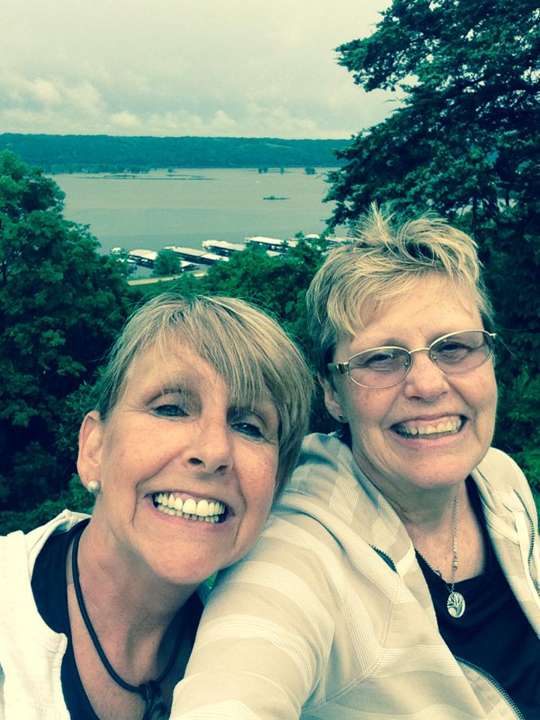
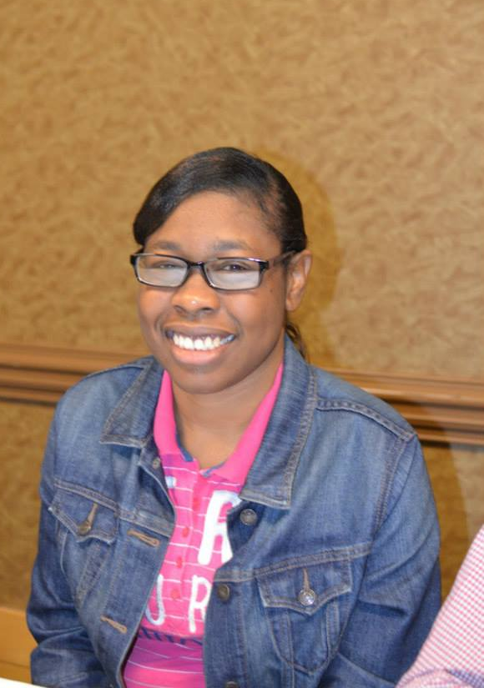
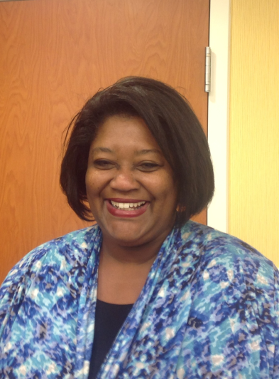
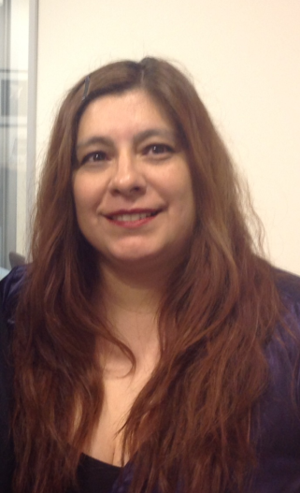
THANK YOU!
Regional Self Advocacy Technical Assistance Center Funded by the Administration on Developmental Disabilities

