Slide 1

YOUR STATE PLAN
SCOTT(SWOT)
Worksheet

Slide 2
Ice breaker
AVENGERS
Work together for the common good

Slide 3

INSTRUCTIONS
Read each character
Choose the one that best describes you
Share with others
Notes:
You do not need to worry about the gender of the character, just the skills

Slide 4

Captain America
Leader
Had a hard life growing up
Strategic planner
Gives his all

Slide 5

Iron Man
Secondary Leader
Support, makes everything easy
Has the money
Creative Designer
Critical thinker

Slide 6

Spiderman
Makes sure everyone is using the best of their abilities
Access to private money
Family support
Works alone
Makes own choices

Slide 7

Thor
3rd Leader
Gets the BIG job done
Has family support
Cares about the people

Slide 8

Black Widow
Executes (gets things done)
Knows where to get her resources
Strategic Planner
Has be institutionalized

Slide 9
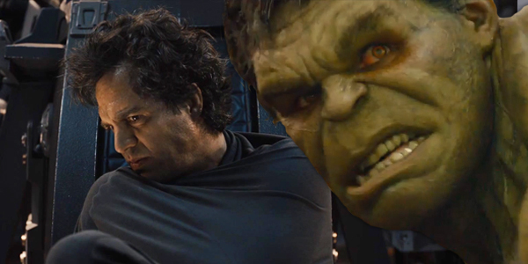
Hulk
Good at details
Gets the BIG jobs done
Angry, wants the cure
Innovative
Critical thinker

Slide 10
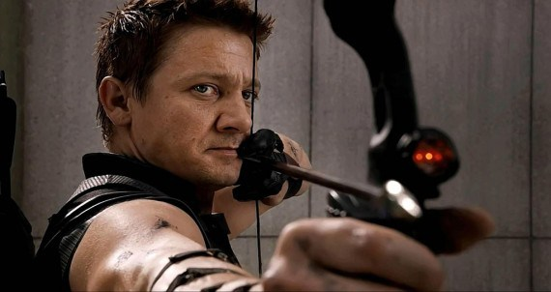
Hawkeye
Detail oriented
Gets the work done
Has family support

Slide 11

Falcon
Strategic planner
Innovative
Gets the work done

Slide 12

Nick Fury
Know where to get the resources
Liaison with the board of directors (attends board meetings)
Development director

Slide 13
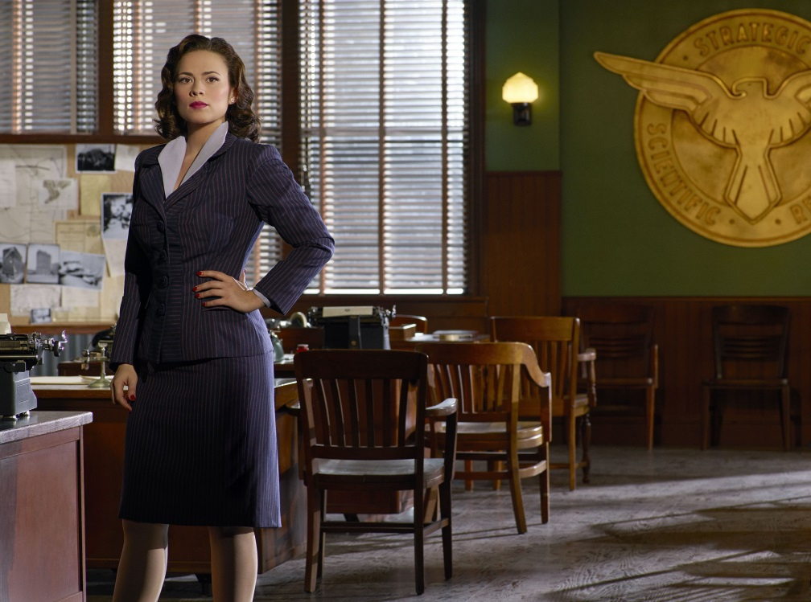
Agent Carter
Know where to get the resources
Has government support and money
Behind the scenes
Founder

Slide 14
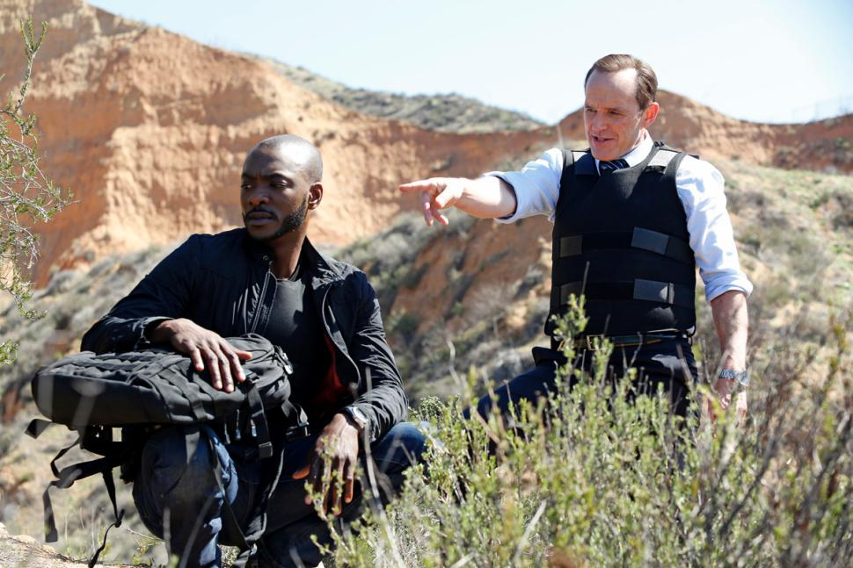
Agent Coulson
Behind the scene person
Knows where to get resources
Has government support and money
Assistant Director with Strategic planning

Slide 15

Pepper
Administrative support
Development director
Focuses on the mission

Slide 16
Who are you?
Which Avenger Character are you similar to?
What are your strengthens?
Which avenger do you need to partner with?

Slide 17
scott
Sustainability Plan

Slide 18
PURPOSE of SCOTT (SWOT) Analysis
Identify possible strategies to work with our partners for sustainability
Develop a plan to sustain Regional Peer to Peer Technical Assistance Efforts of Our Community Standing Strong

Slide 19

How do we start?
We will use these worksheets to guide our discussion

Slide 20

How do we start?
Review you the results of our surveys
Notes:
Juliana will put up Tennessee Survey as an example for the group. You do not have to review all of the survey

Slide 21
Next Steps:
Review your Mission Statement
A Mission Statement is the main purpose of our group
Example:
  To Strengthen self advocacy organizations in the South

Slide 22
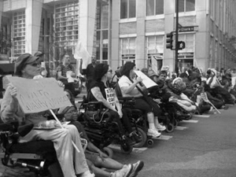
Next Steps:
YOUR HISTORY
Review the history of Our Community Standing Strong (Southern Collaborative)

Slide 23
SCOTT (SWOT)Analysis
A good way is to find out what your group is good at and what you need to continue to work on is to use what we are calling a “SCOTT” Analysis. Others may call it “SWOT” Analysis.
Strengths | Challenges
Opportunities | Threats and Trends

Slide 24
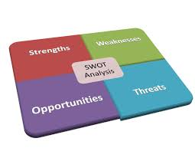
SCOTT (SWOT)Analysis
We changed this because we do not like the word weakness.
SCOTT stands for
  S- Strengths
  C-Challenges (Weaknesses don’t work for us)
  O-Opportunities
  T and T-Threats and Trends

Slide 25


S (Strengths)
Make a list of the things you are most proud of (Strengths)
Examples
  Our Community Standing Strong members produced 36 Vlogs about disability issues

Slide 26

C (Challenges)
Make a list of what does not work for our group or does not work well

Slide 27
O (Opportunities)
Make a list of your resources: people, partnerships and money (Opportunities)

Slide 28

TT (Threats and Trends)
What problems keep us from accomplishing our goals (Threats and trends)

Slide 29
Next:
What so what is important to us to sustain our efforts?

Slide 30
Next:
Why is important to us to sustain our efforts?

Slide 31
Next:
ACTIONS STEPS/STRATEGIES
How will do it?>
Actions required:

Slide 32
Next:
ACTION STEPS
Actions required:

Slide 33
Next:
ACTION STEPS

Slide 34
Next:
ACTION STEPS

Slide 35
Next:
ACTION STEPS

Slide 36
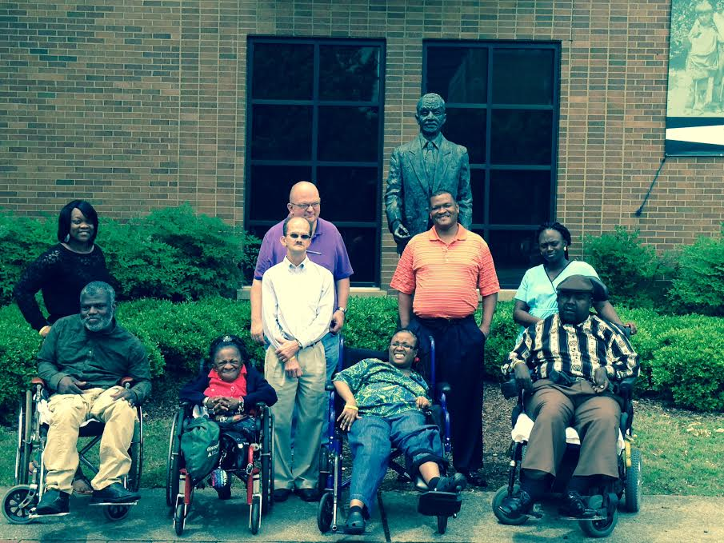
OCSS funded as a Project of National Significance by the Administration on Intellectual and Developmental Disabilities

