Slide 1

OCSS WEBINARS
SELF ADVOCACY AND
VIDEO BLOGGING
VLOGGING

Slide 2
Welcome
Chaqueta Stuckey

Slide 3
State | Group | Representative | Allies supporting project
Alabama | People First of Alabama | Darren Morris, SABE Alt. Reg. 6 Lauren Kimbrell Jeff Ridgeway | ADAP-P and A Alabama DD Council Susan Ellis* -People First of Alabama George Neal AL Dept of Mental/health
Arkansas | People First of Arkansas | Eric Treat (SABE Alt. Reg. 9) Alan Plumee Burke Fanari Joel Fuller | All DD Network Partners Julie Petty-UCED
Florida | Florida/FL SAND, | Amanda Baker Arizona Jenkins | Florida DD Council Richard Chapman, Arts in Action
Georgia | People First of Georgia | Bernard Baker (SABE Rep. Reg. 6) Marian Jackson Teresa Coleman | Ruby Moore, Georgia P&A
North Carolina | Self Advocacy Local Groups | David Taylor Jr.(SABE Alt. Reg. 6) Laura Newell Ellen Perry | Arc of North Carolina
Oklahoma | Oklahoma People First Oklahoma Self Advocacy Network | Tomas Davis Linda Gonzales Nancy Ward | P and A Lance Davis, Oklahoma People First
South Carolina | I.M.PA.C.T South Carolina | Chaqueta Stuckey (Co-Director, Reg. 6 Rep.) Connie Coleman Glenda Singletary ,Support OCSS | All DD Network Partners Cindy Cox-IMPACT Kristi Hartwell-UCED Glenda Hyman Singletary OCSS
Tennessee | People First of Tennessee | Gatha Logan, Past Pres. PF Suzanne Colsey Christy Cox Sam Gage | DD Council P and A Arc
SABE | SABE and other national partners | Bryon Murray, Vicki Turnage (Co-Director), Juliana Huereña, support | Katie Arnold, NSN Betsy Barkley-Valnes, NYLN

Slide 4
POLL QUESTIONS
Answer the poll questions
Poll 1
Poll 2

Slide 5
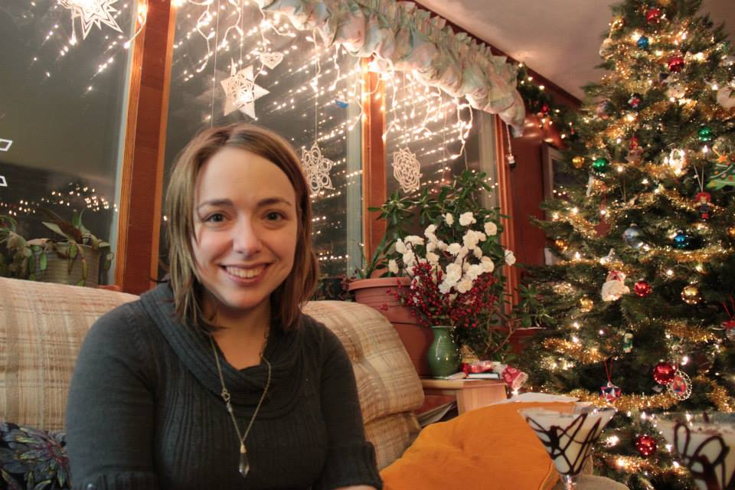
PRESENTER
Beth Hopkins
M. A., Nonprofit Organizations
Self-Advocate Mentor
The Arc Tennessee

Slide 6
BETH HOPKINS
Beth Hopkins is a self-advocate who is involved in multiple facets of the disability community in Middle Tennessee.
As a legal assistant for Maurer and Gardner, she assists families with conservatorships and special needs trusts.
She is also a mentor and trainer of self-advocates, and runs a job club and mentoring group for the Arc TN.
An avid writer, Beth has a blog called In Case of Fire, Use Stairs, and she is a regular contributor to Breaking Ground Magazine and the Huffington Post.
In her spare time, Beth can be found enjoying a cup of coffee and planning for her upcoming wedding.

Slide 7

PURPOSE OF THIS WEBINAR
Give instructions for OCSS Southern Collaborative State Vlogs
Teach people how to Vlog on disability issues

Slide 8
WHAT IS VLOGGING?
A brief idea of a topic that is video recorded and invites comments.
Wikipedia
A video blog or video log, sometimes shortened to vlog^{[1]} (pronounced 'vlog' or 'v-log') is a form of blog for which the medium is video,^{[2]} and is a form of web television. Vlog entries often combine embedded video (or a video link) with supporting text, images, and other metadata. Entries can be recorded in one take or cut into multiple parts. The vlog category is popular on YouTube.

Slide 9
WHY BLOG?
Improves the communication in an organization
Expresses the thought and opinions about an issue
Creates a conversation with others
Can ask a question and get many answers

Slide 10
LOGISTICS NEEDED
TO VLOG
Hardware
Examples of Software
Video camera to download
  Digital Camera
  Smart phone
  Tablet
  Laptop/computer
Web camera
  or
Headsets
Microphone
Speakers
Editing program(some are free, some cost)
  iMovie
  Adobe Premiere
  Window share
  Movie Maker
  Avid

Slide 11
INSTRUCTIONS FOR
OCSS VLOGGING
Pick a topic
  Employment and Subminimum wage, how to get a job
  Nursing home, if children are in institution, how are we closing institutions?
  Self Advocacy, making choices
  Social Security, how does it work?

Slide 12
INSTRUCTIONS FOR
OCSS VLOGGING
Write a script with 3 points
Short and to the point
Up to 10 minutes long

Slide 13
TOPICS FOR
ORGANIZATIONAL VLOGGING
Self Advocacy group News
Self Advocacy group Events
Questions about an issue
What has worked for self advocacy groups
What has worked for self advocates
Hot disability topics
Hot non-disability topics

Slide 14

QUESTIONS FOR
VLOGGING OR BLOGGING
Questions
  What worked for your self advocacy group?
  What did you do in your state?
  How do you communicate with your DD Network partners?

Slide 15


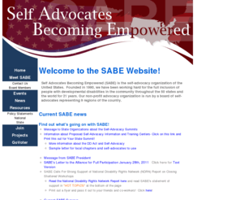

WHERE CAN YOU
VLOG OR BLOG
YouTube Self Advocates Becoming Empowered Channel
SABE Website
SABE OCSS Facebook page
Twitter

Slide 16
OTHER PLACES TO BLOG
Newsletters
  SABE Nation
Mass texting
  Cell phone sending a message to other cell phones at the same time

Slide 17
SETTING UP A VLOG
1 person or a group of people talking
Interviewing someone with 3 questions
Before and after scenarios
Background
Props
Video Camera

Slide 18

EXAMPLE OF A VLOG
SABE closing institutions
Go to Self Advocates Becoming Empowered YouTube Channel
iMovies links you to YouTube

Slide 19
EXAMPLE OF A VLOG OUTLINE
Title page
Introduction of presenters
Introduction of blog topic
Blog
Acknowledgement page

Slide 20
EDUCATE ABOUT LOBBYING
There are 2 sides on every issues
The legislators get information so they can decide
Organizational blogging educates about an issue and not tell them which one to pick
Tell your story

Slide 21
ACCESSIBLITY
Close Caption
Hard copy of materials and information
Minimum of 14 Font size (16-18 Font size better), Verdana or Arial Font
Readability Statistics, Flesch-Kinkaid Grade Level
Ask partners for contacts with Braille companies, it may cost for this service and time to prepare materials

Slide 22
Any questions:

Slide 23
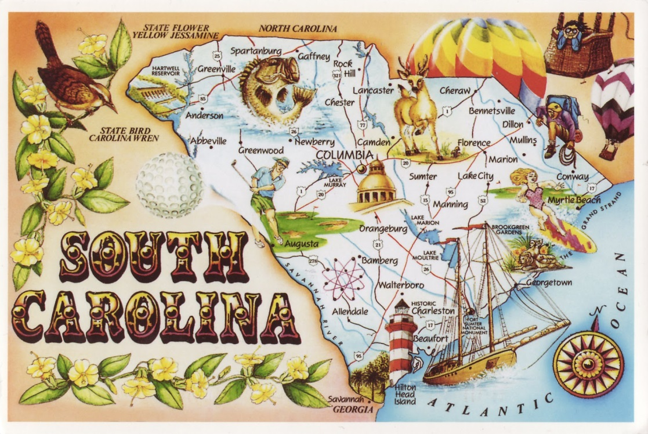
BLOGGING WEBINAR Part II
South Carolina will be presenting about blogging at a later date.

Slide 24

HOW TO TWITTER
A Twitter PowerPoint presentation will be emailed out to OCSS members

Slide 25

OCSS WOULD LIKE
YOUR INPUT
Next Face to Face
will be May 9-10, 2014
in Birmingham, Alabama
Please answer the survey questions after the webinar.
Thank you.

