Slide 1
Partnerships Outside the Disability Community
July 23, 2015

Slide 2
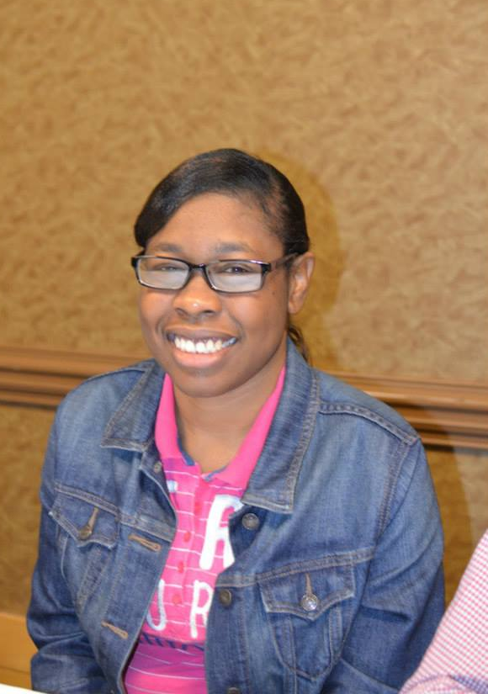

Slide 3
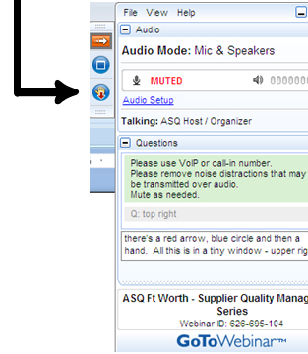
WELCOME
Reminders:
Please mute your device once you join the call
Remember to raise your hands for questions or write a message in text box
We will give everyone a chance to ask questions at the end of the presentation
Notes:
Chaqueta

Slide 4
WELCOME
Reminders:
If you are using more than one device for this webinar, please do not place next to each other, to reduce echoing or feedback.
Make sure your speakers are turned on.
Notes:
Chaqueta

Slide 5
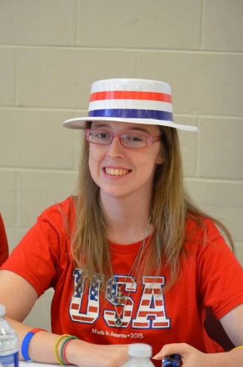
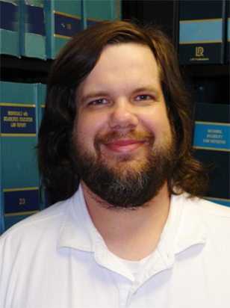
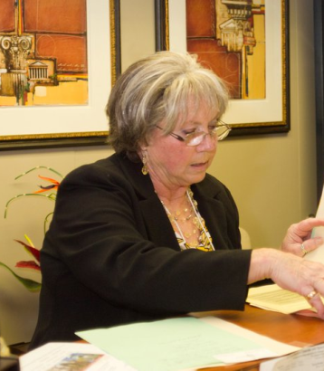
PRESENTERS
Brittney Gore, People First of Alabama
Patrick Hackney, ADAP
Judy Roy, DRR
Kaiya Andrews
Green Mountain Self-Advocates

Slide 6
THE PURPOSE OF THIS WEBINAR
Participants will learn about how other self advocacy groups have reached out to their communities for support and the different types of organizations they have ongoing relationships.

Slide 7
POLL QUESTION #1
Has your self advocacy group partnered with other groups outside the disability community?

Slide 8
POLL QUESTION #2
What Groups have you partnered with?
Human Rights
Labor
LGBTQ
Business
Other

Slide 9
ALABAMA
PARTNERSHIPS OUTSIDE THE DISABILITY COMMUNITY

Slide 10
People First of Alabama
People with disabilities need to be involved in all aspects of our communities. We represent an important force in society!

Slide 11
Organizations with which we have relationships

Slide 12
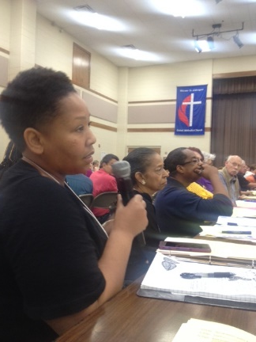
Alabama ARISE
People First of Alabama is a member organization of Alabama Arise Citizen’s Policy Project.

Slide 13
Alabama ARISE
Arise Citizens' Policy Project (ACPP), founded in 1994, is a statewide nonprofit, nonpartisan coalition of 150 congregations and community groups and hundreds of individuals united in their belief that low-income people are suffering because of state policy decisions.

Slide 14
Alabama ARISE
Through ACPP, groups and individuals join together to promote state policies to improve the lives of low-income Alabamians.
In a state that by many measures is the worst place for poor people to live in the United States, ACPP believes acts of charity are vital, but they are not enough; we must work to improve harmful state policies.

Slide 15
Alabama ARISE
ACPP provides a structure in which Alabamians can engage in public debates with the goal of improving the welfare of all Alabamians.
Donations to ACPP, a 501(c)(3) organization, are tax-deductible.

Slide 16
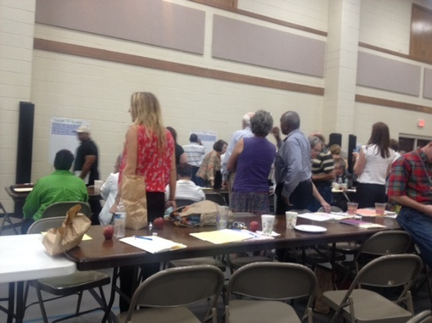
Alabama ARISE
People First participates in many of the policy initiatives of ACPP.

Slide 17
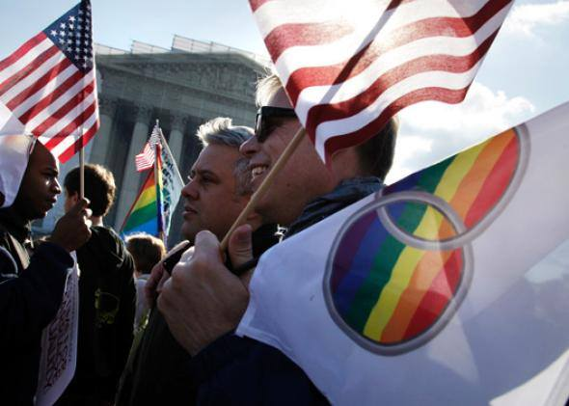
Parents, Families and Friends of Lesbians and Gays (PFLAG)
ADAP gathered sister advocacy organizations: National Association on Mental Illness (NAMI); Family Ties; SABE; Alabama Parent Education Center; and People First to discuss success in advocacy issues. PFLAG shared their experience in growing members, lobbying for policy change, and community support.

Slide 18
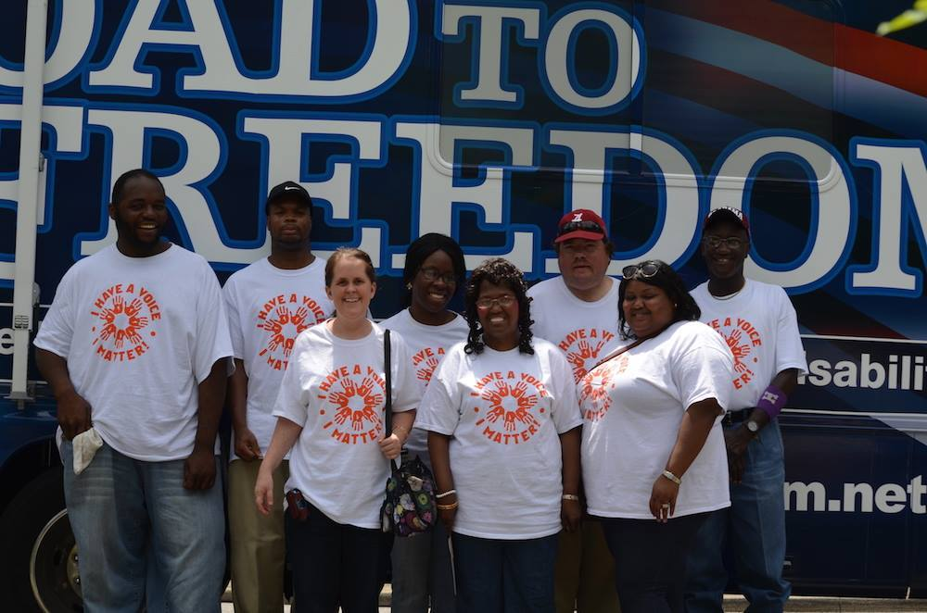
Americans with Disabilities Act 25th Celebration
People First of Alabama participated in a coalition of community and disability organizations to celebrate.

Slide 19
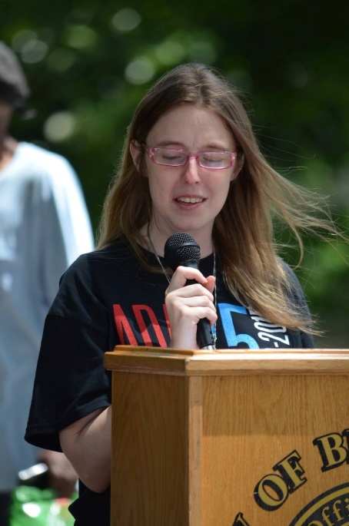
Americans with Disabilities Act 25th Celebration
Organizations like Alabama Institute for the Deaf and Blind, Disability Rights and Resources, Arc, Governor’s Office On Disabilities, as well as the city of Birmingham, Birmingham Museum of Art, the Birmingham MAX transit system, Regions Bank, and many more community organizations worked as a team to coordinate a week of activities.

Slide 20
Stand Tall Alabama
Citizens campaign to send a message to each state representative and state senator to prepare a budget that meet the needs of our citizens.

Slide 21
Stand Tall Alabama
“Without $300 million in new revenue, Alabama will experience budget cuts that endanger the lives of the most vulnerable and will threaten the well-being of even the most independent of our citizens. Through two legislative sessions, lawmakers have failed to produce a budget that meets the needs of our children, working mothers and our senior citizens. Now, a second special session will be required. What will happen if our legislators fail once again to vote Yes for new revenue?”

Slide 22
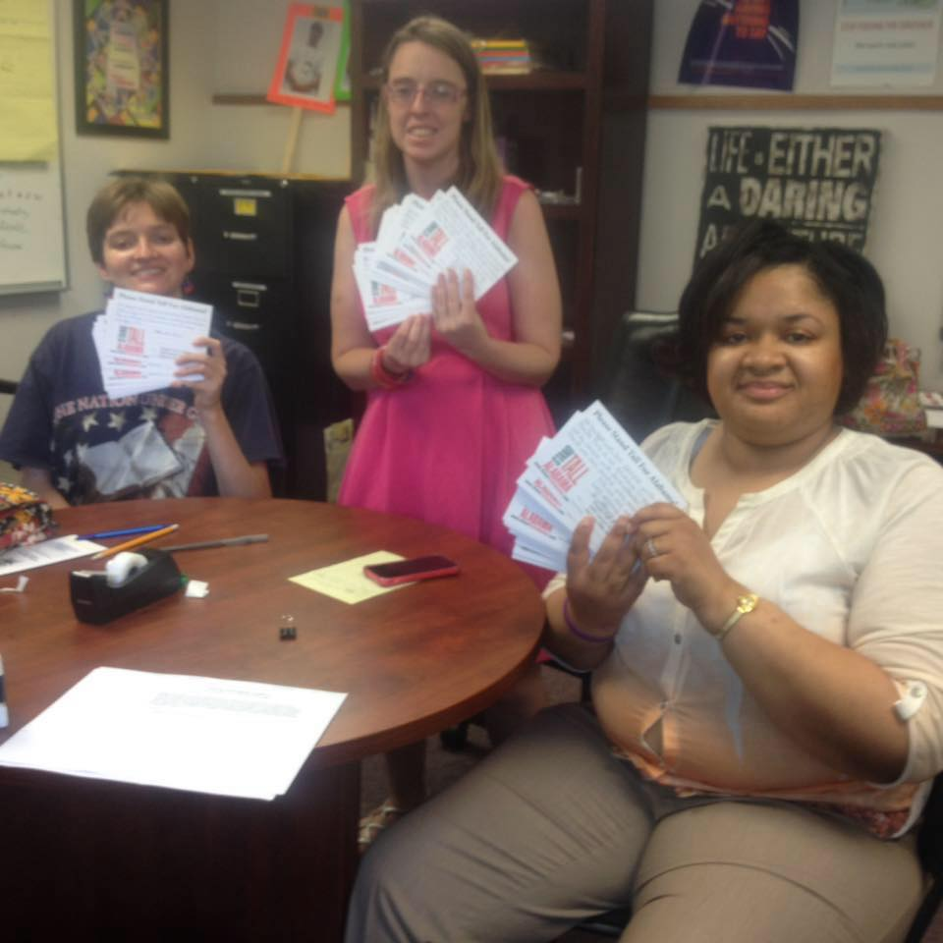
Stand Tall Alabama
People First members and supporters wrote personal messages to each state legislator and more.

Slide 23
Connecting with our Alabama Civil and Human Rights Heritage
People First of Alabama has organized educational opportunities in the historic civil rights district the Birmingham Civil Rights Institute (BCRI) and accessed speakers from the Greater Birmingham Ministries, celebrated the 50th anniversary of the March from Selma to Montgomery, and hosted events at the BCRI and more.

Slide 24
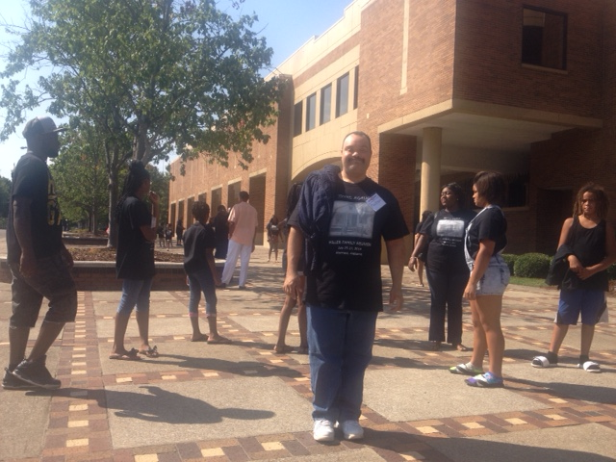
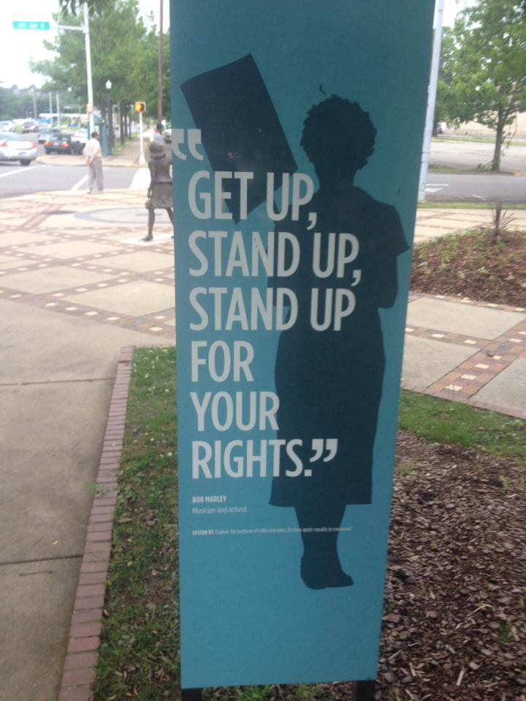
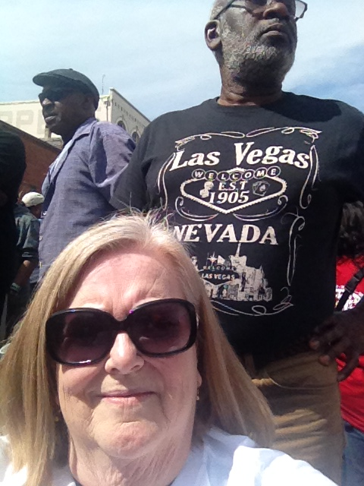
Connecting with our Alabama Civil and Human Rights Heritage

Slide 25
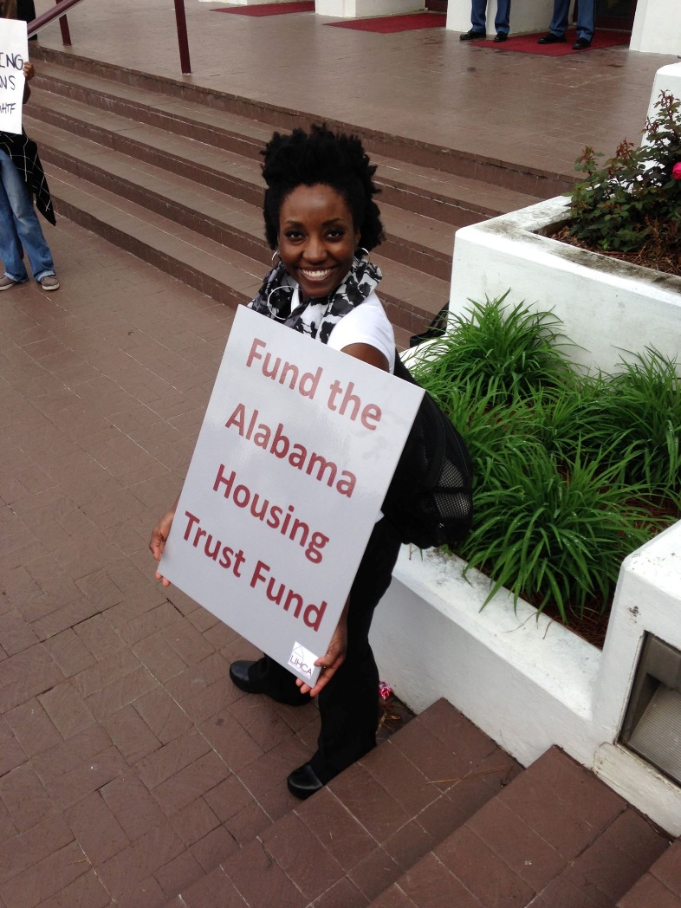
Low Income Housing Coalition of Alabama
Staff and members participated in LICA strategic planning meeting to determine community needs and priorities. Housing is a critical issue for people with disabilities.

Slide 26
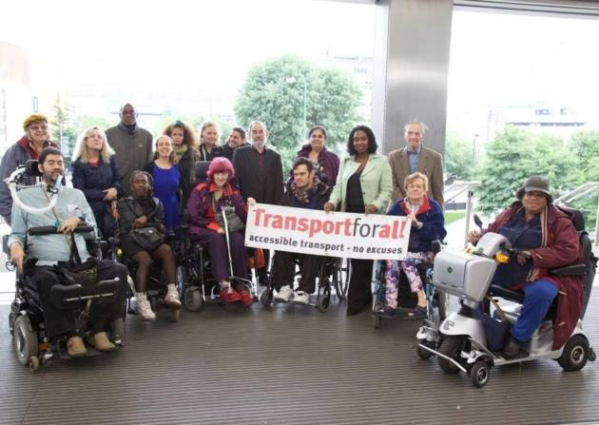
Transportation initiatives
People First members participate in community education and surveys of needs in our community for accessible transportation. PF members advocate for access to diverse and new transportation solutions like UBER.

Slide 27
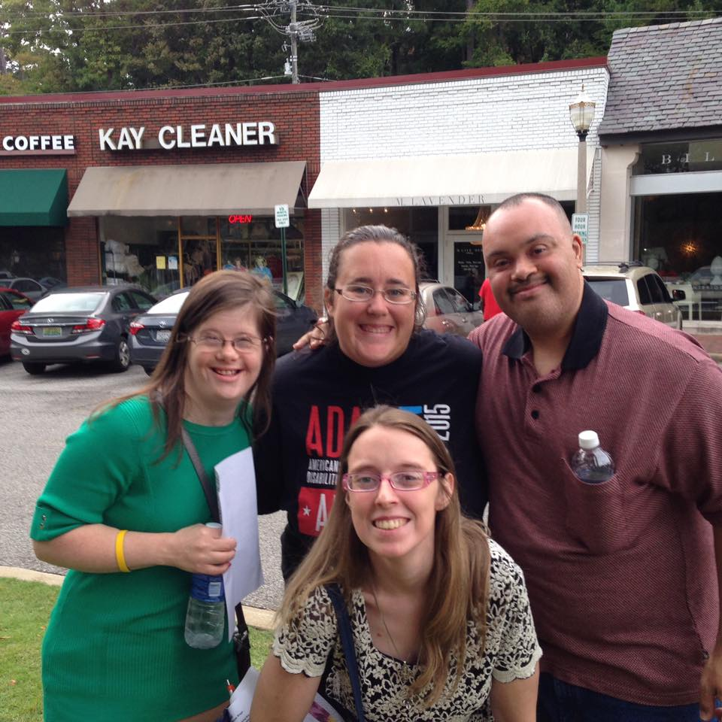
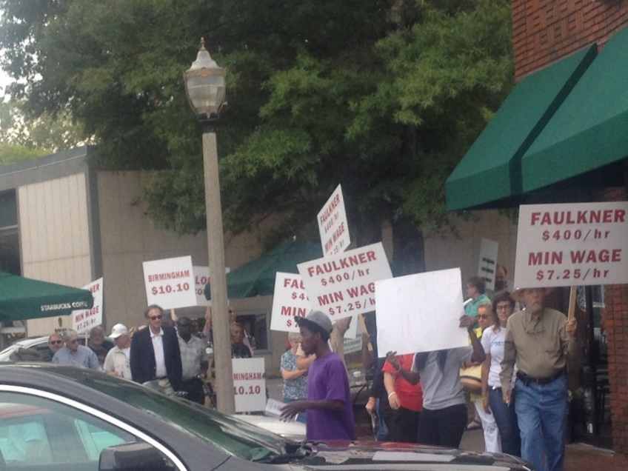
Fair wages and increase minimum wage
People First educates public and members on fair wages and minimum wage increase.

Slide 28
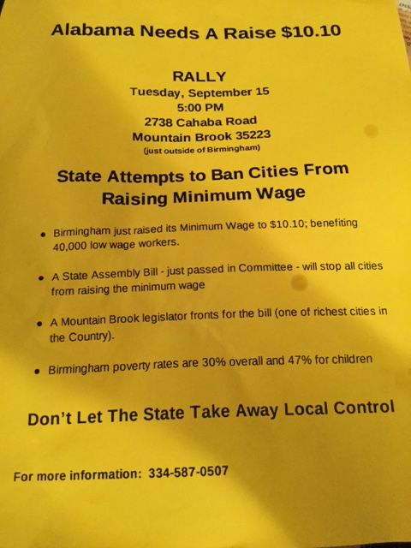
Fair wages and increase minimum wage

Slide 29
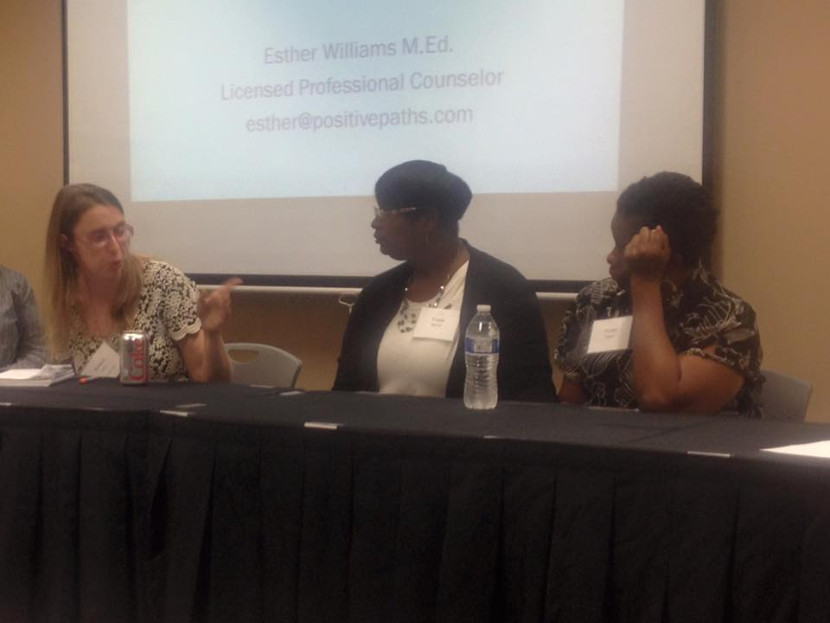
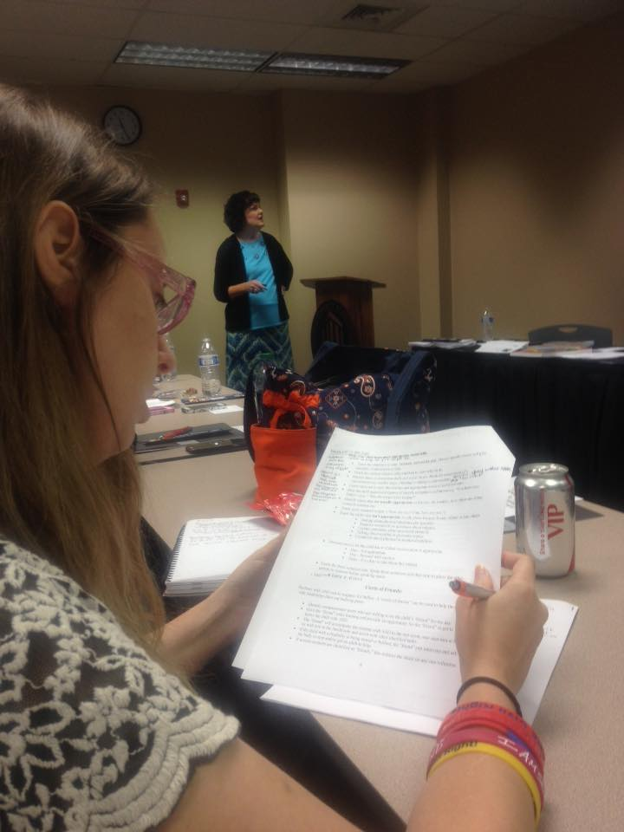
Bullying Conference
People First participates in community education for prevention of bullying. President, Brittany Gore, speaks on panel.

Slide 30
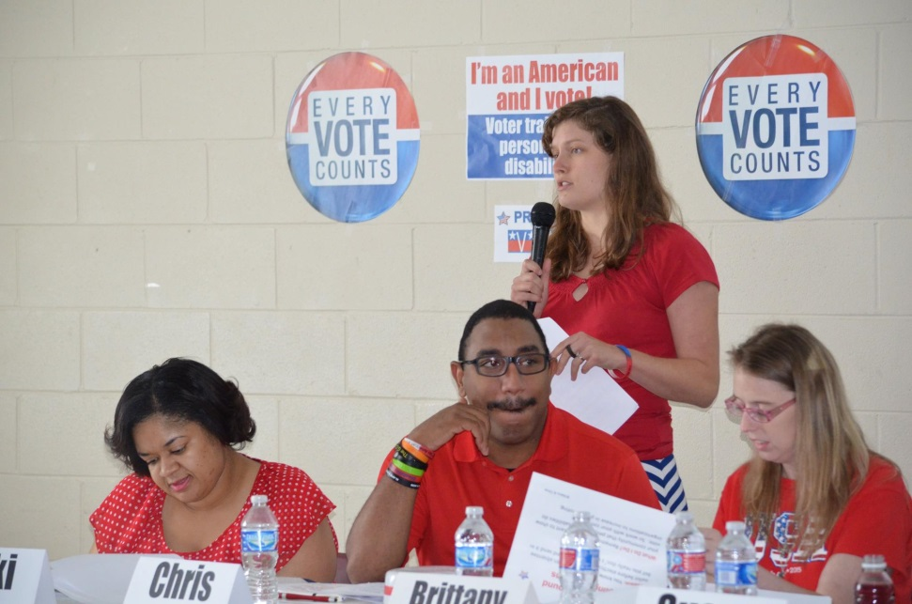
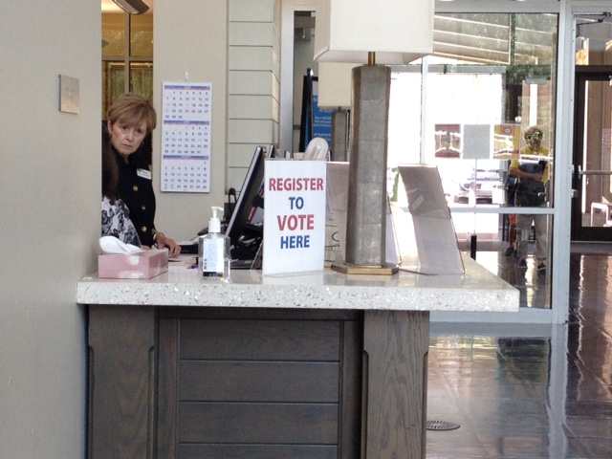
League of Women Voters
People First and Alabama Disabilities Advocacy Program (ADAP) partnered with the League of Women Voters to educate on voting access, registration and informed voting.

Slide 31
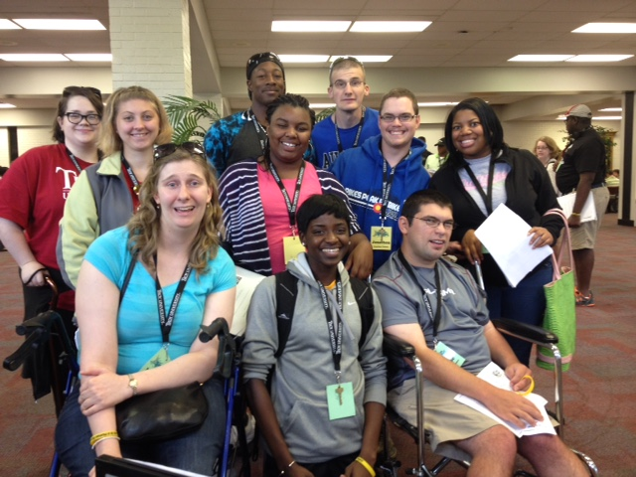
Alliances with many organizations
People First members are part of Alabama Youth Leadership Forum, legislative alliances and coalitions, and recently 25th anniversary of the ADA celebrations! All bringing community awareness of self-advocacy and community participation in important issues.

Slide 32
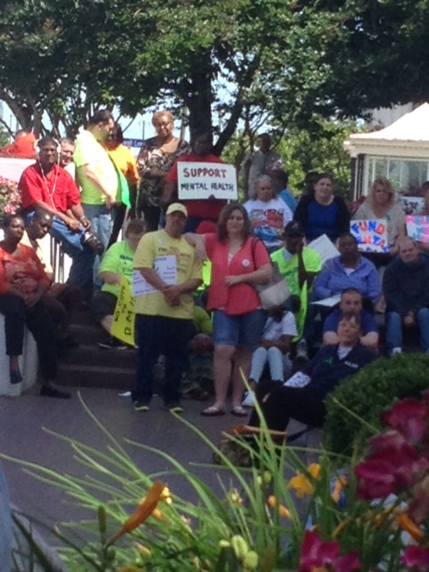
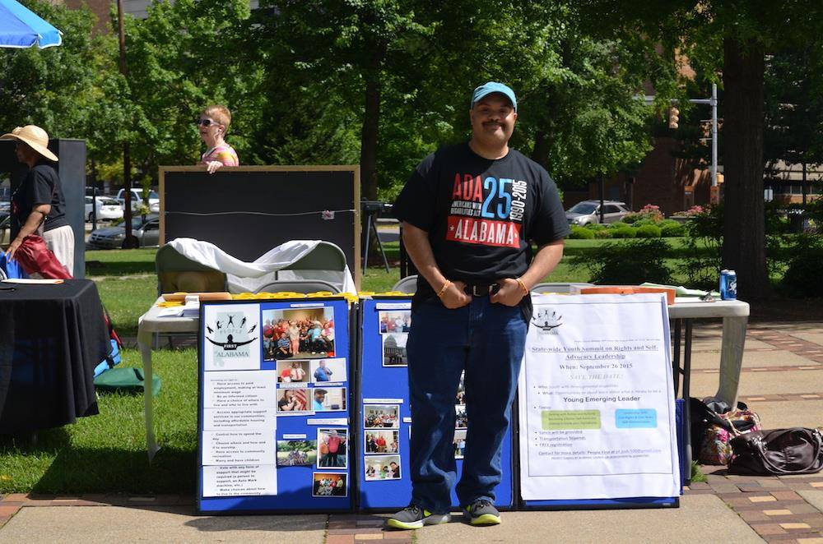
Alliances with many organizations

Slide 33
Young Emerging Leaders grant: It’s All About Human and Civil Rights
The project is funded by our DD partner, Alabama Council on Developmental Disabilities and will create a group of youth ages 14-26 with developmental disabilities who will be prepared to be community leaders…joining leadership bodies of community organizations for disability rights and other groups supporting human and civil rights.

Slide 34
Community organizations Project partners
University of Al at Birmingham School of Business and UAB Civitan’s Center
Alabama Arise Citizen’s Policy Project
Southern Poverty Law Center
Low Income Housing Coalition
Church of the Reconciler
National Voting Rights Museum in Selma, AL
The Well House, The Well House is a nonprofit, faith-based organization devoted to the rescue and recovery of women who are being sexually exploited. Based in Birmingham, Alabama.

Slide 35
Coalition Building
Judy Roy, DRR

Slide 36
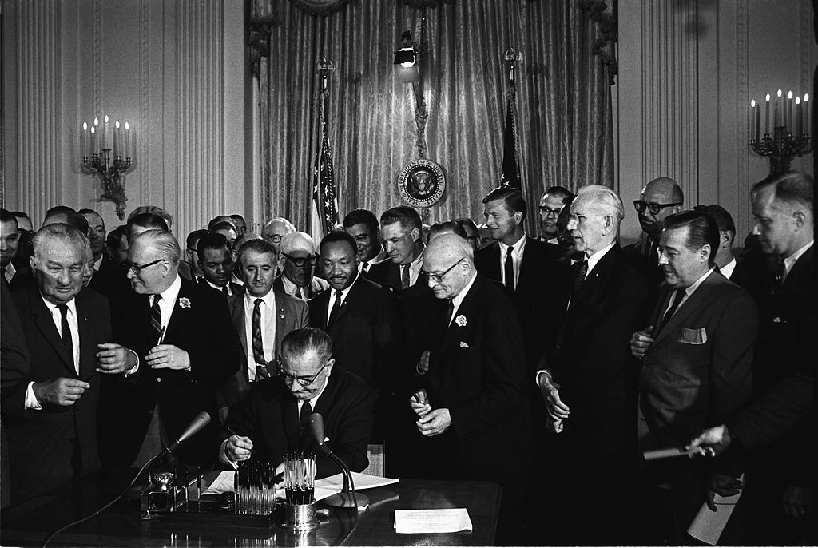
Civil Rights Are Disability Rights

Slide 37
President Johnson signed the Civil Rights Act 1964-- landmark legislation that broadly outlawed discrimination based on race, color, religion, sex or national origin.

Slide 38
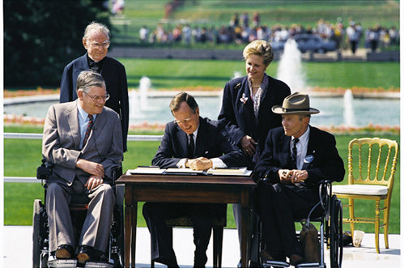
Disability Rights Are Civil Rights

Slide 39
“ I now lift my pen to sign this Americans with Disabilities Act and say: Let the shameful wall of exclusion finally come tumbling down. God bless you all.”
Pres. George Bush
July 26, 1990

Slide 40
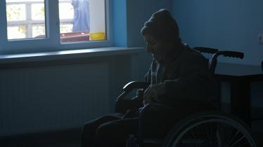
Disability Rights Are Human Rights

Slide 41
The United Nations, in the Universal Declaration of Human Rights and in the International Covenants on Human Rights, has proclaimed and agreed that everyone is entitled to all the rights and freedoms set forth therein, without distinction of any kind
2008

Slide 42
Coalition Building
Include people with disabilities in poverty reduction.
Disability is both a cause and a consequence of poverty.
“Nothing about us, without us!”

Slide 43
Kaiya Andrews and Karen Topper
Green Mountain Self-Advocates in Action with Allies

Slide 44
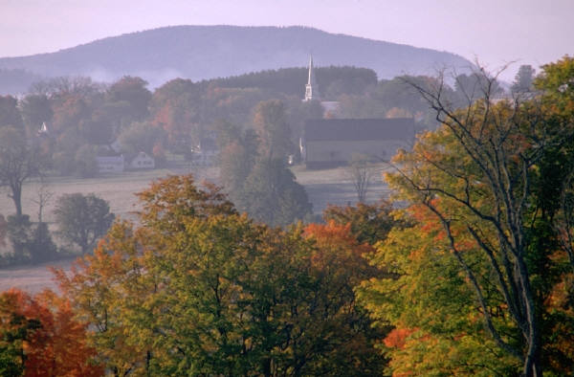
Vermont …
More dirt roads than paved roads!
Population 624,000
Montpelier (capital) 7,500

Slide 45
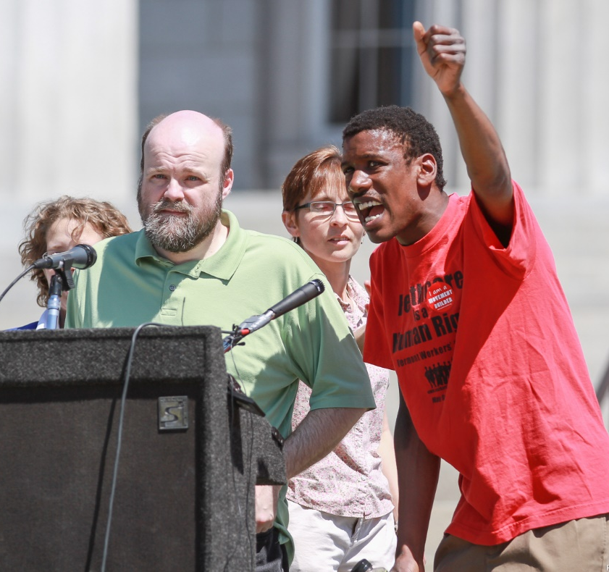
We are part of an unified movement for human rights and dignity in Vermont working with…
VT Workers Center
Migrant Justice
350 VT & Rising Tide
VT Interfaith Action
Pride Center of Vermont
Anti-Defamation League
Public Assets

Slide 46
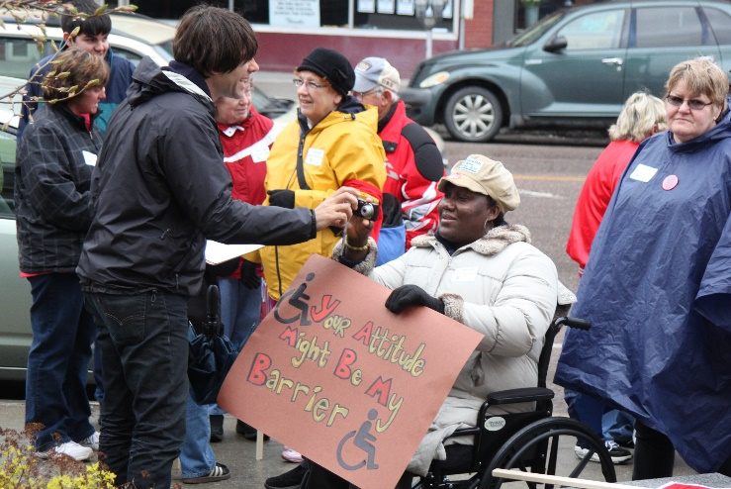
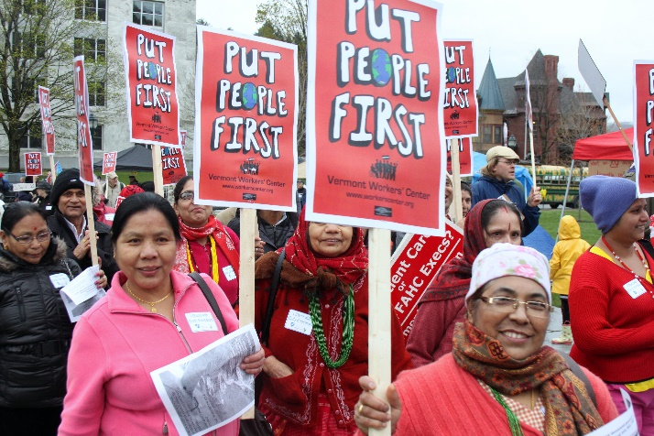
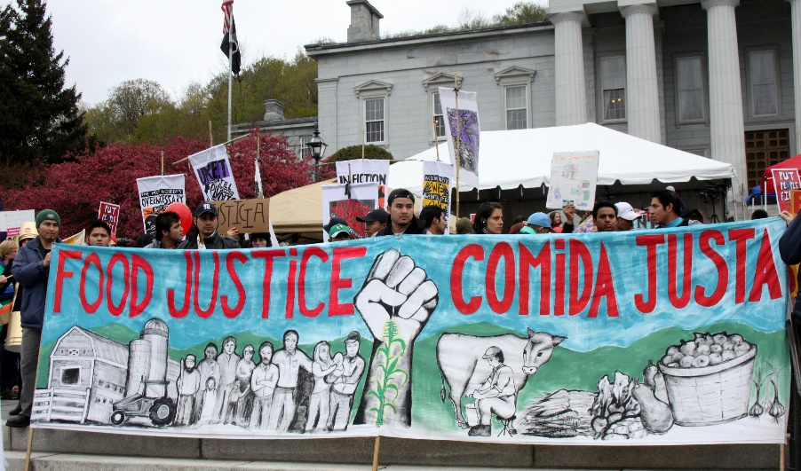
GMSA is part of the leadership team of the Vermont Human Rights Council

Slide 47
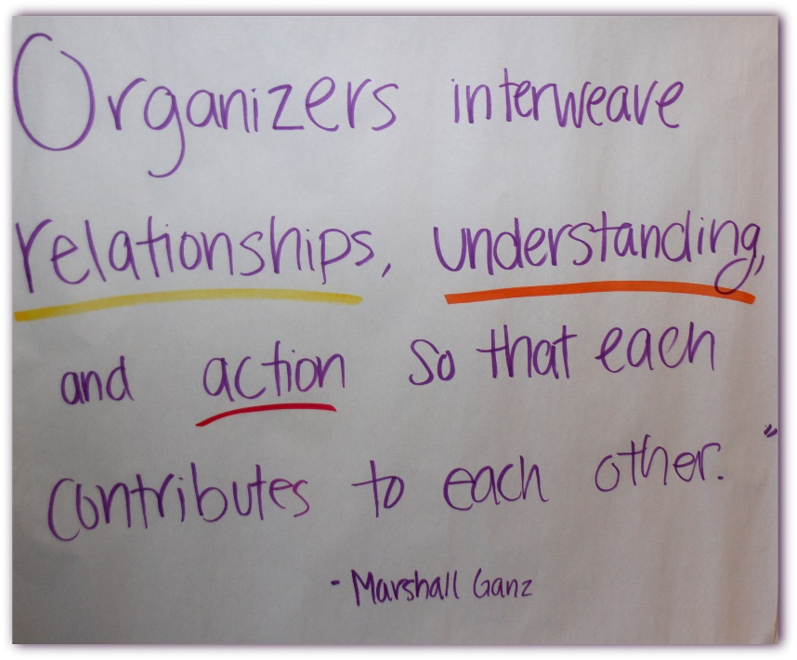
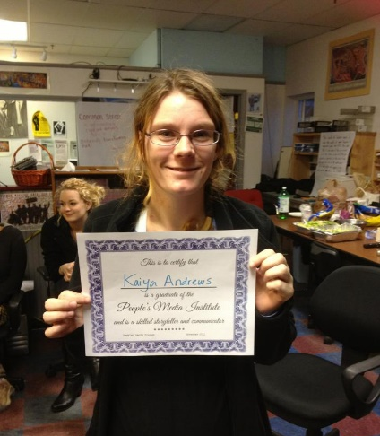
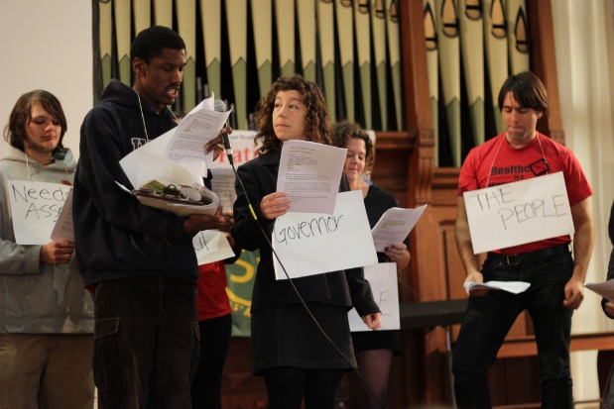
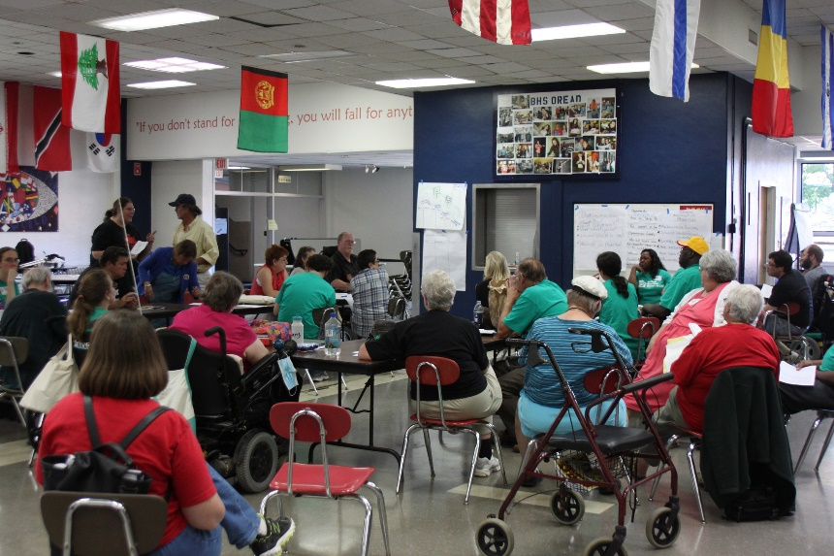
Sharing Information and Organizing Strategies
Media Institute, Fundraising Training, Anti-Racism for Collective Liberation, People's University for Learning & Liberation, Put People First Campaign, Healthcare as a Human Right Campaign …

Slide 48
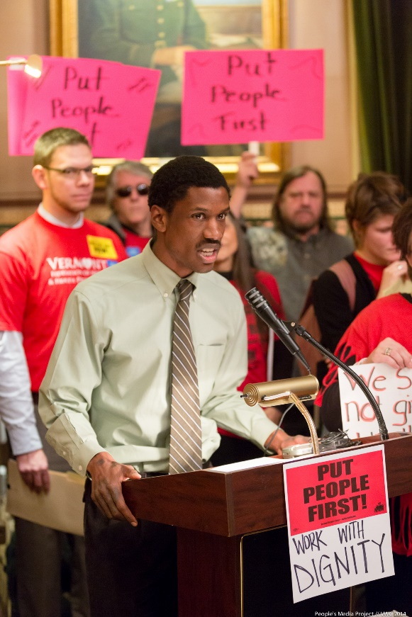
Nothing About Us Without US Together we meet with public officials and hold press conferences
Max Barrows (GMSA) lead speaker at press conference following the Governor’s Budget address
Nicole (GMSA) and Sheila (VWC) meeting with Bernie Sanders

Slide 49
Just one example of the many rallies we have organized together over the years. April 2015, Nicole LeBlanc, self-advocate speaks at a Vermont rally to end budget cuts

Slide 50
Raymond Gordon, Think College Student makes his case for employment services at a candidate forum. He teamed-up with a fellow college student who was there to speak up about college debt.
One successful strategy has been to jointly organize candidate forums in each county. Speakers from each of our organizations ask questions.

Slide 51
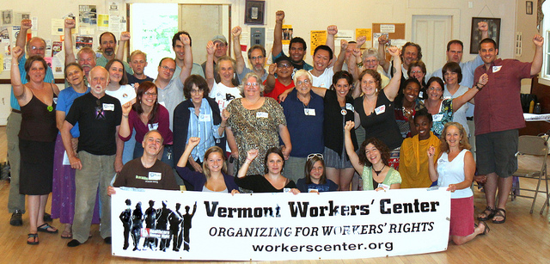
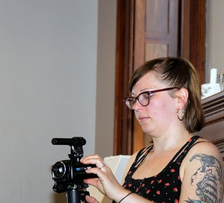
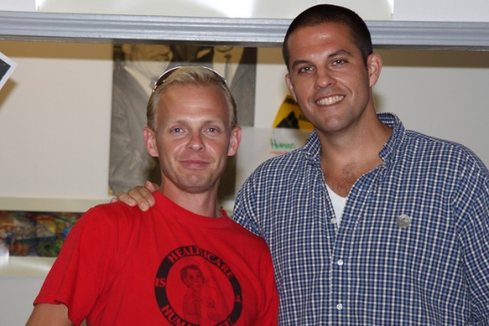
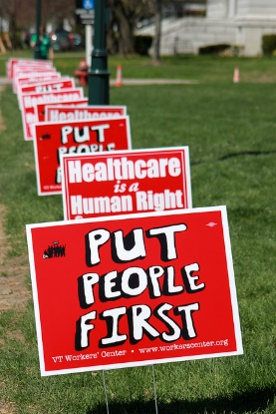
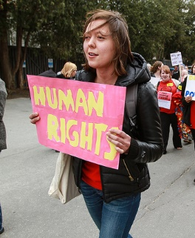
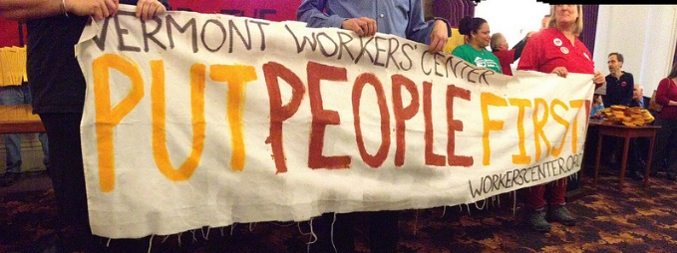
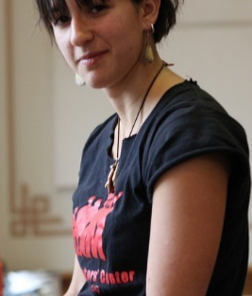
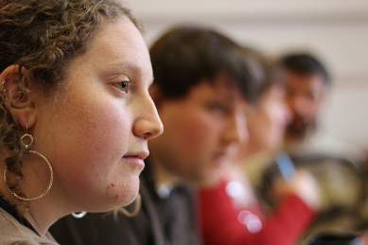
True Allies
PUT PEOPLE FIRST
Adapted from Tracy Thresher’s Blog 8/2/2012 (GMSA Peer Leader)
Yesterday I had the opportunity to meet with young representatives from the Vermont Workers’ Center. Sitting amongst us and having dialogue on topics that affect our lives, these young makers of positive change not only listened to our issues but pledged to continue to rise to walking the walk to ensure that all Vermonters have a voice. The Vermont Workers’ Center’s vision is to “Put People First.” To do so they have begun to canvas the state to open up dialogue with ALL Vermonters. The dialogue we are now having is a launch pad for change. Paramount to making change is including the stakeholders when inquiring what issues need to be addressed.
The young twenty- something leaders are a force of inclusive political change in Vermont. Quietly building momentum to push through heavy political obstacles, making democracy a reality for all people.
Let’s continue to be in partnership with grassroots organizations to communicate the need for the supports for people to live lives of their choosing.

Slide 52
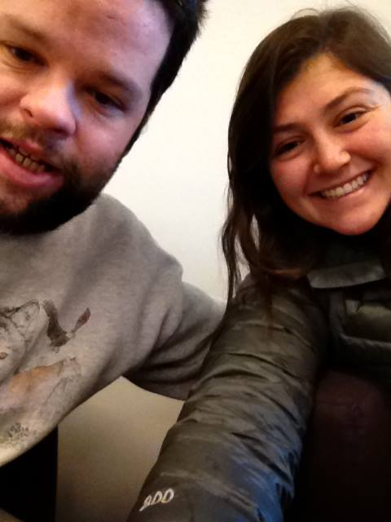
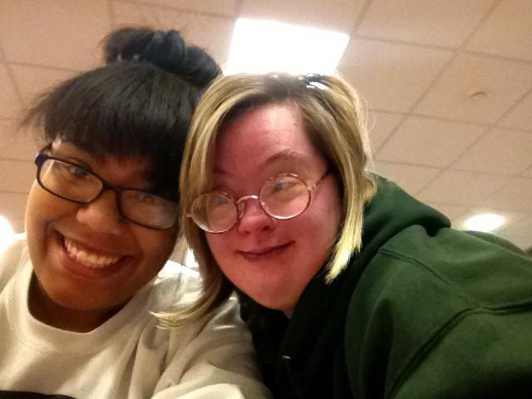
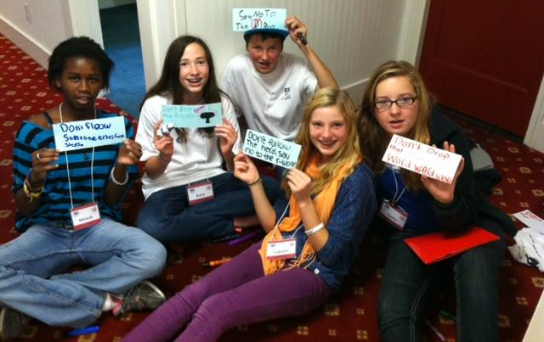
New Ways of Connecting With Youth
…On campus … Rallies and direct action… Organizing a Youth Congress

Slide 53
Campaigns: Building a Moral Economy Universal Healthcare Campaign

Slide 54
There is no climate justice without migrant justice, no workers rights without disability rights.

Slide 55
DATES TO REMEMBER

Slide 56
DATES TO REMEMBER
Final 2014-2015 invoice due now September 30, 2015 Supplemental Invoice due.
October 10-11, 2015 Face to Face meeting in Decatur, Georgia

Slide 57
Next OCSS Webinars 3:30 p.m. EST 2:30 p.m. CST
Webinar dates | Topic
October 22, 2015 | Closing Institutions

Slide 58
THANK YOU!
Regional Self Advocacy Technical Assistance Center Funded by the Administration on Intellectual and Developmental Disabilities.

