Slide 1

YOUR STATE PLAN
Sustainability Plan
October 10-11, 2015
Advisory Board Meeting
Decatur, Georgia

Slide 2
Our Leadership: Who are we???
AVENGERS
Work together for the common good

Slide 3

INSTRUCTIONS TO THE GROUP
Read each character
Choose the one that best describes you
Share with others
Notes:
You do not need to worry about the gender of the character, just the skills

Slide 4

Captain America
Leader
Had a hard life growing up
Strategic planner
Gives their all
Our Leaders and Allies: Brittany, Ebony, Chaqueta, Bernard, Bill, Ellen, Tom

Slide 5

Iron Man
Secondary Leader
Support, makes everything easy
Has the money
Creative Designer
Critical thinker
Our Leaders and Allies: Ellen, Brittany, Teresa

Slide 6

Spiderman
Makes sure everyone is using the best of their abilities
Access to private money
Family support
Works alone
Makes own choices
Our Leaders and Allies: George, Ellen, Brittany

Slide 7

Thor
3rd Leader
Gets the BIG job done
Has family support
Cares about the people
Our Leaders and Allies: Taylor, Nikki,
Bobbi, George, Sam

Slide 8

Black Widow
Executes (gets things done)
Knows where to get her resources
Strategic Planner
Has been institutionalized
Our Leaders and Allies:
Cheri, Cindy, Nancy, Vicki

Slide 9
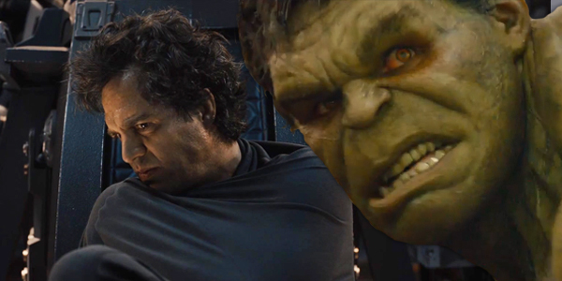
Hulk
Good at details
Gets the BIG jobs done
Angry, wants the cure
Innovative
Critical thinker
Our Leaders and Allies:
Arizona, Bernard, Dee, Eric, Vicki

Slide 10
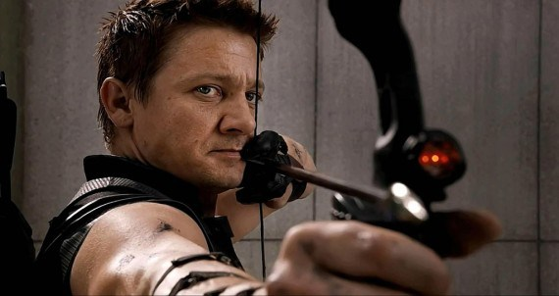
Hawkeye
Detail oriented
Gets the work done
Has family support
Our Leaders and Allies:
Ebony, Nikki, Dee

Slide 11

Falcon
Strategic planner
Innovative
Gets the work done
Our Leaders and Allies:
Ebony, Chaqueta, Tom

Slide 12

Nick Fury
Know where to get the resources
Liaison with the board of directors (attends board meetings)
Development director
Our Leaders and Allies:
Jerry, Juliana, Brenda

Slide 13
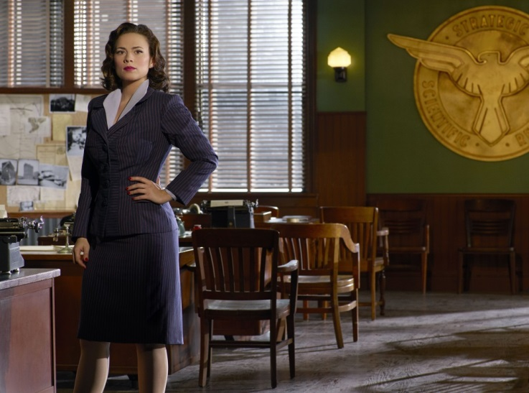
Agent Carter
Know where to get the resources
Has government support and money
Behind the scenes
Founder
Our Leaders and Allies:
Cheri, Nikki, Vicki

Slide 14
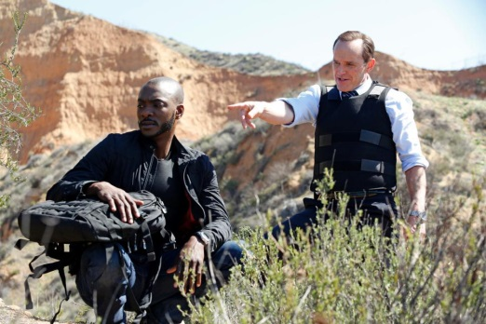
Agent Coulson
Behind the scene person
Knows where to get resources
Has government support and money
Assistant Director with Strategic planning
Our Leaders and Allies: Bill L. and Nancy

Slide 15

Pepper
Administrative support
Development director
Focuses on the mission
Our Leaders and Allies: Carol, Latrice, Brenda Glenda, Pamela, Juliana

Slide 16
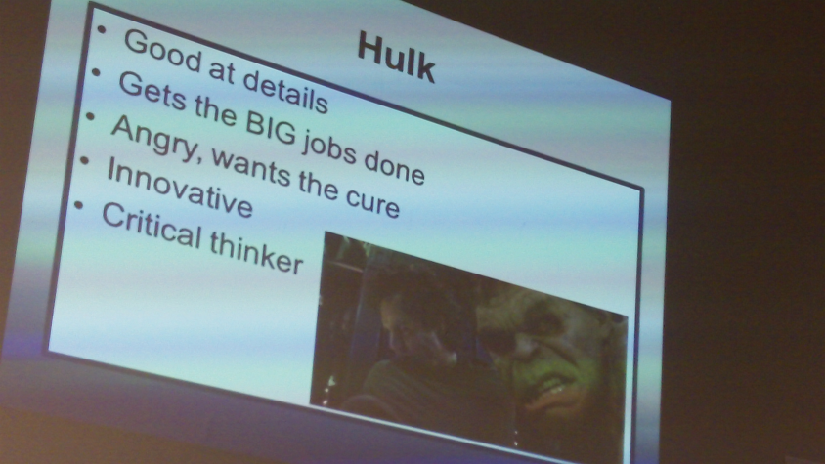
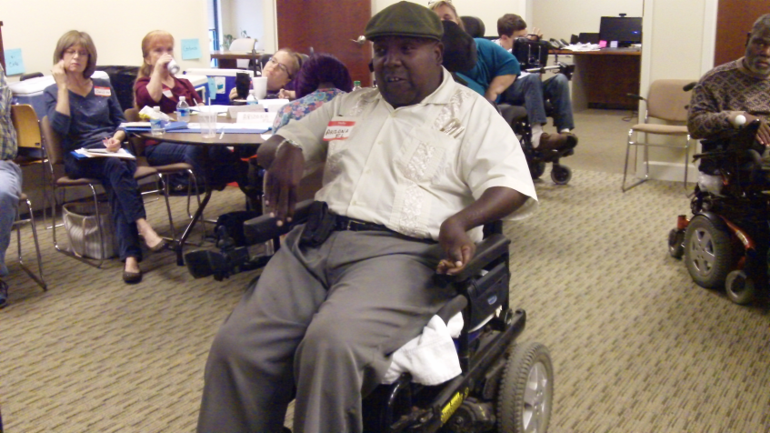
Our Leadership Characteristics
The group discussed their strengths and how the group needed all types of leaders to be strong.

Slide 17
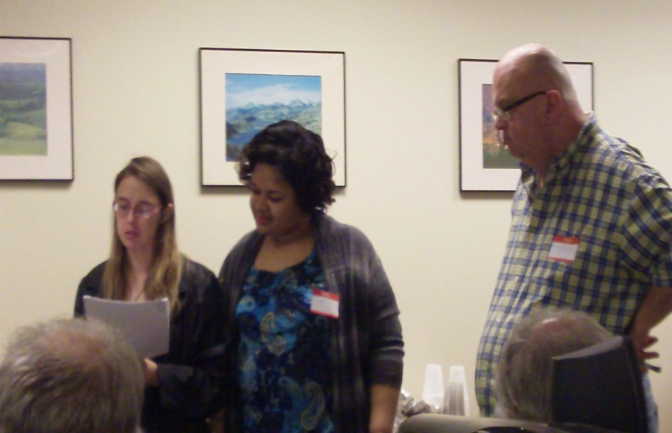
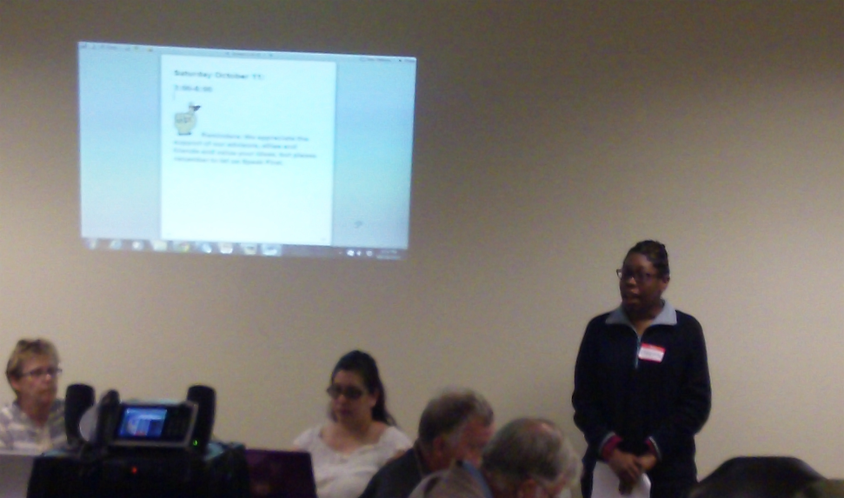
Scott(SWOT)
Sustainability Plan

Slide 18
PURPOSE of SCOTT (SWOT) Analysis
Identify possible strategies to work with our partners for sustainability
Develop a plan to sustain Regional Peer to Peer Technical Assistance Efforts of Our Community Standing Strong

Slide 19

Our Mission Statement
  To strengthen the self advocacy movement in the South by identifying and removing barriers for a good lives for all

Slide 20
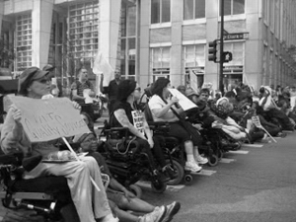
HISTORY OF OUR COMMUNITY STANDING STRONG (SOUTHERN COLLABORATIVE
Rich history of the power of the self advocacy movement
1988 People First of Tennessee assisted People First of Alabama to start their organization
1991 People First of Tennessee filed a lawsuit to close institutions

Slide 21
HISTORY OF OUR COMMUNITY STANDING STRONG (SOUTHERN COLLABORATIVE
1992 Self Advocates Becoming Empowered (SABE)National Conference in Nashville
1994 People First of Alabama helped People First of Georgia start self advocacy chapter in Atlanta

Slide 22
HISTORY OF OUR COMMUNITY STANDING STRONG (SOUTHERN COLLABORATIVE
1997 Alabama, Georgia and Tennessee received a grant to work on self determination in the south and on closing institutions. Southern Collaborative was formed. Hosted a national meeting in Nashville to develop a position on self determination
1998 PF of Alabama worked on Plan to closed institutions with SABE

Slide 23
HISTORY OF OUR COMMUNITY STANDING STRONG (SOUTHERN COLLABORATIVE
2001-2006 Southern Collaborative hosted regional meetings on self determination and leadership in Alabama, North Carolina, Tennessee, Georgia, Arkansas and Louisiana
2004 Southern Collaborative expanded to include Region 6 and 9 of SABE (Alabama, Arkansas, Florida, Georgia, Louisiana, North Carolina, South Carolina, Texas, Tennessee and Kentucky)

Slide 24
HISTORY OF OUR COMMUNITY STANDING STRONG (SOUTHERN COLLABORATIVE
2006 Southern Collaborative hosted the National Self Advocacy Conference “ We Had a Dream: Now We Have the Power” in Atlanta, Georgia.
2013-2015 SABE received a grant from AIDD for a Regional Self Advocacy Technical Assistance Center ( Our Community Standing Strong) The center currently serves 9 states from the original southern collaborative.

Slide 25
HISTORY OF OUR COMMUNITY STANDING STRONG (SOUTHERN COLLABORATIVE
2013-2015 OCSS has supported member states to publish vlogs, offer peer to peer technical assistance to states through webinars, advisory meetings and face to face meetings.
The leaders from the states are working together to develop state plans and identify common ground on issues of concerns
Leaders are breaking barriers and stereotypes

Slide 26
HISTORY OF OUR COMMUNITY STANDING STRONG (SOUTHERN COLLABORATIVE
2001-2006 Southern Collaborative hosted regional meetings on self determination and leadership in Alabama, North Carolina, Tennessee, Georgia, Arkansas and Louisiana
2004 Southern Collaborative expanded to include Region 6 and 9 of SABE (Alabama, Arkansas, Florida, Georgia, Louisiana, North Carolina, South Carolina, Texas, Tennessee and Kentucky)

Slide 27
SCOTT (SWOT)Analysis
A good way is to find out what your group is good at and what you need to continue to work on is to use what we are calling a “SCOTT” Analysis. Others may call it “SWOT” Analysis.
Strengths | Challenges
Opportunities | Threats and Trends

Slide 28
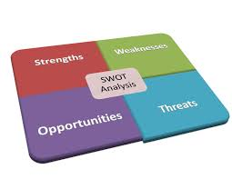
SCOTT (SWOT)Analysis
We changed this because we do not like the word weakness.
SCOTT stands for
  S- Strengths
  C-Challenges (Weaknesses don’t work for us)
  O-Opportunities
  T and T-Threats and Trends

Slide 29


S (Strengths)
Make a list of the things you are most proud of (Strengths)
Our history of working together
Strong Leaders
Teamwork
Comfortable expressing ourselves
Transparency (we are honest with each other)

Slide 30

S (Strengths)
Make a list of the things you are most proud of (Strengths)
Our states and SABE have strong projects: Long Road Home, Project Vote, SALT, YEL and OCSS
We make our voices heard
Communication with each other
We share opinions
Our leadership and allies are diverse

Slide 31
S (Strengths)
Make a list of the things you are most proud of (Strengths)
We have youth leaders within our group
Support of our Allies
Persistence
Planning
Embrace Technology

Slide 32
S (Strengths)
Make a list of the things you are most proud of (Strengths)
Welcoming, loving and hospitable
Opened minded
Driven a
Committed
Clear vision

Slide 33
S (Strengths)
Make a list of the things you are most proud of (Strengths)
Respectful of each other
Listen to each other
Passionate
Use our limited resources well
We have some funding to our work

Slide 34
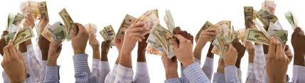
C (Challenges)
External
Technology: access, website, social media presence
Transportation to get to places
Presumed competency by others

Slide 35
C (Challenges)
Getting together to share our ideas and learn from each other
Having to prove our competency to others

Slide 36
C (Challenges)
Commitments by supporters and partners
Engagement with self advocates in their communities
Money- consistent funding for self advocacy organizations

Slide 37
C (Challenges)
Equal places at the table
Education of policy makers on the importance of self advocacy
Geography of our states (rural, access to public transportation)

Slide 38
C (Challenges)
Helping people get our of segregated settings: institutions, sheltered workshops and group homes
Voting

Slide 39
C (Challenges)
Internal
Commitment and long term relationship with personal support assistance
Engagement and commitment by people with disability
Communicating our message clearly

Slide 40
C (Challenges)
Internal
We accept “no” as an answer too frequently
Commitment
Access and use of technology

Slide 41
O (Opportunities)
Make a list of your resources: people, partnerships and money (Opportunities)
Partnerships on grants and projects: Vote, Long Road home, Youth Projects
Explore new grants: Morehouse Health Care Access , Federation of the Blind

Slide 42
O (Opportunities)
Use the power of our communication skills to tell our personal stories and showcase our leaders
Share information on our successful projects and partnerships
Use a Listserv to communicate with each other

Slide 43
O (Opportunities)
Allies could assist with technology and space)
Develop relationships with business and other agencies, i.e. Delta, Red Cross, Google Microsoft
Parents and Sibling Groups

Slide 44
O (Opportunities)
Share information on how we get our funding
Work on our issues as a Region: Long Road Home, Transportation, Closing Segregated Settings, Youth recruitment

Slide 45

TT (Threats and Trends)
What problems keep us from accomplishing our goals (Threats and trends)
Limited funding opportunities
Transportation
Personal and organizational supports are limited

Slide 46
Next:
Why is important to us to sustain our efforts?
      Self Advocacy is our power!

Slide 47
Next:
ACTIONS STEPS/STRATEGIES
How will do it?
Actions required-Identified in our discussion in Myrtle Beach March 19-20, 2015
Use our elevator speeches to talk about self advocacy, funding and our issues
Write white papers or position papers
Develop relationships with our legislators, policy makers and allies
Be persistence with our message-Act like the energizer bunny
Tell our stories about the power of self advocacy and our issues
Enlist our partners and allies support

Slide 48
Next:
ACTION STEPS
Develop a way to evaluate our efforts to prove that self-advocacy is important and valuable for our lives and others
Work with UCEDD’s in the region on an evaluation tool and participatory research on the power of self-advocacy
Work with our partners on grants and projects

Slide 49
Next:
ACTION STEPS
Continue to develop relationships with our partners by working on grants and projects as equal partners

Slide 50
Next:
ACTION STEPS
Stable funding for state, local, regional and national organizations
Persevere-Celebrate our successes, our leaders and our relationships

Slide 51
What do we want to sustain from Our Community Standing Strong?

Slide 52
ALABAMA
  Vlogs
  Webinars
  Face to Face Regional Meetings
  Employment First as a Regional project
  Our Strength
  Host the 2018 National Self Advocacy Conference in South

Slide 53
ARKANSAS
Market our stories
Regional Conferences
Technical Assistance

Slide 54
FLORIDA
  Vlogs
  Regional events
  Bring new people into the group
  Network with local groups
  Webinars
  Host the 2018 National Conference

Slide 55
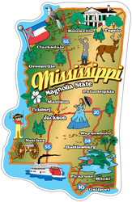
MISSISSIPPI
Vote Project
Youth recruitment
Social Media (Instagram)
Captioning of videos (We could help with this)
Help with technology videos

Slide 56
NORTH CAROLINA
Look for more grants to keep the group together
Foundations and research

Slide 57
OKLAHOMA
Face to Face meetings
Vlogs
Webinars
Distance Training
Keep the focus on youth

Slide 58
SOUTH CAROLINA
Face to face
Webinars
Vlogs
Networking
Regional Meeting
Consider forming an Advisory Board with officers

Slide 59
TENNESSEE
Showcase Vlogs and webinars
Consistent marketing message across national Self Advocacy TA centers
Develop a financial plan for the group

Slide 60

Next OCSS Webinars Advisory Committee Meeting
3:30 p.m. EST
2:30 p.m. CST
Webinar dates | Topic
November 19, 2015 | Youth Leadership Training, Youth Summits and other ways to Engage Youth
December 10, 2015 | Advisory Committee Meeting

Slide 61
Next Face to Face Meeting
March, 2016 or May 2016: Dates to be determined
Possible locations: Mississippi, Arkansas, or Florida

Slide 62
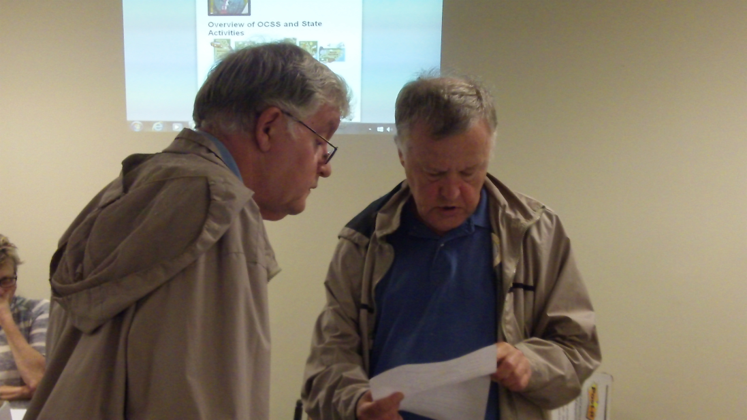
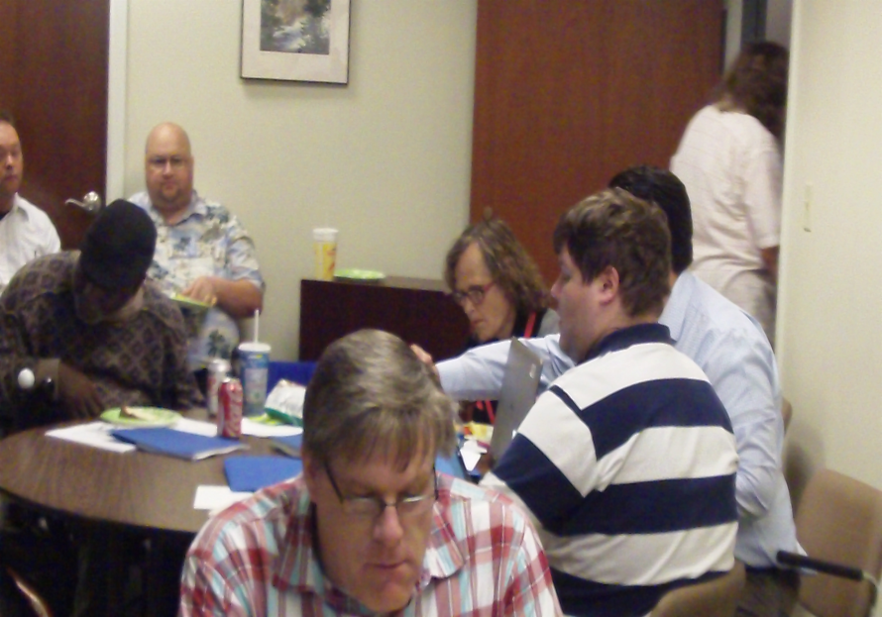
OCSS Hard at Work!
OCSS funded as a Project of National Significance by the Administration on Intellectual and Developmental Disabilities

Slide 63
Participants of Advisory Committee Meeting October 10-11, 2015-Decatur, Georgia
*Denotes Advisory Council Member
Alabama Nikki Dawson* Brittany Gore* George Neal Brenda Doss | Arkansas Eric Treat* by conference call Tom M. Masseau
Florida Arizona Jenkins * | Georgia Bernard Baker* Teresa Coleman* Cheri Mitchell
Mississippi *Cindy Singletary * Johnny Taylor Jerry Alliston | *North Carolina Participating by phone Ellen Perry* by conference call
South Carolina Ebony De Loach * | Oklahoma Nancy Ward Dee Banta
Tennessee Bill Gage * Sam Gage* Carol Rabideau | SABE Chaqueta Stuckey Glenda Hyman Singletary Juliana Huerena Bill Lucero Vicki Hicks Turnage

