Slide 1


Youth Leadership- Youth Summits and Other Ways to Engage Youth
November 19, 2015

Slide 2

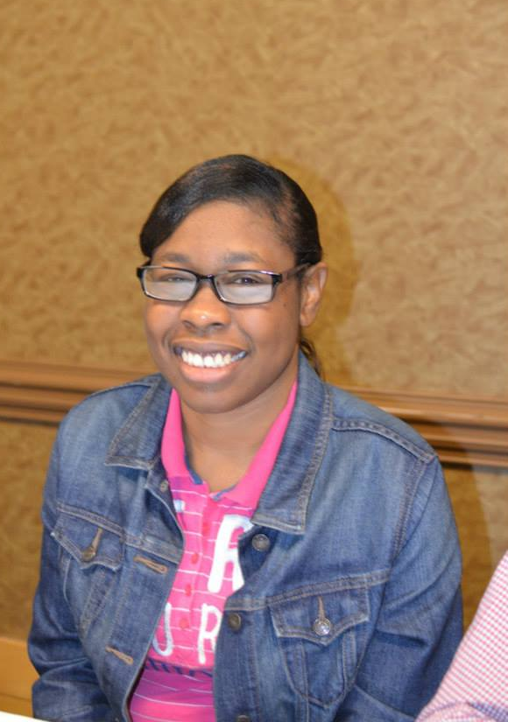

Slide 3
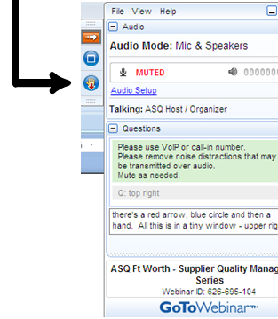

WELCOME
Reminders:
Please mute your device once you join the call
Remember to raise your hands for questions or write a message in text box
We will give everyone a chance to ask questions at the end of the presentation
Notes:
Chaqueta

Slide 4

WELCOME
Reminders:
If you are using more than one device for this webinar, please do not place next to each other, to reduce echoing or feedback.
Make sure your speakers are turned on.
Notes:
Chaqueta

Slide 5

THE PURPOSE OF THIS WEBINAR
Participants will learn about successful strategies for the recruitment and development of youth leaders.

Slide 6
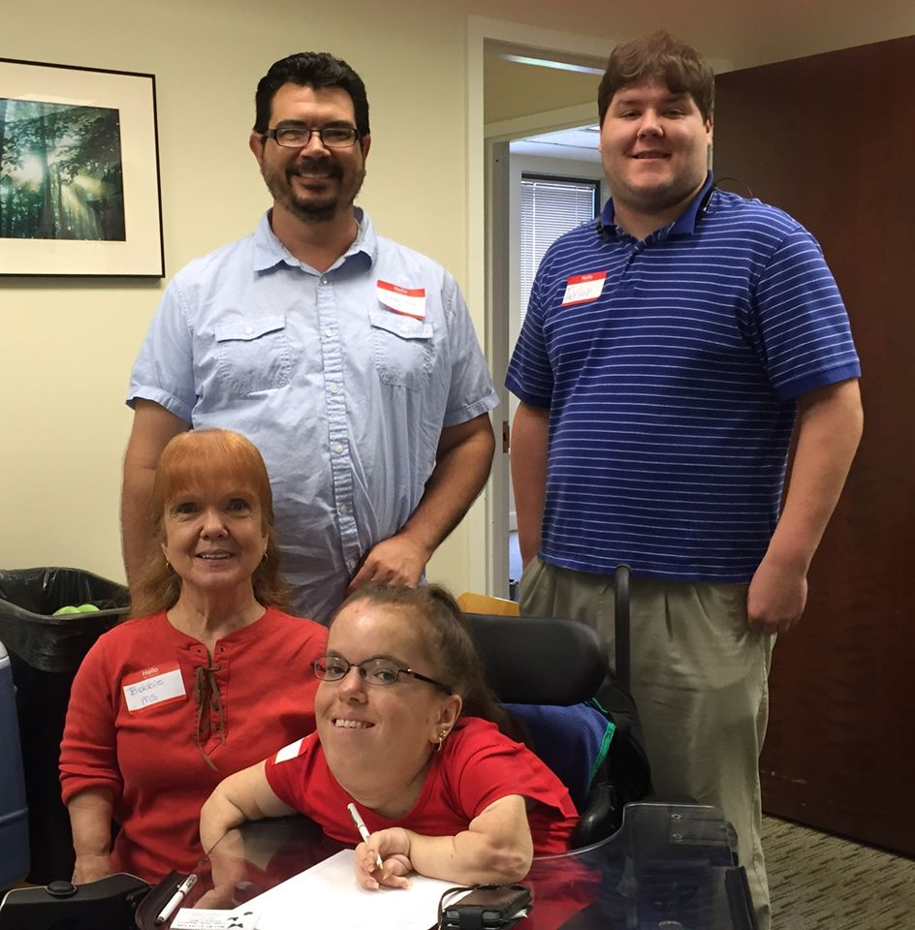
Cynthia “Cindy” Singletary & Taylor Carley

Slide 7

Why are Youth Vital to the Self-Advocacy and Disability Rights Movement?
The two most vital laws of disability rights have been in law for their whole lives.
  Youth need to know the history
  Youth need to know what the steps are to gain more rights and to keep from any progress from being lost

Slide 8

Why are Youth Vital to the Self-Advocacy and Disability Rights Movement?
The movement needs
a fresh perspective.
“This is how we have always done things.”
This saying does not make this style the only and best way. Things change. Embrace the change.
Mentors/”Experienced” advocates can help youth navigate through similar difficult experiences.
The benefits and rights youth with disabilities live with are why you went through the hard times. Sharing experiences allow both perspectives to grow.

Slide 9

Including Youth Takes a Direct Effort
If youth are not already part of the program, they will need to be shown why they need to devote their efforts and time. The question of “What’s in it for me?” must be addressed in outreach.
Long-term goals are always part of our work, but there are short-term benefits that are often taken for granted.

Slide 10

Youth Outreach Styles
Partner with Organizations and Programs
University Center on Excellence and Developmental Disabilities
Centers on Independent Living (CILs)
Parent Training Center (PTI)
ARC
NAACP
Vocational Rehabilitation (VR)
Department of Human Services (DHS)
Schools/Colleges And any others serving youth (not only disability)

Slide 11
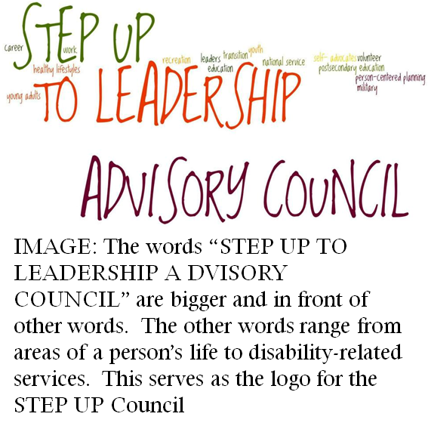
How Mississippi Has Done It
STEP UP Council
Every UCEDD has a Consumer Advisory Council (CAC). We have structured IDS’s to have a youth/young adult sub-committee.
The sub-committee has elected officers including two co-chairs. The Co-Chairs represent the sub-committee as full members of the CAC. STEP UP has a focus of service and fun to keep the youth actively involved.

Slide 12
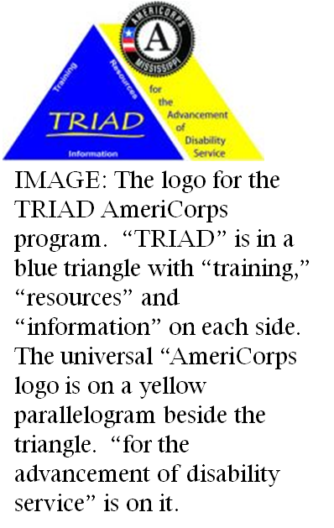
How Mississippi Has Done It
TRIAD AmeriCorps
The UCEDD has had an AmeriCorps volunteer service program that has been geared to young adults inclusively providing a rare opportunity. This program has led to future jobs and education after their service terms.

Slide 13
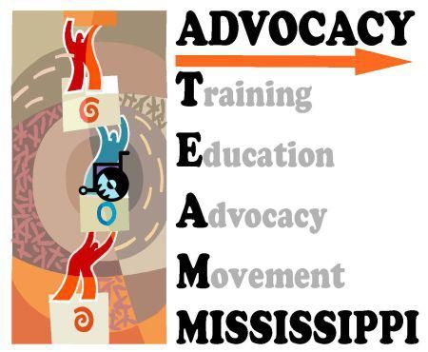
How Mississippi Has Done It
AdvocacyTEAM
Following the 2011 Regional Summits of AIDD, we decided to reinstate the state team of self-advocates with more self-advocates from throughout the state representing multiple disabilities, cultures and ages.
Youth and young adults were a part of this mixture. The Team determined further guidelines including there will be Co-Chairs. One will be an “experienced” advocate. The other will be a youth/young adult. They will both be elected by the Team.
IMAGE: ATEAMM Logo

Slide 14
How Mississippi Has Done It
Youth Summits & Trainings
Regional trainings focused on transition needs. Requires partnership with schools… Additional agency & organization partnerships encouraged.
Multi-faceted…
  Remember learning styles vary
  Young adults & “experienced” advocates lead.
  End with engaging to the other opportunities.
IMAGE: ATEAMM Logo

Slide 15
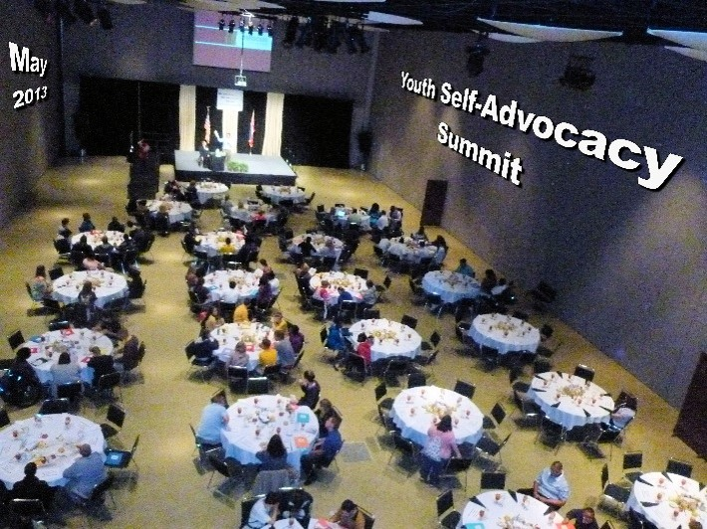
Youth Advocacy Summit

Slide 16
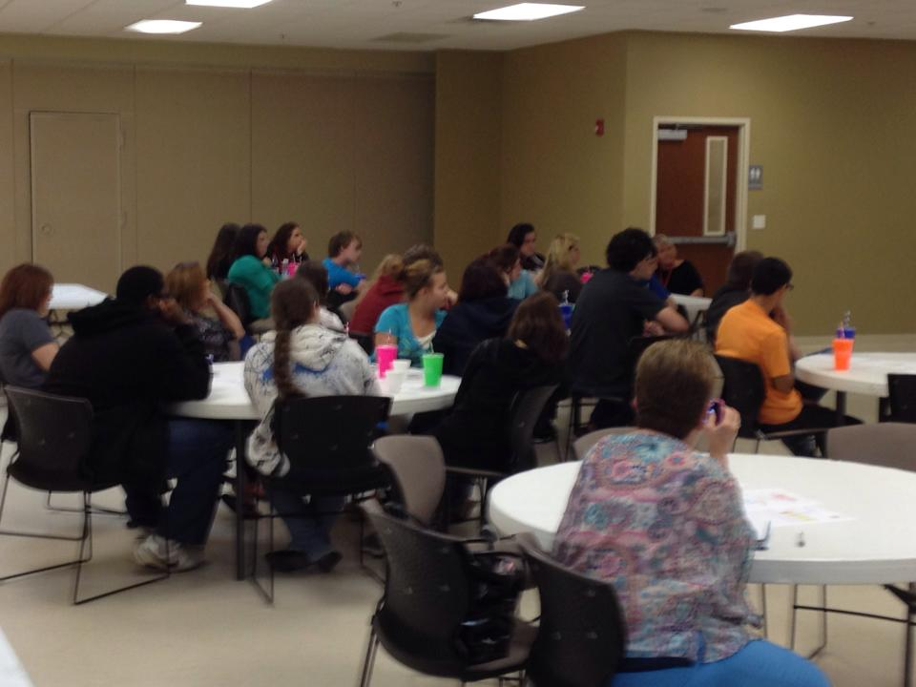

Slide 17
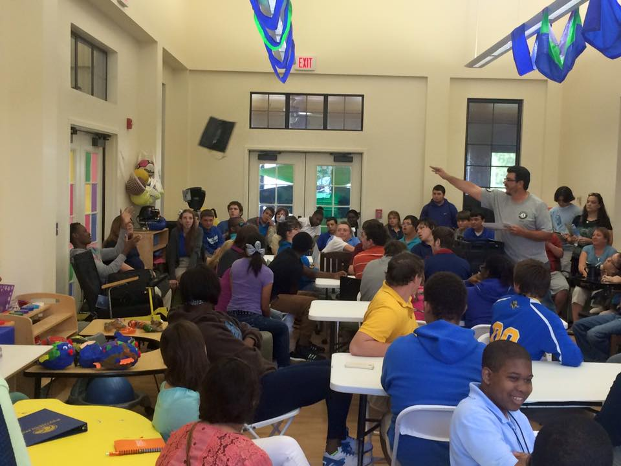

Slide 18

Thank You!!!
Cynthia “Cindy” Singletary
  cynthia.singletary@gmail.com
Taylor Carley
  robert.carley@usm.edu

Slide 19
OCSS STATES QUESTIONS AND ANSWERS

Slide 20

STATE QUESTIONS
What have you done to engage youth in your state?

Slide 21
ALABAMA COMMENTS
Gone to Transition fairs
Attend state sponsored youth forums
Completed YEL training in Oct 2015 (Civil and Human Rights)
Trained youth Ages 16-26
Youth will do 3 community project (Right to marriage and family, disability now and then, multiple training, media education, etiquette and issues)
Went to schools to do 6 trainings and developing relationships with them

Slide 22
ALABAMA CONTINUES
Attend all VR and school system Transition fairs: (Montgomery, Shelby Co, Chilton Co., Greater Birmingham area)
Attend state sponsored Youth Leadership Forum in the summer
Actively seeking partnerships with school systems and vocational rehabilitation counselors
Participate
Attend and present at annual statewide transition conferences

Slide 23
ALABAMA CONTINUES
Work with Children' Rehabilitation Services to perform workshops on leading your own IEPs
Developing relationships with school systems (last summer did a series of 6 workshops with students from Walker Co)
Secured a grant from our state DD council for youth leadership training: developed curriculum focusing on human and civil rights training and community participation.
The Youth Leadership training will be replicated around the state as we are capable.

Slide 24
ALABAMA CONTINUES
Alabama has recently completed trainings for 16 youth ages 16 to 26 years as part of the first cohort of youth leaders and is currently supporting these youth to complete 3 community projects related to disability awareness and human rights: The right to marriage and family/ Disability Now and Then (presentations on ABLE Act, Home and Community Based waivers, employment first, and college programs for youth with disabilities)./ and Media education on disability etiquette and issues.
Go to meeting about new possible IEP procedural code changes to pass flyers out and talk about PF to engage more youth.

Slide 25
ARKANSAS COMMENTS
Working with UCEDD CAC

Slide 26
FLORIDA COMMENTS
We engage youth in our state by going to schools and churches and talking to them about disability rights and the rights that they have as youths. We talk to them about what kinds of accommodations they need as people with disabilities.
We also consult with parents that don't quite know how to deal with their child's disability and help them determine the best avenues by which they can help their children succeed in the real world.

Slide 27
GEORGIA COMMENTS
Get later

Slide 28

MISSISSIPPI COMMENTS
presented

Slide 29
NORTH CAROLINA COMMENTS
Get later

Slide 30
OKLAHOMA COMMENTS
Get later

Slide 31
SOUTH CAROLINA COMMENTS
ABLE SC group in Columbia, SC
Meet monthly, Community Leadership Academy for youth
Peer to peer support, Empower hours meet monthly (healthcare), Ebony talked about relationships
Webinars on youth focused topics
Equip program

Slide 32
TENNESSEE COMMENTS
Get later

Slide 33
DATES TO REMEMBER

Slide 34

DATES and ACTIVITIES TO REMEMBER
  November- Complete OCSS Survey on Plans for 2016
  December 10 Advisory Meeting-GoToMeeting
  December 31 Return W 9
  December 31 (no later than January 19) Submit 1st Quarter Invoice. quarterly Plan update, First Vlog for year

Slide 35

Next OCSS Webinars
3:30 p.m. EST
2:30 p.m. CST
Webinar dates | Topic
January 21, 2016 | Mock Legislature Initiatives
February 18, 2016 | How can our Partners help to sustain our Peer to Peer efforts?
March 17, 2016 | Leadership Training Curriculums

Slide 36

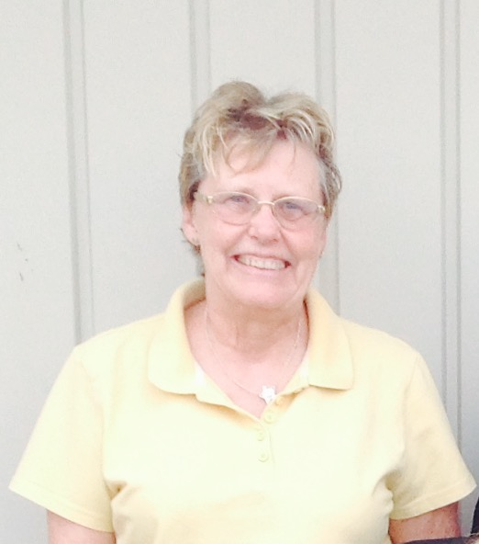
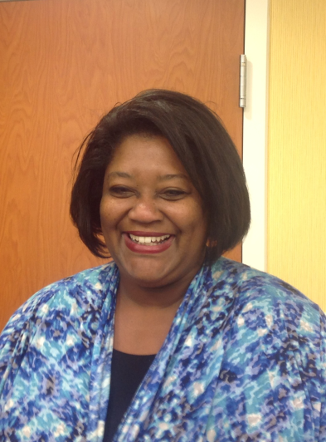
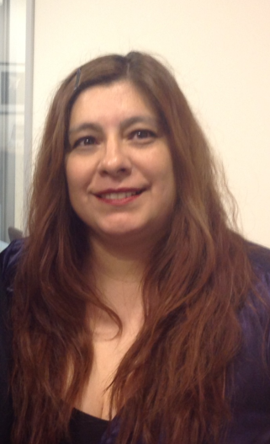
THANK YOU!
Regional Self Advocacy Technical Assistance Center Funded by the Administration on Intellectual and Developmental Disabilities.

