Slide 1


Strategies for Membership Recruitment: Generation What?
Connecting With Students
June 18, 2015

Slide 2

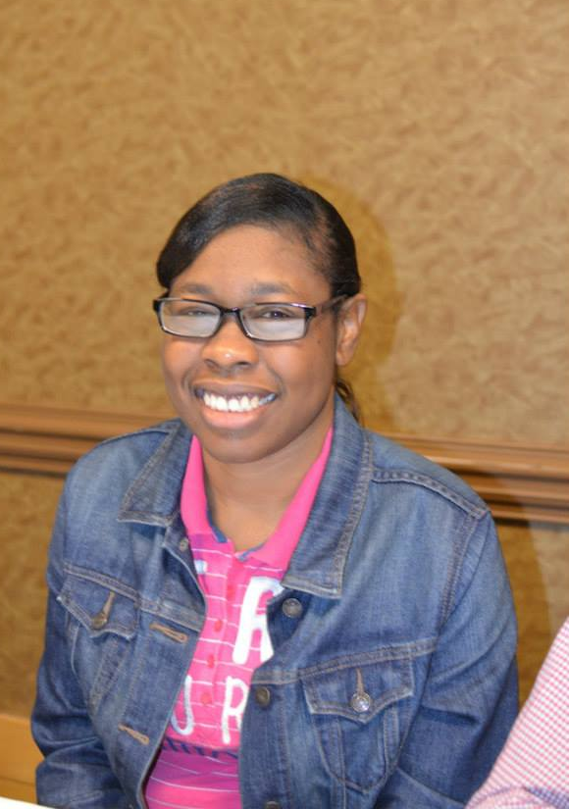

Slide 3
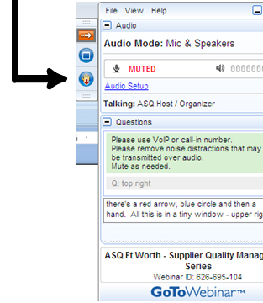

WELCOME
Reminders:
Please mute your device once you join the call
Remember to raise your hands for questions or write a message in text box
We will give everyone a chance to ask questions at the end of the presentation
Notes:
Chaqueta

Slide 4

WELCOME
Reminders:
If you are using more than one device for this webinar, please do not place next to each other, to reduce echoing or feedback.
Make sure your speakers are turned on.
Notes:
Chaqueta

Slide 5

THE PURPOSE OF THIS WEBINAR
Participants will learn about…..
Recruiting members
How to involve youth

Slide 6

POLL QUESTION #1
How many members do you have in your self advocacy group?

Slide 7
POLL QUESTION #2
Do you consider your membership diverse?

Slide 8
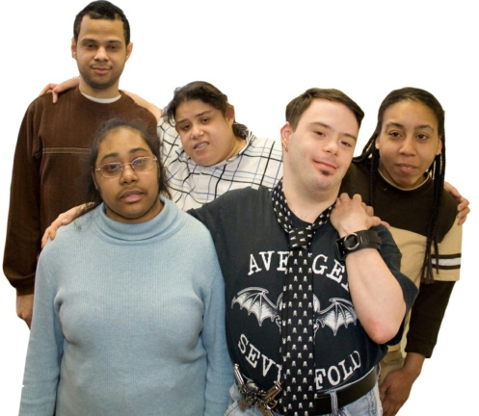
Generation What?
Connecting With Students
Beware of labels!

Slide 9
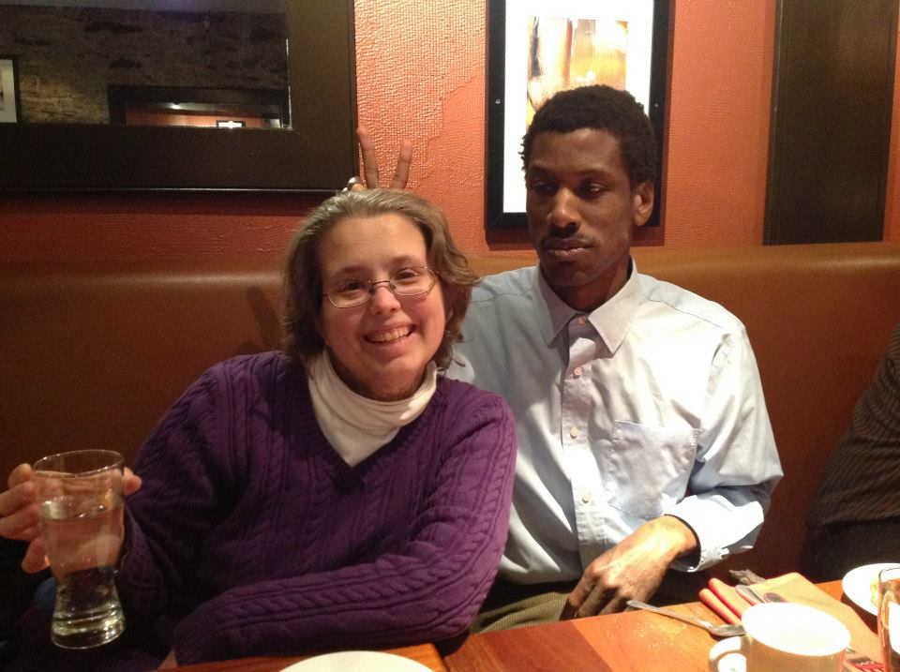
Presenters:
Max Barrows
Nicole LeBlanc
Karen Topper

Slide 10
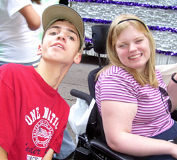
What messages did you hear about young people when you were growing up?

Slide 11

Beware we hear a lot of bad messages about young people.
Those old messages about youth bouncing around in our heads.

Slide 12
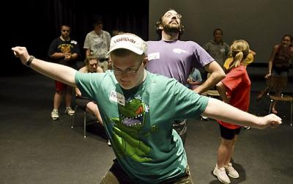
Don’t judge people by their age, consider their experience.
Don’t talk to youth in a way that it sounds like you are talking to a child.
Avoid assuming young people won’t be able to understand something. Instead take the time to explain information to them.

Slide 13
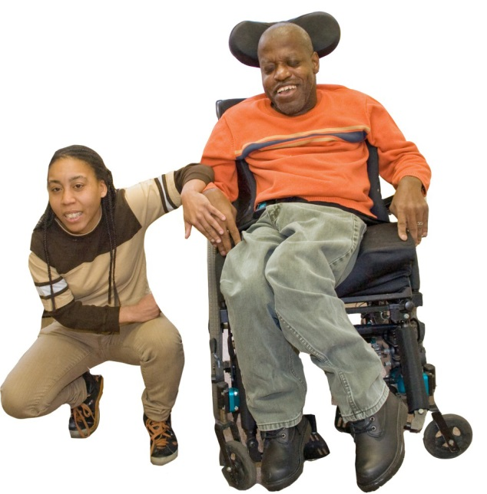
Sometimes adults can be disrespectful of young people.
It’s no one’s fault.

Slide 14
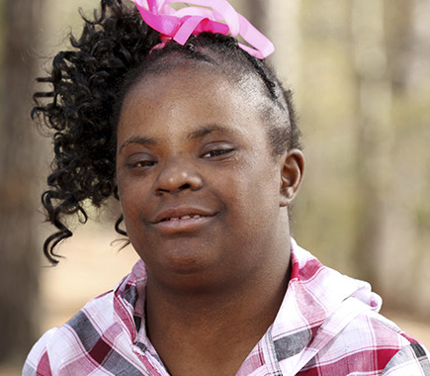
In your group, don’t just ask young people to handle only small or not so important jobs.
Try not to be surprised when young people say something intelligent, when they are dressed nicely, or when they are well organized.

Slide 15
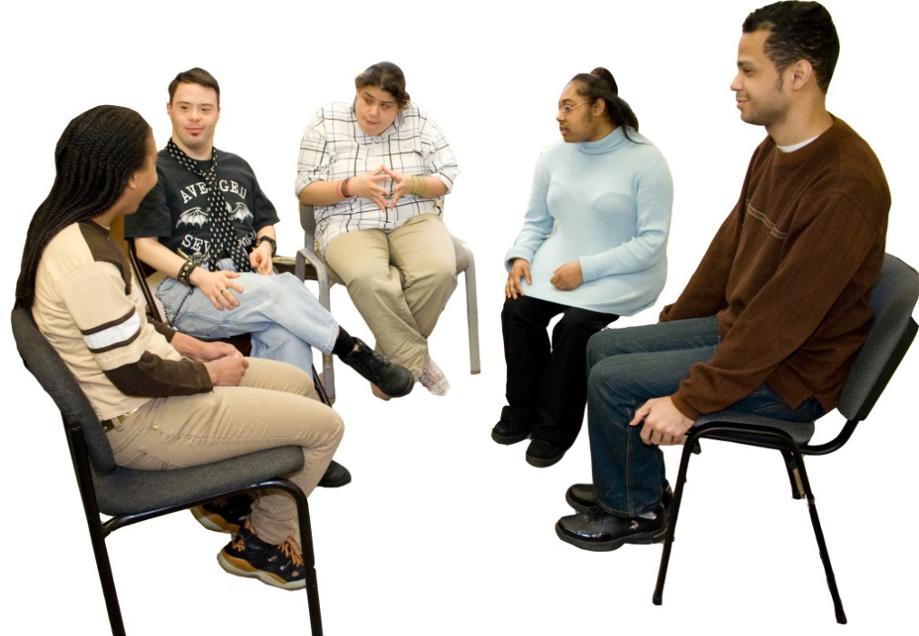
What attracted you to get involved in self-advocacy?

Slide 16
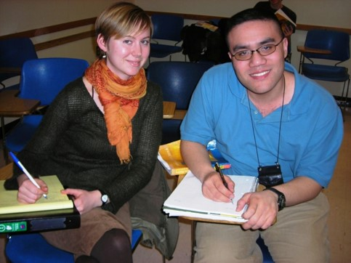
Some tips…
When you meet with students, begin by asking them what they think self-advocacy is.
Ask them what they think when they hear the words “independent living”.
Ask students where they see themselves beyond high school. Keep in mind this maybe a hard question to be asked. Students may not be able to answer this question the first time.

Slide 17
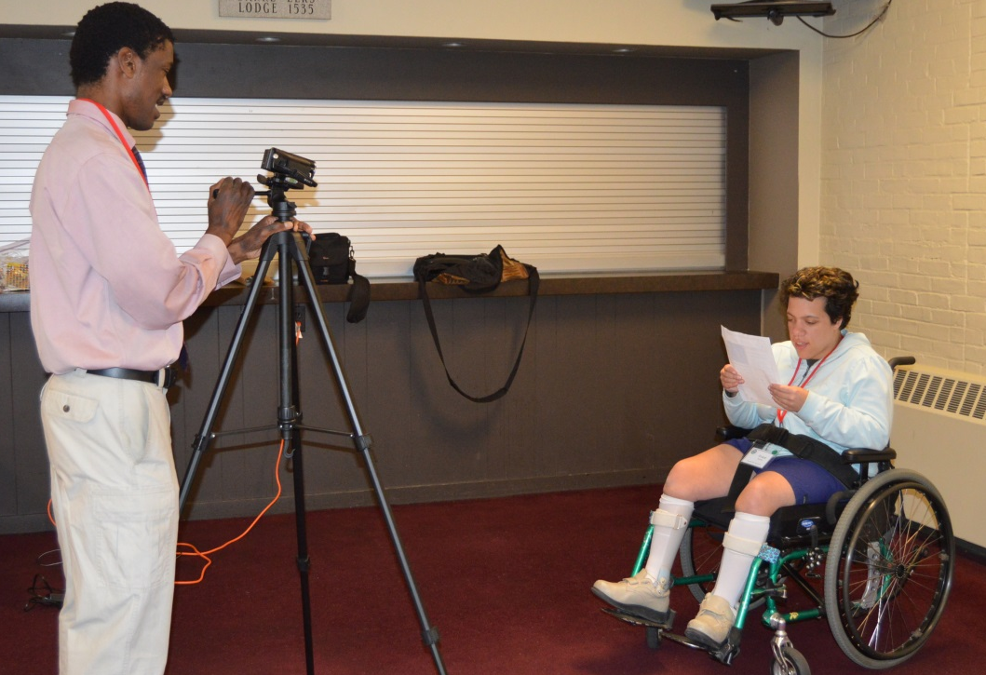
How have you tried to get young people involved?

Slide 18
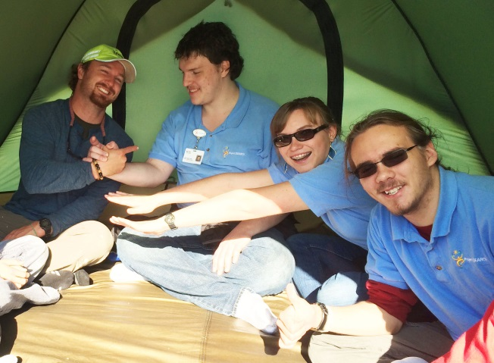
Some tips…
Do not judge students. Tell them their opinions are important. Keep your own opinions to yourself.
Find meaningful ways for youth to get involved.
Remember we are all individuals. When a teen expresses their opinion they are not speaking for everyone under the age of thirty.

Slide 19

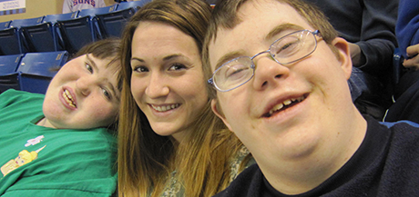
Some tips…
Make the meeting fun with lots of hands on activities.
Sometimes youth are reluctant to speak up when teachers, support staff or parents are in the room.

Slide 20

Give us an example of how you make a meeting fun with lots of hands on activities.

Slide 21

The last tips…
Remember students have busy lives. Respect their choices.
Set up group agreements. They should include reminding seasoned leaders to talk as little as possible.
A disability rights meeting may be new to youth, so remember to take your time and not go too fast.

Slide 22
The last tips…
Be careful not to interrupt a young person. Give them time to share their ideas.
Create an atmosphere that says it is okay to make mistakes. This can be an opportunity to introduce what we call “dignity of risk
Be laid back. Listen. Don’t jump in with an answer.

Slide 23

Tell us a short story from your life that is an example of you speaking up, taking control, making a big decision that was not popular with the people around you?

Slide 24
Many thanks to www.nyln.org for sharing great resources
Free tools http://www.Nyln.Org/resources-3/information-clearinghouse/free-tools/
Get The Word Out Http://www.Nyln.Org/wp-content/uploads/2010/10/getthewordout1.Pdf
Say yes to youth http://www.Nyln.Org/wp-content/uploads/2010/10/yesbookweb.Pdf
Accessibility checklist http://www.nyln.org/resources-3/information-clearinghouse/orc-adult-allies/
Disability Pride Video https://www.youtube.com/watch?v=qEOb7-E-hOs

Slide 25
OCSS STATES QUESTIONS AND ANSWERS

Slide 26

STATE QUESTIONS
How many members do you have under the age of 24? Between the ages of 25-30?
Do you have a youth recruitment plan?
If not, how do you recruit youth?
What other activities do you use to enhance the diversity of your self advocacy group?

Slide 27
ALABAMA COMMENTS
Question | Answer
How many members do you have under the age of 24? Between the ages of 25-30?
Do you have a youth recruitment plan?
If not, how do you recruit youth?
What other activities do you use to enhance the diversity of your self advocacy group?

Slide 28
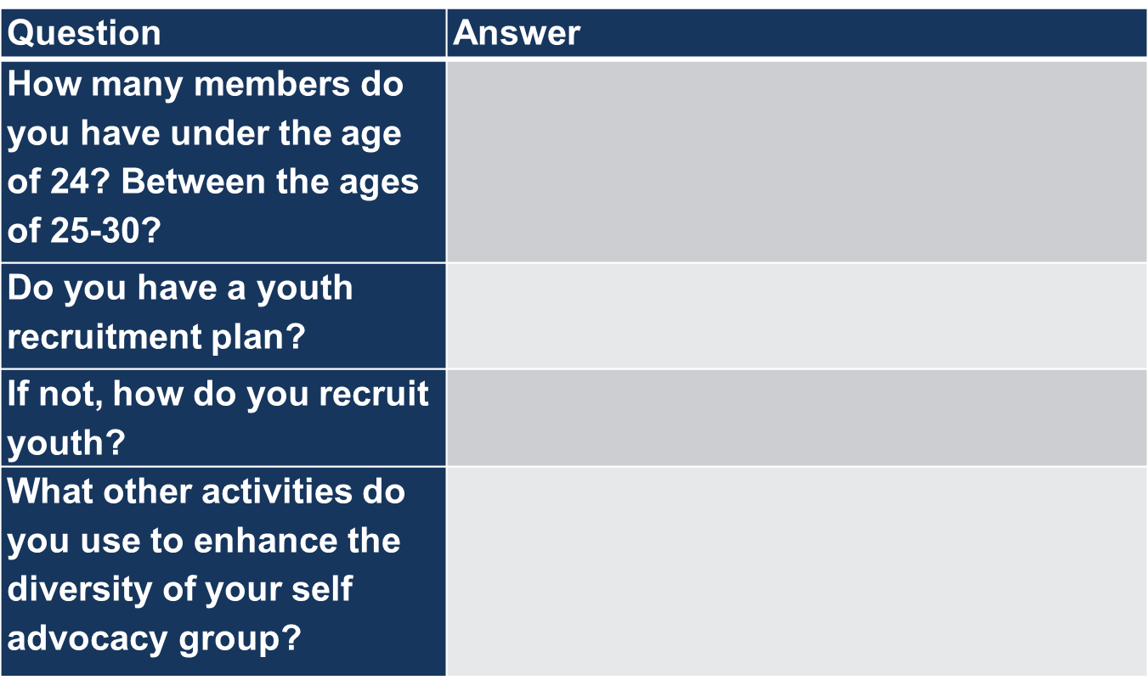
ARKANSAS COMMENTS
Question | Answer
How many members do you have under the age of 24? Between the ages of 25-30?
Do you have a youth recruitment plan?
If not, how do you recruit youth? | presentations at the Junior highs
What other activities do you use to enhance the diversity of your self advocacy group?

Slide 29
FLORIDA COMMENTS
Question | Answer
How many members do you have under the age of 24? Between the ages of 25-30?
Do you have a youth recruitment plan?
If not, how do you recruit youth?
What other activities do you use to enhance the diversity of your self advocacy group?

Slide 30
GEORGIA COMMENTS
Question | Answer
How many members do you have under the age of 24? Between the ages of 25-30? | 75 under 24 250 25-30
Do you have a youth recruitment plan? | no
If not, how do you recruit youth? | building chapter, outreach, have meetings at the community centers
What other activities do you use to enhance the diversity of your self advocacy group? | 2-85 year old w/cross-disability, review what we have

Slide 31
NORTH CAROLINA COMMENTS
Question | Answer
How many members do you have under the age of 24? Between the ages of 25-30?
Do you have a youth recruitment plan?
If not, how do you recruit youth?
What other activities do you use to enhance the diversity of your self advocacy group?

Slide 32
OKLAHOMA COMMENTS

Slide 33
SOUTH CAROLINA COMMENTS
Question | Answer
How many members do you have under the age of 24? Between the ages of 25-30? | no one younger than 24 Only one person is 25-30
Do you have a youth recruitment plan? | DDPC is advertising their leadership program at the schools
If not, how do you recruit youth? | partnering with ABLE and schools about advocacy
What other activities do you use to enhance the diversity of your self advocacy group? | DDPC, IMPACT working on Chaqueta attending Diversity project with Georgetown University-Tawara and will share information she will learn

Slide 34
TENNESSEE COMMENTS
Question | Answer
How many members do you have under the age of 24? Between the ages of 25-30?
Do you have a youth recruitment plan?
If not, how do you recruit youth?
What other activities do you use to enhance the diversity of your self advocacy group?

Slide 35
DATES TO REMEMBER

Slide 36
DATES TO REMEMBER
  July 5 Submit 3nd Quarter Invoice, 2nd Vlog due and quarterly report on progress on Plan
  September 17 Advisory Meeting-GoToMeeting
  September 19 Submit 4th Quarter Invoice quarterly report on Plan

Slide 37

Next OCSS Webinars
3:30 p.m. EST
2:30 p.m. CST
Webinar dates | Topic
July 16, 2015 | Steps in Organizing Around an Issue
August 20, 2015 | Partnerships Outside of the Disability Community
September 2015 | Institutions

Slide 38

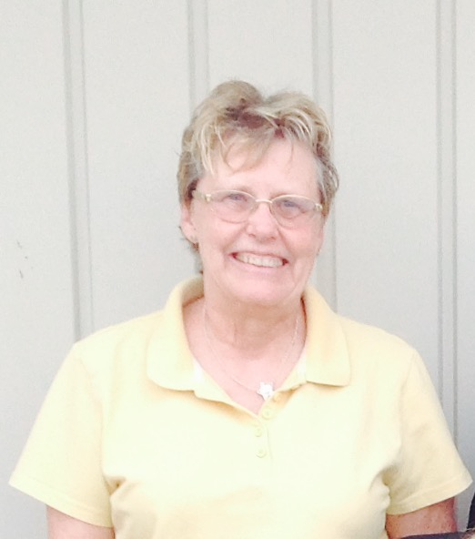
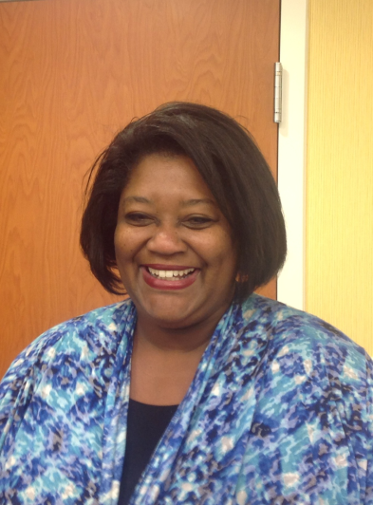
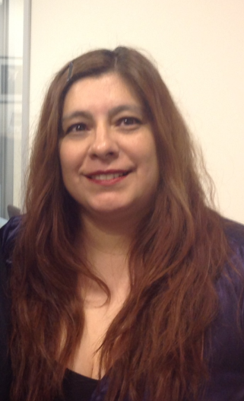
THANK YOU!
Regional Self Advocacy Technical Assistance Center Funded by the Administration on Intellectual and Developmental Disabilities.

