Slide 1


Organizing Around an Issue
July 23, 2015

Slide 2

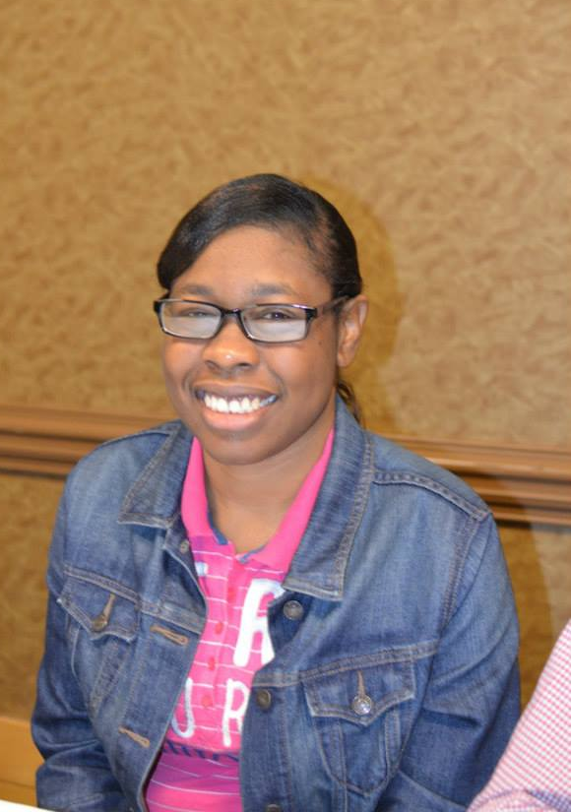

Slide 3
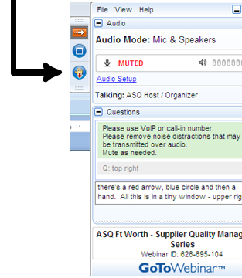

WELCOME
Reminders:
Please mute your device once you join the call
Remember to raise your hands for questions or write a message in text box
We will give everyone a chance to ask questions at the end of the presentation
Notes:
Chaqueta

Slide 4

WELCOME
Reminders:
If you are using more than one device for this webinar, please do not place next to each other, to reduce echoing or feedback.
Make sure your speakers are turned on.
Notes:
Chaqueta

Slide 5

THE PURPOSE OF THIS WEBINAR
Participants will learn about…..
Strategies for organizing around issues of importance to members of your organization

Slide 6

POLL QUESTION #1
Has your self advocacy group or board had any grassroots organizing training before?

Slide 7
POLL QUESTION #2
If so, did it make our group more effective when working on issues?

Slide 8
Grassroots Organizing
By Cheri Mitchell

Slide 9

WHAT IS GRASSROOTS ORGANIZING?
          Grassroots organizing involves people working together to arrange an event or accomplish a common goal.
          Example :
          The Long Road Home is a highly successful grassroots effort of People First of Georgia. The Georgia Advocacy Office supports
          People First in this effort.

Slide 10
HOW DO YOU INVOLVE OTHERS?
It starts with having something that people care about and are passionate about
Networking and being Welcoming
Being Organized
Flexibility
Having do-able goals

Slide 11
WHAT IS A DO-ABLE GOAL?
A do-able goal is one that you feel you can accomplish.
Remember, the reason people get involved in grassroots organizing is to make a difference!
You have to have goals that you can accomplish for your grassroots organizing to be successful.

Slide 12
CONTACT INFORMATION
Cheri Mitchell
Georgia Advocacy Office
150 East Ponce de Leon Avenue, Suite 430
Decatur, Georgia 30030
Office: (404) 885-1234
Cell: (404) 849-8209 * best number to call
Email: cherimitchellg@gmail.com or cmitchell@thegao.org

Slide 13
SUPPORTING SELF ADVOCATES

Slide 14

ADVOCATING
All organizing must be supported by the groups purpose and mission

Slide 15


ADVOCATING
The group also need to be able to advocate when something threatens self advocate’s lives

Slide 16

ADVOCATING
Sometimes it is hard for self advocates to react quickly on their own

Slide 17

ADVOCATING
Self advocates need supports from allies to make sure they understand

Slide 18

ADVOCATING
Allies will need to help and know what advocacy means to the individual

Slide 19

IF NOTHING HAPPENS
It may be because it is overwhelming
Individuals may not understand
Not connecting to the right supports or allies

Slide 20


Slide 21
OCSS STATES QUESTIONS AND ANSWERS

Slide 22

STATE QUESTIONS
What statewide ISSUES has your state worked on in the past?
What type of STRATEGIES and TECHNIQUES have you used when organizing around an issue?
Were you working by yourselves or with supports? If so with supports, WHO?
What are the current HOT topics your self advocacy group wants to work on?

Slide 23

HOT TOPICS
Self advocacy funding
The word “Self advocate”
SSDI
Employment
Minimum wage
Transportation
Marriage Penalty for people with disabilities (SSI, SS)
Institutions

Slide 24
ALABAMA COMMENTS

Slide 25
ARKANSAS COMMENTS

Slide 26
FLORIDA COMMENTS

Slide 27
GEORGIA COMMENTS

Slide 28
NORTH CAROLINA COMMENTS

Slide 29
OKLAHOMA COMMENTS

Slide 30
SOUTH CAROLINA COMMENTS

Slide 31
TENNESSEE COMMENTS

Slide 32
DATES TO REMEMBER

Slide 33

DATES TO REMEMBER
  September 17 Advisory Meeting-GoToMeeting
  September 19 Submit 4th Quarter Invoice quarterly report on Plan
  October 10-11 Face to Face Meeting Decatur, Georgia: Topic: Sustaining our Regional TA Center: Developing our strategic Plan
  Our Hotel is the Courtyard Marriott. Meetings to be held at the Georgia Advocacy Office in Decatur. Arrive by 2:00 on Saturday October 10th. Meeting begins at 3:00. We will finish by 3:00 on Sunday October 11th.

Slide 34

Next OCSS Webinars
3:30 p.m. EST
2:30 p.m. CST
Webinar dates | Topic
August 20, 2015 | Partnerships Outside of the Disability Community
September 3, 2015 | Institutions

Slide 35

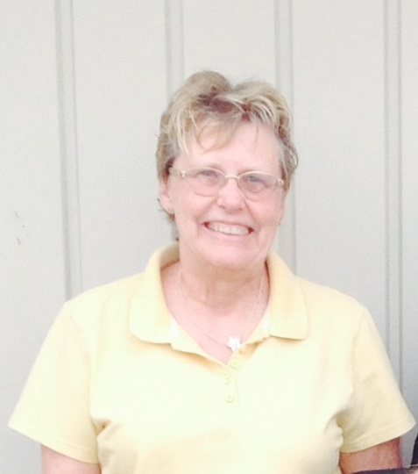
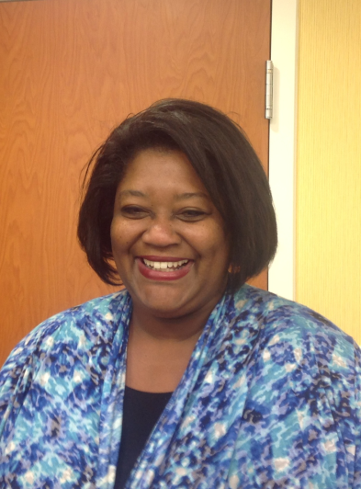
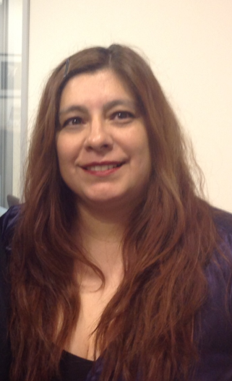
THANK YOU!
Regional Self Advocacy Technical Assistance Center Funded by the Administration on Intellectual and Developmental Disabilities.

