Slide 1


Long Road Home and Olmstead: How do we Expand our Efforts Beyond Institutions and Nursing Homes?
January 21, 2016

Slide 2

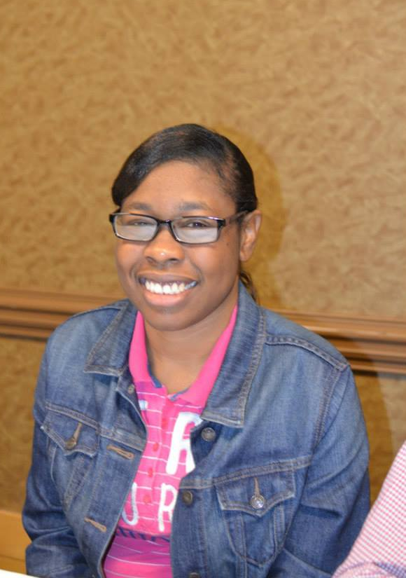

Slide 3
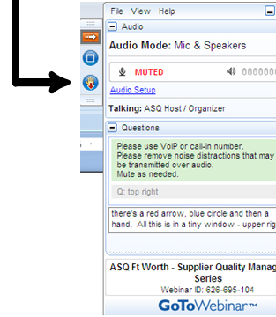

WELCOME
Reminders:
Please mute your device once you join the call
Remember to raise your hands for questions or write a message in text box
We will give everyone a chance to ask questions at the end of the presentation
Notes:
Chaqueta

Slide 4

WELCOME
Reminders:
If you are using more than one device for this webinar, please do not place next to each other, to reduce echoing or feedback.
Make sure your speakers are turned on.
Notes:
Chaqueta

Slide 5

THE PURPOSE OF THIS WEBINAR
Participants will learn about expanding long road home to address other segregated settings such as group homes, sheltered workshops, and family homes.

Slide 6

Co-Presented by People First of Georgia
Supported by The Georgia Advocacy Office
Cheri Mitchell

Slide 7

LONG ROAD HOME
The Olmstead
Decision

Slide 8

Olmstead Decision History
It all started with Two ladies who wanted to live in the community instead of an institution. Lois Curtis and Elaine Wilson, who had mental illness and developmental disabilities, and were voluntarily admitted to the psychiatric unit in the State-run Georgia Regional Hospital.
Following the women's medical treatment there, Lois and Elaine was ready to move into the community. However, the women remained confined in the institution, each for several years after the initial treatment was concluded. They filed suit under the Americans with Disabilities Act (ADA) for release from the hospital.

Slide 9
Olmstead Decision History
Sue Jamieson, who was an attorney at the Atlanta Legal Aid Society, filed a lawsuit on behalf of Lois (and then later added Elaine) for supports to be provided in the community.
The lawsuit, which is known as “the Olmstead decision,” ended up going to the highest court in the country, the United States Supreme Court. The name Olmstead comes from the name of the Defendant in the case, Tommy Olmstead, who was the Commissioner of the Georgia Department of Human Resources.

Slide 10

Olmstead Decision History
The Supreme Court agreed with Lois and Elaine. The Court found that under the Americans with Disabilities Act, also known as “the ADA,” it is against the law for the state to discriminate against a person based on his or her disability.
The Court said that the state discriminated against Lois and Elaine by requiring them to live in a mental health hospital. It should have instead provided services for them in the community. By confining them in the hospital, the state was segregating them by requiring them to live with others with disabilities.
The Court said that people with disabilities like Lois and Elaine have the right to receive the treatment they needed in an integrated setting if that is what they want

Slide 11
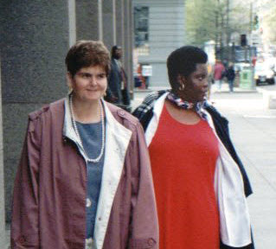
Olmstead Decision History
In 1999, the Supreme Court decided in Olmstead v. L.C. that people with disabilities have the right to live in the “most integrated setting,” meaning the community.
Even with the support of the Supreme Court, many people with disabilities are still trapped in segregated settings like institutions and nursing facilities.

Slide 12
Olmstead Decision
Olmstead Decision
“most integrated setting,”
meaning Living in the community.

Slide 13
LONG ROAD HOME History
Now, every year across the country, the disability community comes together to host Long Road Home events to raise awareness. Long Road Home was the brainchild of Kate Gainer, who, with People First of Atlanta, started Long Road Home in 2004.
Long Road Home events are an opportunity to have crucial conversations about whether your state is “Olmstead compliant” and to build real collaborations within the disability community. It's simple: Long Road Home is a civil rights movement. People should not be locked away or segregated because they have a disability.

Slide 14

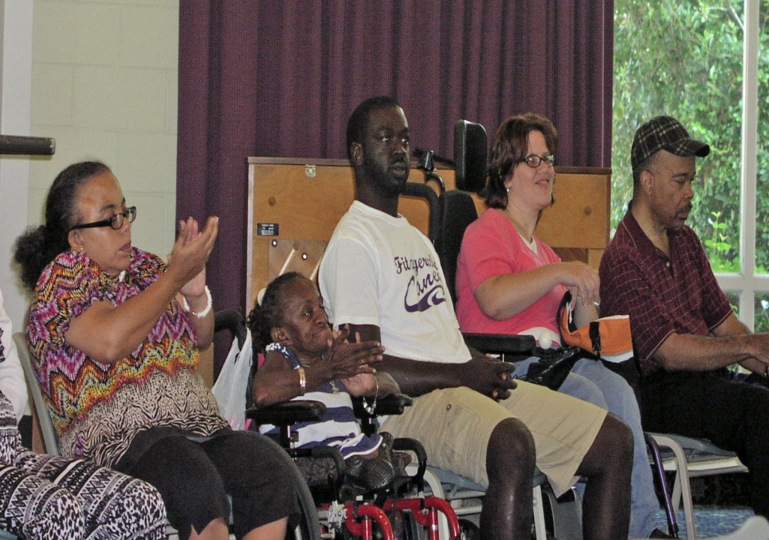
LONG ROAD HOME

Slide 15
What is Long Road Home and why is it important?

Slide 16
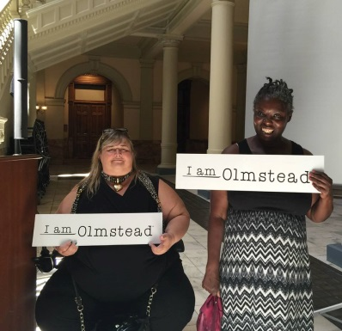
LONG ROAD HOME
Long Road Home is a celebration of Disability Civil Rights.
It is to celebrate the Olmstead Decision, which says that people with disabilities have the right to receive services in the “most integrated setting,” meaning the community. This event is to raise community awareness about that right.

Slide 17
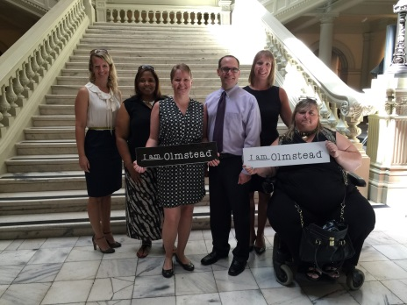
LONG ROAD HOME
In Georgia we collaborate with many organizations to do our Long Road Home events
The Georgia Advocacy Office (GAO), the Protection and Advocacy system for Georgia
Atlanta Legal Aid Society (ALAS)
Georgia Council on Developmental Disabilities (GCDD)
Center for Leadership in Disability at Georgia State University (CLD)The National Federation of the Blind of Georgia (NFO of GA)Georgia Mental Health Consumer Network (GMHCN)

Slide 18

LONG ROAD HOME
We have partnered with businesses and churches, too
We will partner with anyone who supports people with disabilities to live in the community

Slide 19
What is a Long Road Home event?

Slide 20
LONG ROAD HOME
Long Road Home events can take many forms.
Some past events have included rallies at State Capitol buildings, marches, public forums, and lunch-and-learns.
Your event can take any shape, but remember that the goal is to bring attention to what the Olmstead Decision is and the fact that there are people with disabilities waiting to be free to have good lives: Real Lives, Real Homes, Real Jobs, Real Education, and Real Votes!

Slide 21
LONG ROAD HOME
We encourage all events to include two things:
I am Olmstead Freedom stories. Freedom stories are told by and about people who have moved out of nursing facilities and institutions and are now living successfully and happily in their community.
Voter registration and voter education. We have a Long Road Home voter flyer you can print and use.

Slide 22
How to Organize a Long Road Home event

Slide 23
LONG ROAD HOME
Arrange a committee and pick a chairperson. The local chairperson will need to contact the national chairperson, Cheri Mitchell, and let her know you will be participating. The national chairperson is available to any group that is interested in more information or needs assistance in planning an event.
Set a planning meeting date once a month so everyone can get it on their calendar.
Discuss what type of event you want to have: a march, a rally at the State Capitol, a lunch-and-learn, or something totally new? It is up to you!
Decide where the best place is to host the event. Keep accessibility in mind.

Slide 24
LONG ROAD HOME
Decide when you want to hold your event. We suggest this should happen in June, but it is up to you. June is the anniversary of the Olmstead Decision. You may even want to have more than one event.
Make a to-do list. At the end of each meeting, list what needs to be done and who is doing it.
Turn in your Long Road Home information to the national chairperson for it to be posted on the Long Road Home website no later than May 30 of every year.

Slide 25
Example Agenda for your event

Slide 26
LONG ROAD HOME
Welcome by Cheri Mitchell
What is Olmstead? presented by Lois Curtis
Olmstead Now by Tally Wells
Freedom Story by Yaz Abdula
Children’s Freedom Initiative by Katie Chandler
The Future of Olmstead by Ruby Moore
Open Mike for Freedom Stories
Close by Bernard Baker, President of PF of GA

Slide 27
LONG ROAD HOME
Long Road Home website: www.peoplefirstofga.com
  Click on Long Road Home
  I am Olmstead website: http://www.olmsteadrights.org/iamolmstead/

Slide 28
LONG ROAD HOME
  Contact National Chairperson
  Cheri Mitchell
  150 East Ponce de Leon Ave., Suite 430
  Decatur, GA 30030
  cherimitchellg@gmail.com or cmitchell@thegao.org
  (404)885-1234, (800)537-2329, or (404) 849-8209

Slide 29
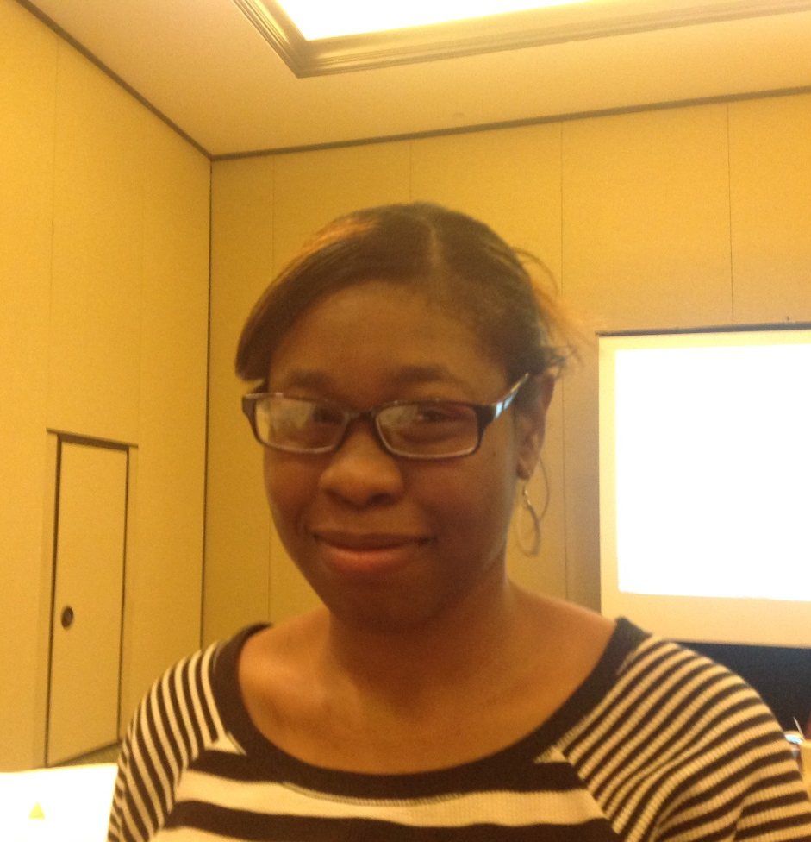
Co-Presented by
Chaqueta Stuckey

Slide 30

Expanding
Long
Road
Home
Why is it important?

Slide 31
Examples of Settings that Isolate People from Freedom
Sheltered Workshop
SCHOOLS
Group Homes
HOSPITALIZATIONS
PARKS
Living at home w/Relatives/Parents

Slide 32
What can we Do?
Allow voices to be heard, Speak up!
Take Action
Continue to collaborate (Events)
Share Stories
Take Risk

Slide 33
Promote the FAB Life
CHOOSE
Freedom over SECLUSION
Accomplishments over STRESSORS
Believe over FAILURE

Slide 34
OCSS STATES QUESTIONS AND ANSWERS

Slide 35

STATE QUESTIONS
Have you sponsored a long road home in your state?
How could you expand beyond institutions and nursing homes to other segregated settings?

Slide 36
ALABAMA COMMENTS
Events to closing institutions
Working with the Department of Mental Health on nursing homes, going to meetings to talk about group rules, there are institutionalized rules (CMS) for all group homes
Do what’s right, if you have lived in one
Employment First and getting out of segregated or least restrictive settings
ADA celebration event
YEL training (Olmstead and Long Road Home)

Slide 37
ARKANSAS COMMENTS
Has a lot of institutions and working on the issue
Restraint report from the DD centers to make improvements
Sheltered workshop are on our radar
Monitoring HCBS and working on the state plan and improving services
Has done Long Road Home in the past

Slide 38
FLORIDA COMMENTS
Did not participate in call

Slide 39
GEORGIA COMMENTS
Putting a museum exhibit together
Displayed artwork

Slide 40

MISSISSIPPI COMMENTS
Settlement Act to get people out of institutions
Bridge to Independence program to get people out of nursing homes and get providers and get access to community living
Employment First (Act) competitive with services, working on closing workshops
Hearing about seclusion and restraints (working on)
Workforce Act working with VR and Dept of Ed and self advocates to get young people to have an awesome life after high school, meeting next month
PTI work with the UCEDD and our youth group on summits where they learn about disability history and how to access services to live independently

Slide 41
NORTH CAROLINA COMMENTS
Have done events in the past

Slide 42
OKLAHOMA COMMENTS
At the conference, developed a strategic plan because OK become a new state to be institution free
The plan shows how OK is going to help people move into their ow communities
Made a commitment to do Long road Home this year

Slide 43
SOUTH CAROLINA COMMENTS
Self advocates are part of Person Center work with HS Providers (CB waiver)
Has not done a Long Road Home event
Will talk with the group to create an event
And develop a PP to present to advisory Council in February
Talked to Georgia about participating

Slide 44
TENNESSEE COMMENTS
Has not hosted an event
Working on closing institutions
Works Project
Educate to Advocate
Disability on the Hill
Clover bottom closing ceremony in Arlington
5 post secondary programs (2 years)

Slide 45
DATES TO REMEMBER

Slide 46

DATES and ACTIVITIES TO REMEMBER
  February 18 Advisory Meeting-GoToMeeting
  January 2016 Submit 1st Quarter Invoice quarterly Plan update, First Vlog for year, if you have not done so

Slide 47

Next OCSS Webinars
3:30 p.m. EST
2:30 p.m. CST
Webinar dates | Topic
March 17, 2016 | How can our Partners help to sustain our Peer to Peer efforts?
April 21, 2016 | Leadership Training Curriculums

Slide 48

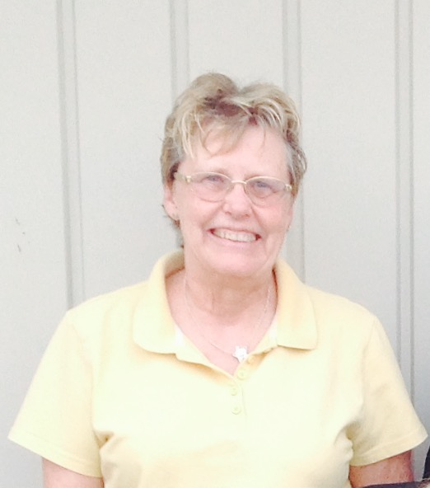
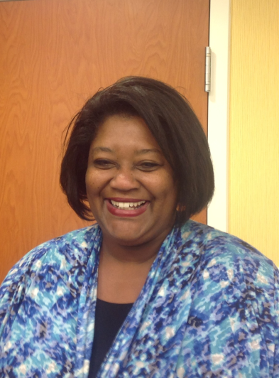
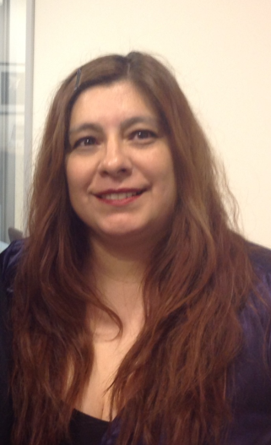
THANK YOU!
Regional Self Advocacy Technical Assistance Center Funded by the Administration on Intellectual and Developmental Disabilities.

