Slide 1
How Can Our Partners Help to Sustain Peer to Peer Efforts?
March 17, 2016

Slide 2
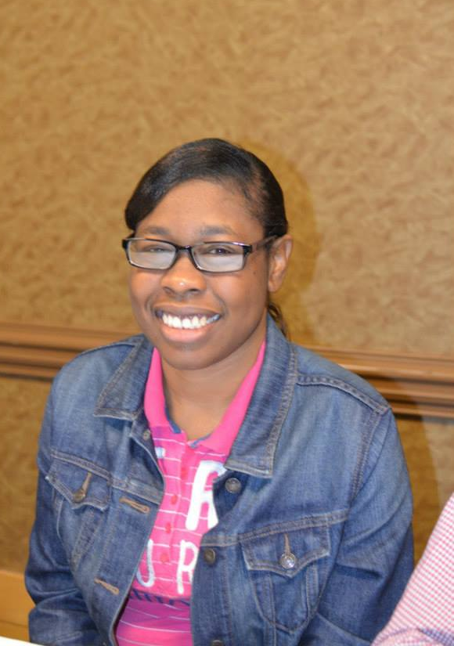

Slide 3
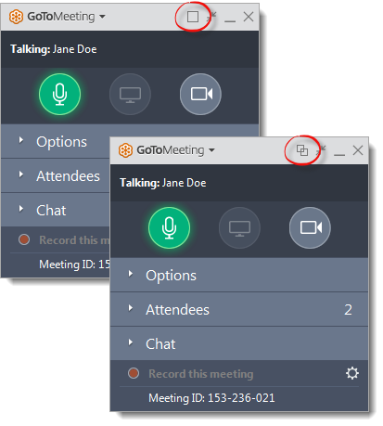
WELCOME
Reminders:
Please mute your device once you join the call
If you have a question, write a message in the chat box
We will give everyone a chance to ask questions throughout the meeting and at the end of the presentation
Notes:
Nancy

Slide 4
WELCOME
Reminders:
If you are using more than one device for this meeting, please do not place next to each other, to reduce echoing or feedback
Make sure your speakers are turned on
Notes:
Nancy

Slide 5
Our Panelists
Chaqueta Stuckey, Co-Director OCSS
Vicki Hicks Turnage, Co-Director
Glenda Singletary, Support
Juliana Huereña, Technology Support

Slide 6
Notes:
Chaqueta:
We have been discussing what we want to sustain from Our Community Standing Strong Regional Self advocacy Technical Assistance Center. Today we are going to give our partners and self advocacy organizations specific examples of what we will need to do to sustain our peer to peer efforts. I will review what we discussed in our February Advisory Meeting

Slide 7
What do we want to sustain?
Maintain our Peer to Peer Technical Assistance
Share our stories of strategies and successes
Connect with youth
Recruit new members
Build partnerships
Obtain funding
States participating in Employment First
Organize around our issues
Build and strength our organizations
Notes:
Chaqueta

Slide 8
How and Who will do this???
How?
Who will do this?
Social media-Instagram, Twitter, Facebook, website, vlogs, blogs, webinars, listserv
Increase accessibility of our message through close captioning, screen reader accessibility
Regional meetings, face to face connections
Host a national conference (2018)
PF of Georgia (Cheri) volunteered to set up listserv
Mississippi Self Advocacy Team and UCEDD volunteered to help with webinars and conference calls
Florida, Alabama, North Carolina and Georgia indicated that they may be interested in the 2018 National SABE Conference
Perhaps a regional effort to organize the conference and or a regional would be possible
Notes:
Chaqueta
After you review this slide, tell the audience that Vicki will review the costs for these activities

Slide 9
How much will it cost to sustain our efforts?
Coordination costs: $35,000
Webinars and conference calls: $5,000
Travel for face to face for lodging $10,000
Food for meetings: $2,500 (donated by states)
State efforts- Vlogs, Needs Assessments: $40,000
Notes:
Vicki

Slide 10
How much will it cost to sustain our efforts?
Regional Projects: $7,500
Hotel for 1 1/2 day Regional Meeting for 60 participants: $25,000
National Conference: $500,000 Minimum
Total Cost: $100,000*- $575,000*
Notes:
Vicki

Slide 11
Where could we get the money?
Share activities to each state supports, regional meetings, voting, technology, youth issues, recruitment, and projects
Grants, Mitsubishi Electric Youth Leadership 1st due June 1, create a committee to write proposal, TN, ASAN have applied in the past $10,000-$75,000
DD Partners
AIDD PNS Projects of National Significant

Slide 12
Where could we get the money?
Regional meeting, share information about state activities
SABE Voter Project, all states could be involved
Foundations
Committee to look at hosting a SABE National Conference
Connect with a celebrity who as a child and works on a community project

Slide 13
How can our Partners Help?
Notes:
Chaqueta:
We have been discussing what we want to sustain from Our Community Standing Strong Regional Self advocacy Technical Assistance Center. Today we are going to give our partners and self advocacy organizations specific examples of what we will need to do to sustain our peer to peer efforts. I will review what we discussed in our February Advisory Meeting

Slide 14
Developmental Disabilities Council | What Activities:
Add OCSS/SABE activities as funding priorities in their 5 year plan | Support with funding for coordination of a Regional Peer to Peer Technical Assistance Center through SABE or another OCSS participating state: Amount per state $10,000.00

Slide 15
Developmental Disabilities Council | What Activities
Add OCSS/SABE activities as funding priorities in their 5 year plan | Support self advocates and their supporters to participate on Advisory Board of the Regional Center and to participate in regional meetings and regional and national conferences with their peers as leaders, participants and instructors

Slide 16
Developmental Disabilities Council | What Activities:
Add OCSS/SABE activities as funding priorities in their 5 year plan | Support self advocates from their state to participate in Regional Self Advocacy Leadership Training Institute for Youth and New Leaders

Slide 17
Developmental Disabilities Council | What Activities:
Add OCSS activities as funding priorities in their 5 year plan | Support the development of expertise of self advocates in the production of vlogs, blogs, and webinars that tell their personal stories about the power of self advocacy and address their issues

Slide 18
Developmental Disabilities Council | What Activities
Add OCSS/SABE activities as funding priorities in their 5 year plan | Support with funding the Collaboration of OCSS states to sponsor the 2018 National SABE Conference: $10,000 per state

Slide 19
Questions and Comments

Slide 20
Protection and Advocacy Organizations | What Activities:
Add support of regional peer to peer self advocacy (OCSS/SABE) as priority for P&A | Work on Vote Project with their state self advocacy groups Work on Employment initiatives with state self advocacy groups

Slide 21
Protection and Advocacy Organizations | What Activities
Add support of regional peer to peer self advocacy as priority for P&A | Work with Self Advocacy groups on closing institutions Work with State Groups on legislative initiatives Provide technical support with technology, listserv and media relations

Slide 22
Questions and Comments

Slide 23
UCEDD | What Activities
Add OCSS/SABE regional peer to peer activities as priorities in their strategic planning | Provide support to self advocates and their organization in learning to use social media technology and securing access to technology resources Provide a resource to serve on a committee to write a grant for a Youth Leadership Academy and submit to Mitsubishi

Slide 24
Questions and Comments

Slide 25
State Self Advocacy Organizations | What Activities
Participate on Advisory Board for Regional Center Support the Regional Peer to Peer efforts through involvement in governance and management of center | Appoint 2 self advocates to continue work on Advisory Committee/Board of the center Provide a staff person to coordinate activities of the center State group manage finances for the center

Slide 26
State Self Advocacy Organizations | What Activities
Participate on Advisory Board for Regional Center Support the Regional Peer to Peer efforts through involvement in governance and management of center | Meet with their DD Council representatives regarding including regional technical assistance in their plan and make request for a commitment of $10,000 per state for the center for basis operations.

Slide 27
State Self Advocacy Organizations | What Activities
Participate on Advisory Board for Regional Center Support the Regional Peer to Peer efforts through involvement in governance and management of center | Talk with their UCEDD about choosing a representative to assist with writing a grant for a regional youth leadership Training Academy Talk with P&A to work on specific issues such as voting, employment, closing institutions and legislative initiatives

Slide 28
State Self Advocacy Organizations | What Activities
Participate on Advisory Board for Regional Center Support the Regional Peer to Peer efforts through involvement in governance and management of center | Agree to collaborate and or host with the Regional Center and the SABE 2018 National Conference

Slide 29
State Self Advocacy Organizations | What Activities
Support the Regional Peer to Peer efforts through management of technical assistance to state self advocacy groups in governance and management of center | Continue to coordinate the center Manage the finances of center Provide technical assistance on an ongoing basis or as needed depending on the development of the center

Slide 30
SABE | What Activities
Support the Regional Peer to Peer efforts through management of technical assistance to state self advocacy groups in governance and management of center | SABE could market Regional Center through social media Assist the Regional Center in the sponsorship of the SABE 2018 National Conference

Slide 31
Questions and Comments

Slide 32
Next Face to Face Meeting
Meeting prior to SABE Board Meeting
July 5-6, 2016
Orlando, Florida
Our meeting will be considered a regional meeting for Region 6 and 9 of SABE-Each state may bring up to 5 participants. We will only pay for 2 rooms per state for a maximum of 2 nights
Meetings will begin at 4:00 on July 5
Focus will be on Finalizing our Sustainability Plan
Youth Leadership Training Presentations by states

Slide 33
DATES TO REMEMBER

Slide 34
Due Now
Return W-9 and your contract, if you have not already
Submit 1st Quarter Invoice, if you have competed the requirements (some states Vlog and quarterly reports are outstanding)
Submit 2nd Quarter Invoices by April 5 with Quarterly Plan update

Slide 35
Next OCSS Webinars and Advisory Committee Meeting 3:30 p.m. EST 2:30 p.m. CST
Webinar dates | Topic
April 21, 2016 | Leadership Training Curriculums
May 19, 2016 | Advisory Meeting
July 5-6, 2016 | Face to Face Meeting Orlando

Slide 36
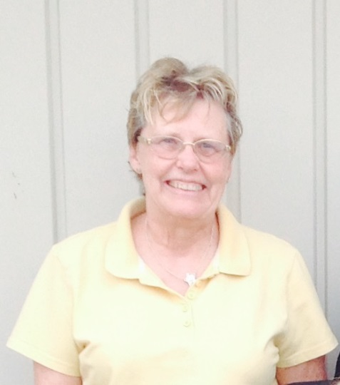
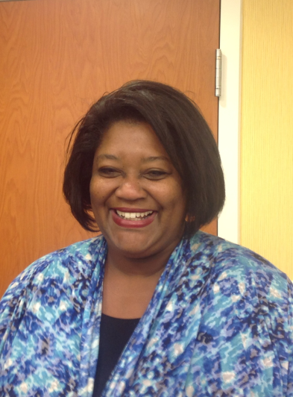
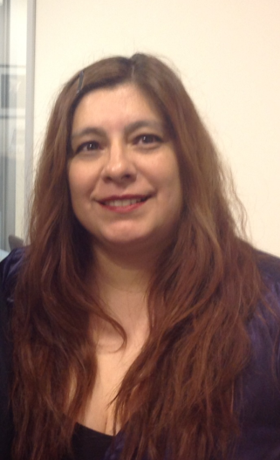
THANK YOU!
Regional Self Advocacy Technical Assistance Center Funded by the Administration on Intellectual and Developmental Disabilities.

