Slide 1


Oklahoma SALT
Self Advocacy Leadership Training

Slide 2

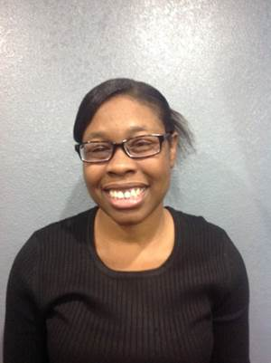

Slide 3
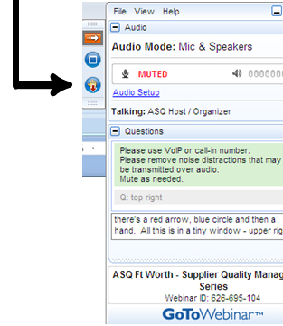

WELCOME
Reminders:
Please mute your device once you join the call
Remember to raise your hands for questions or write a message in text box
We will give everyone a chance to ask questions at the end of the presentation
Notes:
Chaqueta

Slide 4
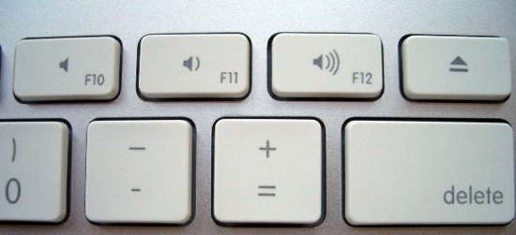
WELCOME
Reminders:
If you are using more than one device for this webinar, please do not place next to each other, to reduce echoing or feedback.
Make sure your speakers are turned on.
Notes:
Chaqueta

Slide 5

THE PURPOSE OF THIS WEBINAR
Oklahoma will discuss their leadership program.
You will learn how to support presenters
You will learn how to support your audience

Slide 6
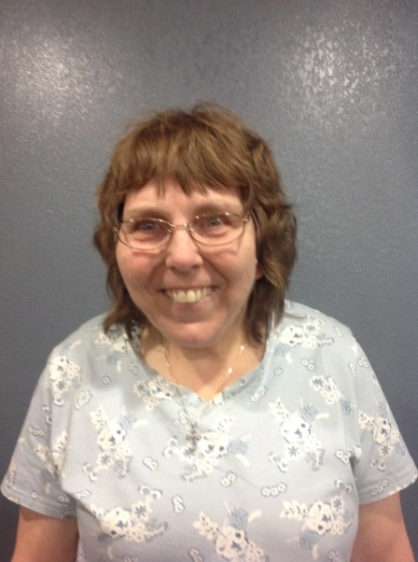
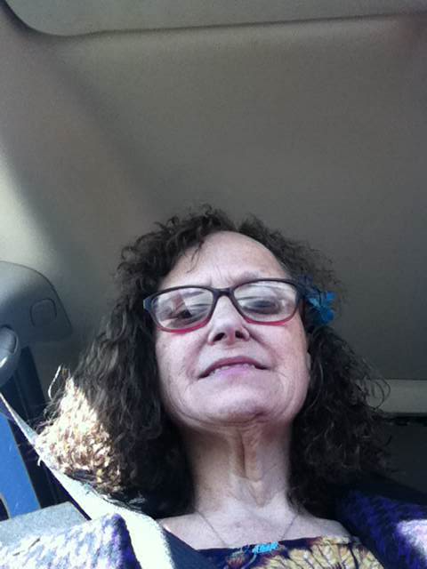
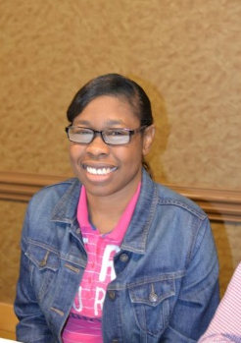
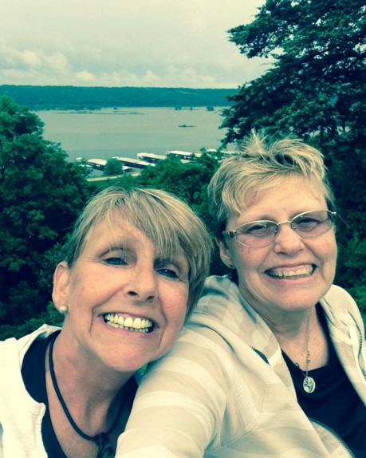
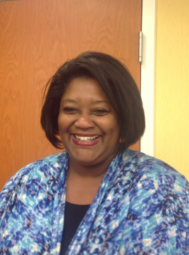
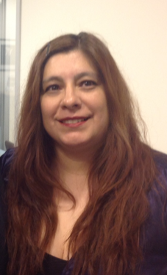
PRESENTERS
Nancy Ward
Dee Banta
From
Oklahoma People First
OCSS staff

Slide 7

POLL QUESTION #1
Do you consider yourself a leader?

Slide 8
Oklahoma SALT
Self Advocacy Leadership Training

Slide 9

HOW SALT WAS DEVELOPED
Self advocates wanted to train others to become leaders
Had a hard time connecting with self advocates using social media and decided to meet face to face
15 Oklahoma PF trainers are from all parts of the state

Slide 10
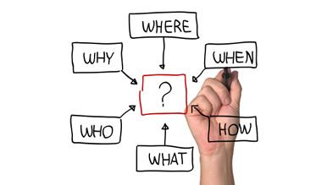
LOGISTICS
Trainers, supports and participants decide together on date, place, and time
Meet with 15-20 people for 2 days
Group established a per diem to pay for transportation and meals
Certificate of completion

Slide 11

TRAINER’S RESPONSIBLE

Slide 12
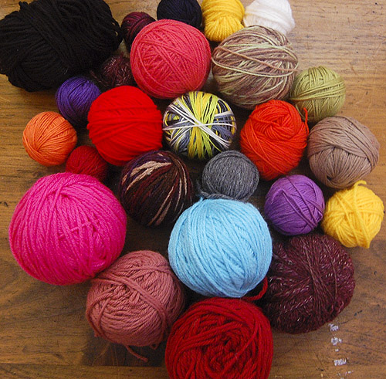
TRAINER’S RESPONSIBILITY
Setting up the room
Materials
Manuals for self and for participants
Ball of Yarn for the Human Dream catcher activity

Slide 13
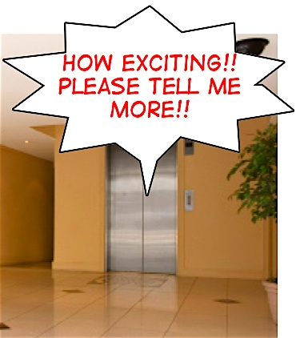
TRAINER’S RESPONSIBILITY
Describe and instruct participants about doing an elevator speech

Slide 14

SALT MODULES
Advocacy (personal and systems)
Good/Bad Leader
Communication
Rights and responsibilities
Mentoring
Networking
Partnership

Slide 15

WHAT’S HELPFUL TO THE TRAINERS
Trainers meet the day before to choose what they want to present and practice together
Make sure presentation are interactive and fun
Review what makes a good leader and what makes a bad leader

Slide 16
OCSS STATES QUESTIONS AND ANSWERS

Slide 17

STATE QUESTIONS
What does leadership mean to you
(your group)?
2. What are the characteristics of a good leader?
3. What are the characteristics of a bad leader?

Slide 18
ALABAMA COMMENTS
Leadership
Delegate and use resources and prepare and are dedicated, collaboration of partners, helping others, step our of your comfort zone
Good
Able to delegate what each person is going to do or each event so it’s not on one person.
It’s always a team effort.
Responsibility
Guiding others
Being Organized
Being a role model for other people
Bad
Unorganized
Taking it on themselves
Not getting there on time, being tardy

Slide 19
ARKANSAS COMMENTS
Leadership
Empower others
Good
Follower first before you can lead
Bad
Doing it all by themselves and not letting others do stuff

Slide 20
FLORIDA COMMENTS
Leadership
Empowering others with disabilities
Good
create other leaders
Build an excellent team around them
Bad
Dictates how it’s supposed to be, if you don’t like it

Slide 21
GEORGIA COMMENTS

Slide 22
NORTH CAROLINA COMMENTS
Leadership
It’s good
Good
Get people to be on the path and be on time
Bad
Not showing up at the meetings

Slide 23
SOUTH CAROLINA COMMENTS
Leadership
Power and encouraging others that helping and advocating not for yourself but advocating for other people. You are leading the way and other people are following you. You are setting the stage. Being positive and remain postive.
Good
Realized they have a team and responsible for running the team effectively, take criticism, respects others, organize and set up meetings, treat others like they want to be treated
Bad
Disrespects other people, doesn’t consider the time as a whole
Doesn’t give others a chance to speak

Slide 24
TENNESSEE COMMENTS
Leadership
Good
Respect and positive thinking, If you see a quiet person, to ask them to be part of the group
Bad
If the leader does not respond or acknowledge others

Slide 25
OKLAHOMA COMMENTS
Leadership
Preparing, leaders feeding off of each other
It takes time to become a leader and to build confidence
Good
Bad

Slide 26
DATES TO REMEMBER

Slide 27
STATE CALLS
We still need to connect with:
Georgia
Arkansas

Slide 28
DATES TO REMEMBER
  March 19-21 Face to Face meeting Myrtle Beach, South Carolina
  April 5 Submit 2nd Quarter Invoice, 1st Vlog due if not submitted in January and quarterly report on progress on Plan
  July 5 Submit 3nd Quarter Invoice, 2nd Vlog due and quarterly report on progress on Plan
  September 17 Advisory Meeting-GoToMeeting
  September 19 Submit 4th Quarter Invoice quarterly report on Plan

Slide 29

Next OCSS Webinars
3:30 p.m. EST
2:30 p.m. CST
Webinar dates | Topic
April 23, 2015 | Strategies for Building an Effective Team
June 18, 2015 | Strategies for Membership Recruitment
July 16, 2015 | Steps in Organizing Around an Issue
August 20, 2015 | Partnerships Outside of the Disability Community

Slide 30





THANK YOU!
Regional Self Advocacy Technical Assistance Center Funded by the Administration on Developmental Disabilities

