Slide 1

Advisory Committee Meeting
September 15, 2016

Slide 2



Slide 3
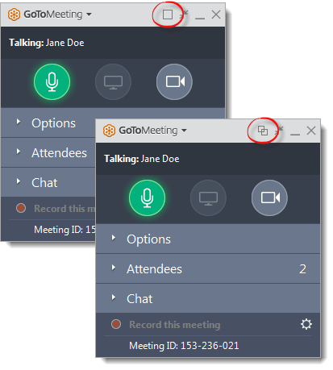
WELCOME
Reminders:
Please mute your device once you join the call
If you have a question, write a message in the chat box
We will give everyone a chance to ask questions throughout the meeting and at the end of the presentation
Notes:
Nancy

Slide 4
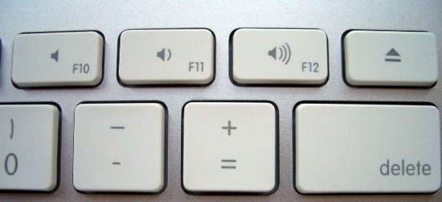
WELCOME
Reminders:
If you are using more than one device for this meeting, please do not place next to each other, to reduce echoing or feedback
Make sure your speakers are turned on
Notes:
Nancy

Slide 5

Agenda
Review Sustainability Plan
4th Quarter Report and Final Report/Outstanding Vlogs
Final Voucher
Technology Video Series
Review of Webinar Schedule and identifying 3 webinars for next year
Final Evaluation
Other Announcements

Slide 6
Sustainability Plan
Sustainability Plan
Plan is attached
Questions

Slide 7
4th Quarter Report and Final
4th Quarter Report and Final Report and Outstanding Vlogs
Review attached Plan
Questions
Due September 26th

Slide 8
Final Voucher
Final Voucher
Review Attached
Questions
Due September 26th

Slide 9
Final Evaluation
Add link to survey monkey
At least 5 per state needed
Questions
Due September 30th

Slide 10
Technology Series
Update
Released by September 28th

Slide 11


Next OCSS Webinars and Advisory Committee Meeting
3:30 p.m. EST
2:30 p.m. CST
Webinar dates | Topic
September 22, 2016 | Cultural Competency, What does it mean??
September 29, 2016 | SALT Leadership Training Oklahoma People First Part 2
October (TBD) | Emergency Preparedness Oklahoma People First

Slide 12
Next OCSS Webinars and Advisory Committee Meeting
3:30 p.m. EST
2:30 p.m. CST
Webinar dates | Topic
October (TBD) | Emergency Preparedness Oklahoma People First
January
April
May

Slide 13

ANNOUNCEMENTS
What’s new ?
2 minutes per state

Slide 14
SABE

Slide 15
ALABAMA

Slide 16
ARKANSAS

Slide 17
FLORIDA

Slide 18
GEORGIA

Slide 19

MISSISSIPPI

Slide 20
NORTH CAROLINA

Slide 21
OKLAHOMA

Slide 22
SOUTH CAROLINA

Slide 23
TENNESSEE

Slide 24
DATES TO REMEMBER

Slide 25

  Due Dates:
  Submit 3rd and 4th Quarter Invoices, Final Vlog and final report by September 26
  Complete final evaluation by September 30 (This will be posted on Survey Monkey by early next week)

Slide 26
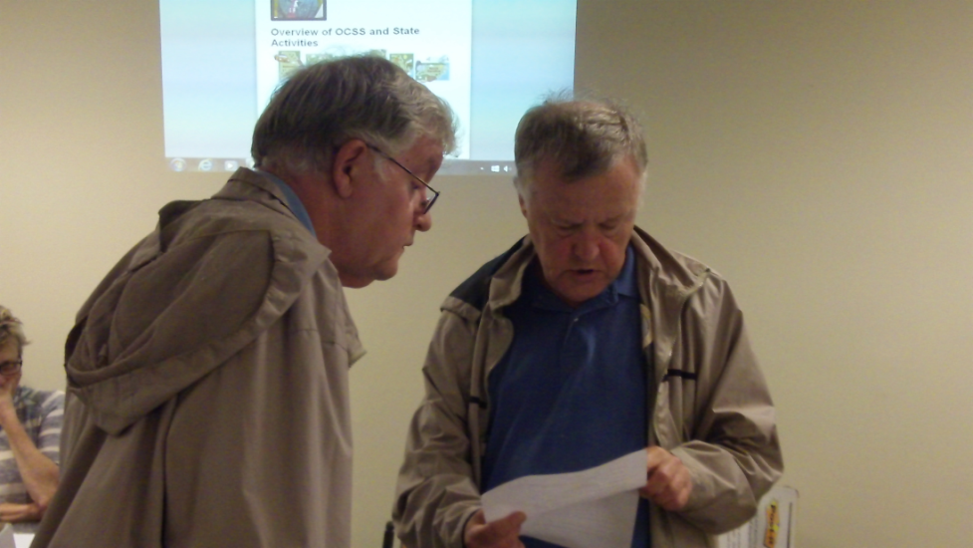
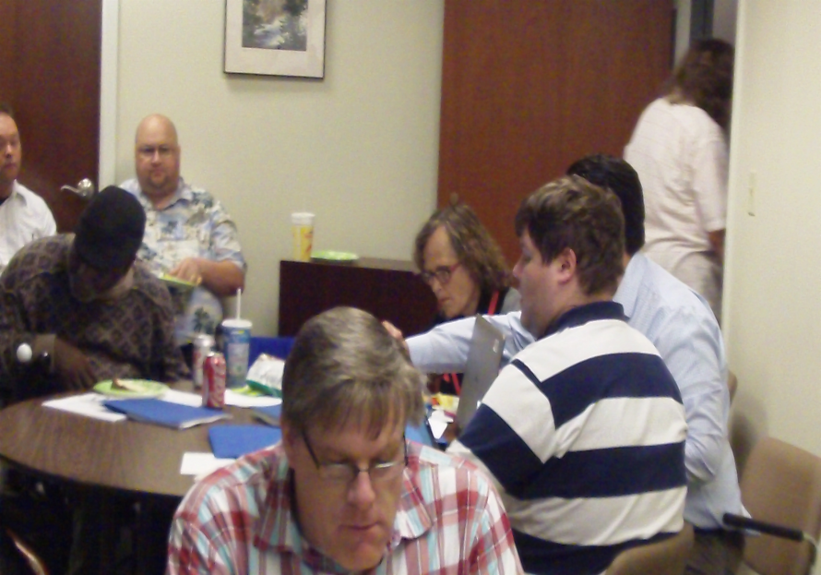
OCSS Hard at Work!
OCSS funded as a Project of National Significance by the Administration on Intellectual and Developmental Disabilities

