Slide 1
Advisory Committee Meeting
May 20, 2016

Slide 2
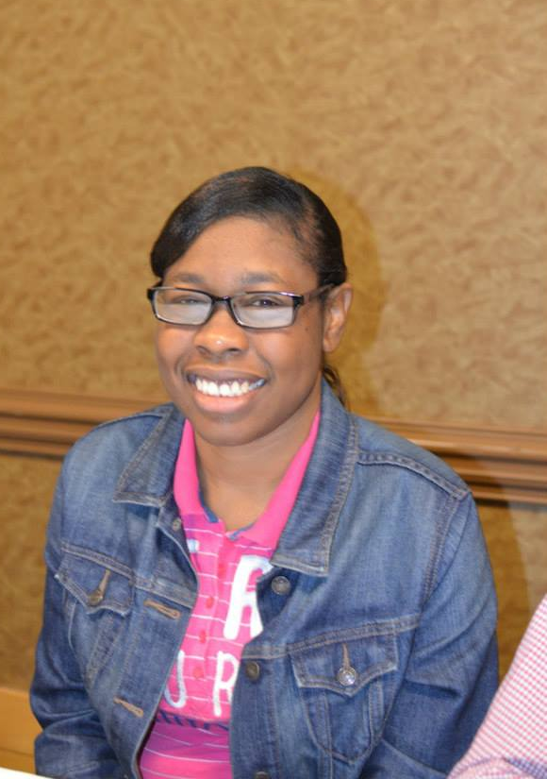

Slide 3
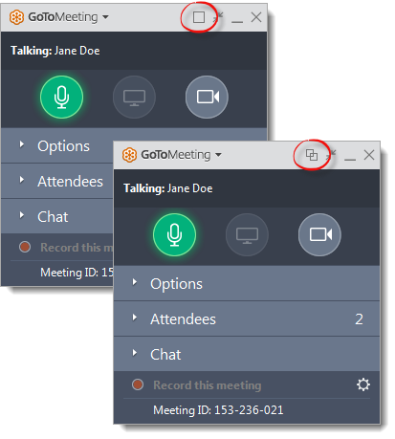
WELCOME
Reminders:
Please mute your device once you join the call
If you have a question, write a message in the chat box
We will give everyone a chance to ask questions throughout the meeting and at the end of the presentation
Notes:
Nancy

Slide 4
WELCOME
Reminders:
If you are using more than one device for this meeting, please do not place next to each other, to reduce echoing or feedback
Make sure your speakers are turned on
Notes:
Nancy

Slide 5
Agenda
Meeting with our partners
State Questions
Mitsubishi Youth Leadership Academy: Need volunteers to work on grant
Regional Meeting and Next Face to Face Meeting
Important Dates and Activities

Slide 6
Meeting with your partners
Each State is being asked to meet with your DD Partners to discuss the following ways they can support our Regional Peer to Peer Technical Assistance efforts
Notes:
Chaquet

Slide 7
Meeting with your Partners
What do we want to accomplish???
We want to continue with our efforts to :
Market/showcase our stories
Maintain our peer to peer technical assistance to share our strategies and successes in
connecting with youth
recruiting new members
building partnerships
obtaining funding
employment first
organizing around our issues: voting, transportation, services
building our organizations etc…

Slide 8
What do we ask each Partner?
What do we ask each Partner?

Slide 9
Developmental Disabilities Council | What Activities:
Add OCSS/SABE activities as funding priorities in their five year plan | Support with funding of the coordination of a regional peer to peer technical assistance center through SABE or another OCSS participating state: Amount per state $10,000.00

Slide 10
Developmental Disabilities Council | What Activities:
Add OCSS/SABE activities as funding priorities in their five year plan | Support self advocates from their state to participate in Regional Self Advocacy Leadership Training Institute for Youth and New Leaders

Slide 11
Developmental Disabilities Council | What Activities:
Add OCSS activities as funding priorities in their five year plan | Support the development of expertise of self advocates in the production of vlogs, blogs, and webinars that tell their personal stories about the power of self advocacy and address their issues

Slide 12
Developmental Disabilities Council | What Activities
Add OCSS/SABE activities as funding priorities in their five year plan | Support self advocates and their supporters to participate on Advisory Board of the Regional Center and to participate in regional meetings and regional and national conferences with their peers as leaders, participants and instructors

Slide 13
Developmental Disabilities Council | What Activities
Add OCSS/SABE activities as funding priorities in their five year plan | Support with funding the Collaboration of OCSS states to sponsor the 2018 national self advocacy conference: $10,000 per state

Slide 14
Protection and Advocacy Organizations | What Activities:
Add support of regional peer to peer self advocacy (OCSS/SABE) as priority for P and A | Work on Project Vote with their state self advocacy groups Work on Employment initiatives with state self advocacy groups

Slide 15
Protection and Advocacy Organizations | What Activities
Add support of regional peer to peer self advocacy as priority for P and A | Work with SA groups on closing institutions Work with State Groups on legislative initiatives Provide technical support with technology, listserv and media relations

Slide 16
UCEDD | What Activities
Add OCSS/SABE regional peer to peer activities as priorities in their strategic planning | Provide support to self advocates and their organization in learning to use social media technology and securing access to technology resources Provide a resource to serve on a committee to write a grant for a Youth Leadership Academy and submit to Mitsubishi

Slide 17
Self Advocacy Organizations
We need answers from you also!!

Slide 18
State Self Advocacy Organizations | What Activities
Participate on Advisory Board for Regional Center Support the Regional Peer to Peer efforts through involvement in governance and management of center | Appoint 2 self advocates to continue work on Advisory Committee/Board of the center Provide a staff person to coordinate activities of the center State group manage finances for the center

Slide 19
State Self Advocacy Organizations | What Activities
Participate on Advisory Board for Regional Center Support the Regional Peer to Peer efforts through involvement in governance and management of center | Agree to collaborate and or host with the Regional center the 2018 national self advocacy conference

Slide 20
Worksheets
You will complete a worksheet for each of your meetings

Slide 21
Developmental Disabilities Council | What Activities | Date of Meeting: _________
Add OCSS/SABE activities as funding priorities in their five year plan | Support with funding the Collaboration of OCSS states to sponsor the 2018 national self advocacy conference: $10,000 per state

Slide 22
DATES TO REMEMBER

Slide 23
Due Now
Submit 2nd Quarter Invoice and progress report, if you have competed the requirements (some states still have outstanding Vlogs and quarterly reports from 1st quarter)
Registration Forms for Orlando Meeting

Slide 24
Due Now
Submit 2nd Quarter Invoice and progress report, if you have competed the requirements (some states still have outstanding Vlogs and quarterly reports from 1st quarter)
Registration Forms for Orlando Meeting

Slide 25
Next Face to Face Meeting
Meeting prior to SABE Board Meeting
July 5-6, 2016 Embassy Suite Orlando Airport
July 7, 2016 Vote Project Meeting with Tom Hicks, Commissioner of Elections Assistance Commission
Our meeting will be considered a regional meeting for Region 6 and 9 of SABE. Each state may bring up to 5 participants. We will only pay for 2 rooms per state for a maximum of 2 nights
Meetings will begin at 3:00 on July 5.
Focus will be on Finalizing our Sustainability Plan
We will need the answers to the questions presented during this meeting

Slide 26
Next OCSS Webinars and Advisory Committee Meeting 3:30 p.m. EST 2:30 p.m. CST
Webinar dates | Topic
June 22, 2016* | SALT Leadership Training Part 1
July 20, 2016* | SALT Leadership Training Part 2
September- Date to be announced | Cultural Competency What does it mean??
September 14, 2016* | Advisory Committee Call * Still tentative. Also all meetings have been changed to Wednesdays

Slide 27
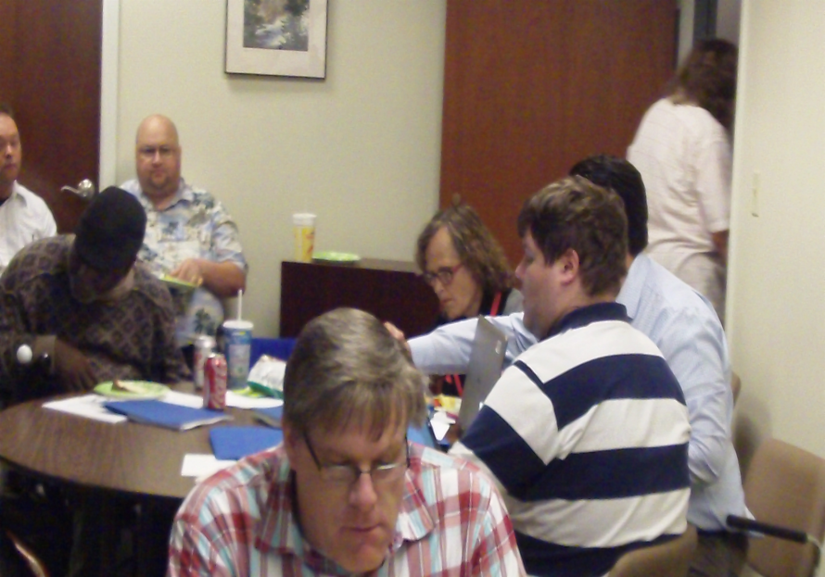
OCSS Hard at Work!
OCSS funded as a Project of National Significance by the Administration on Intellectual and Developmental Disabilities

