Slide 1


Funding Strategies for Self Advocacy Organizations
Notes:
Chaqueta
Use this slide to Welcome everyone to our Webinar on Funding Strategies for Self Advocacy Organizations

Slide 2
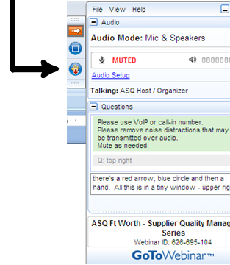

Welcome
Reminders:
Please mute your device once you join the call
Remember to raise your hands for questions or write a message in text box
We will give everyone a chance to ask questions at the end of the presentation
Notes:
Chaqueta

Slide 3

Welcome
Reminders:
If you are using more than one device for this webinar, please do not place next to each other, to reduce echoing or feedback.
Make sure your speakers are turned on.
Notes:
Chaqueta

Slide 4

Welcome
During our webinar we will ask each state representative to talk for five minutes about their organization funding and their successes and challenges
We will use the survey data for these presentations
Notes:
Chaqueta
Please remind folks that we included slides for states that sent information to us ahead of time

Slide 5
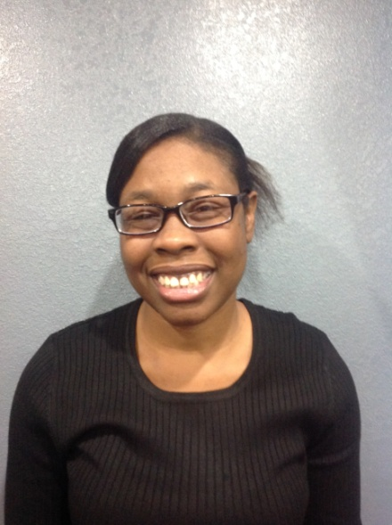
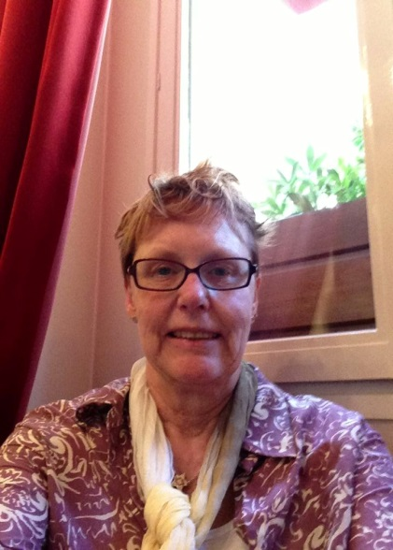
Presenters
Chaqueta Stuckey-OCSS Co-Director
Vicki Hicks Turnage-OCSS Co-Director
Notes:
Chaqueta
Juliana:
Need pictures of Chaqueta and I

Slide 6
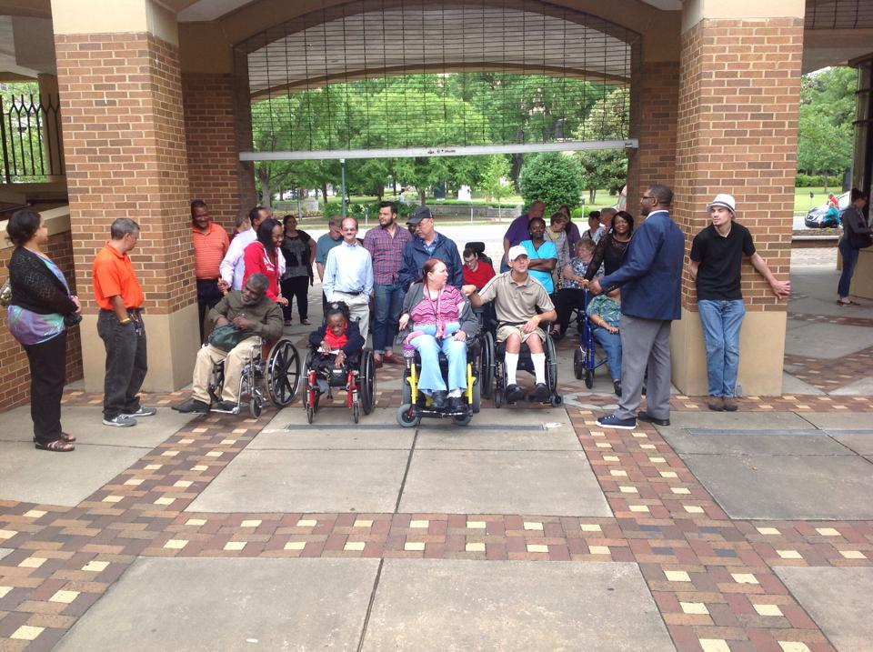
Presenters
OCSS Advisory Committee members
Notes:
If you have a better picture please insert it

Slide 7

THE PURPOSE OF TODAY’s WEBINAR
Review individual states demographic survey results
Review the Summary data for states
Identify successful funding strategies
Notes:
Vicki

Slide 8
Notes:
If for some reason the presenter for Alabama is not present, I will handle these slides

Slide 9
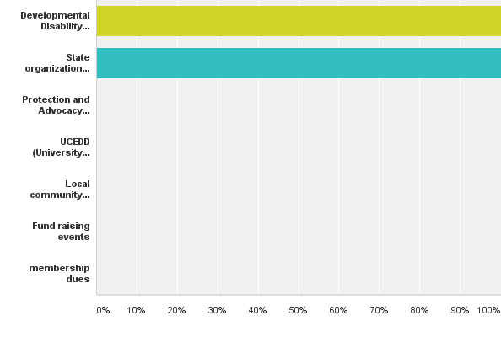
Where do you get your funding?

Slide 10
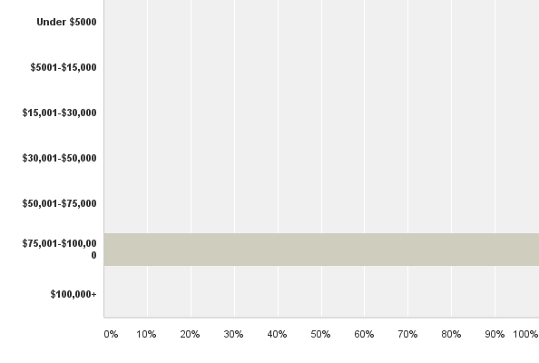
What is the annual budget for your state organization?

Slide 11
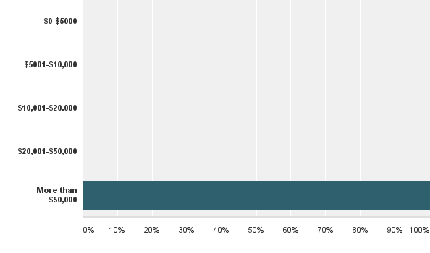
How much money does your organization have in savings or reserves?

Slide 12
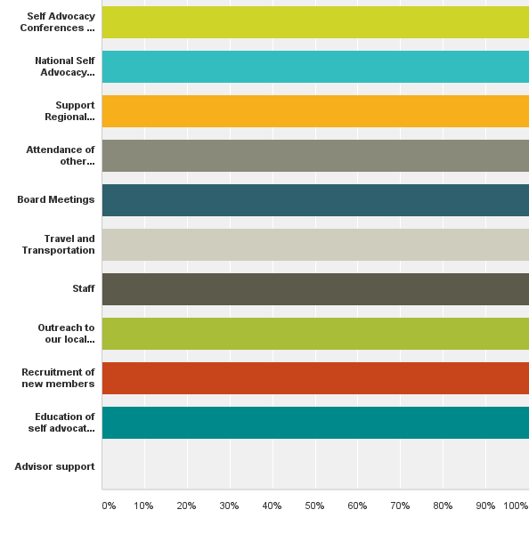
What do you use your money for?

Slide 13
Successful Strategies:
People First of Alabama receives grants for the majority of its funding
Funded consistently by the Department of Mental Health with state funds for outreach and organizing. Previously funded by a Medicaid System Change Grant

Slide 14
Successful Strategies:
Grant writers volunteer and paid over the years
Financial management to account for funds
Local groups supported by volunteer advisors from agencies
Local groups charge membership fees and have fund raisers

Slide 15
Successful Strategies
The Developmental Disabilities Council for special projects, state and national conference participation
Strategies that have been successful have been grant contracts for hourly rates for board members and volunteers
Conference registrations

Slide 16
Good Financial Management
Saving our money: (over $100,000 in bank)
Special outcome based projects such as OCSS sub-contracts
The Department of Mental Health and the DD Council has been consistent supporters
A strategic plan with a five year business plan that tells us how much we need to do our work and outlines our strategies

Slide 17
Strategies that have not been successful:
  Corporate funders (we have not tried this)
  Donations (we have some but have not explored this)

Slide 18
Notes:
Ask Eric or someone from Arkansas to review these slides.
This will be the same script for each state.
If no one is present you review and I will comment if needed.

Slide 19
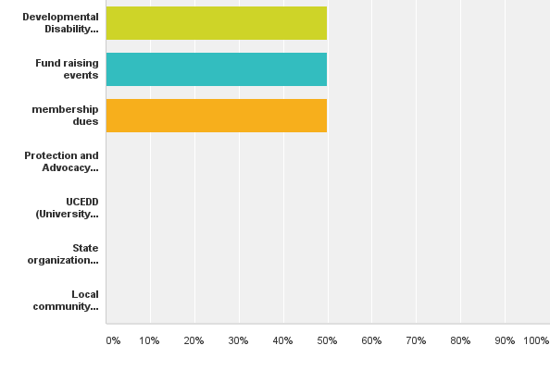
Where do you get your funding?
Answered: 2 Skipped: 0

Slide 20
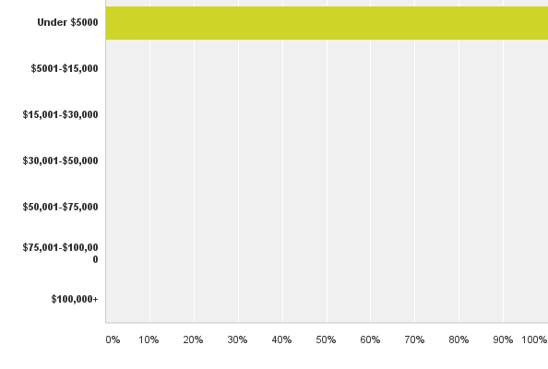
What is the annual budget for your state organization?
Answered: 2 Skipped: 0

Slide 21
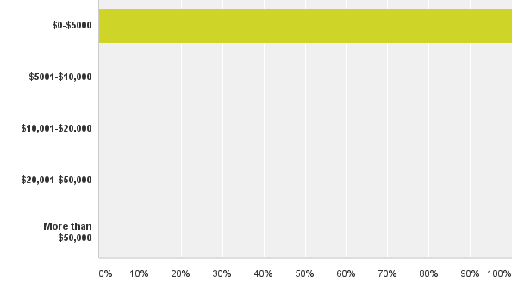
How much money does your organization have in savings or reserves?
Notes:
People First of Alabama receives grants for the majority of its funding
Funded currently by the Department of Mental Health with state funds for outreach and organizing. Previously funded by a Medicaid System Change Grant
Local groups supported by volunteer advisors from agencies
Local groups charge membership fees and have fund raisers
The Developmental Disabilities Council for special projects, state and national conference participation

Slide 22
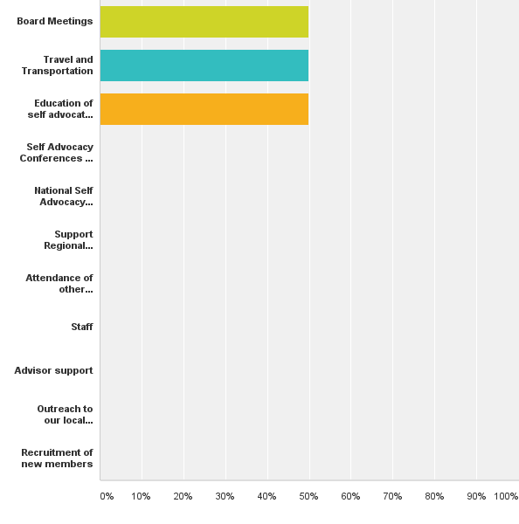
What do you use your money for?

Slide 23
Comments
Strategies that have worked
Strategies that have not worked or we have not tried

Slide 24
Notes:
Richard or Arizona

Slide 25
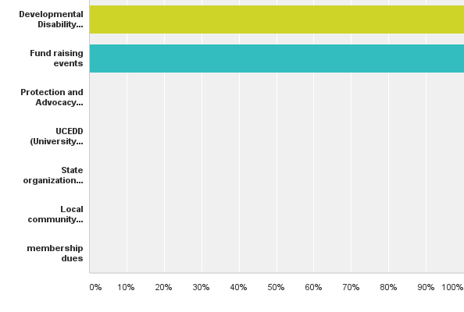
Where do you get your funding?

Slide 26
What is the annual budget for your state organization?
Answered: 1 Skipped: 0

Slide 27
How much money does your organization have in savings or reserves?
Answered: 1 Skipped: 0

Slide 28
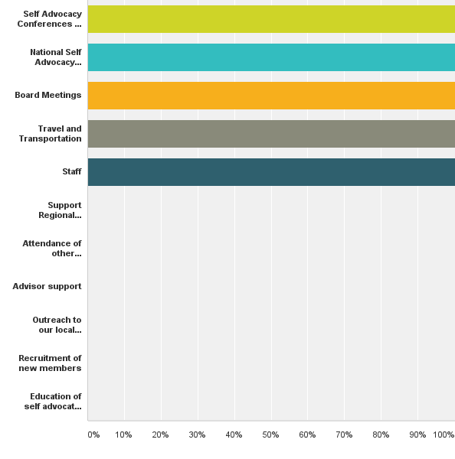
What do you use your money for?
Answered: 1 Skipped: 0

Slide 29
Comments
Strategies that have worked
Strategies that have not worked or we have not tried

Slide 30
Notes:
Bernard or Cherie or someone from Georgia

Slide 31
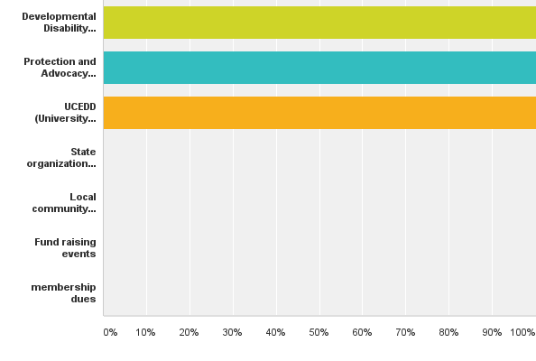
Where do you get your funding?

Slide 32
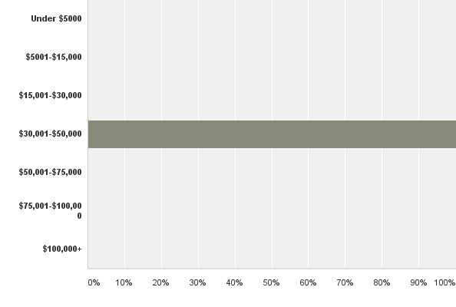
What is the annual budget for your state organization?

Slide 33
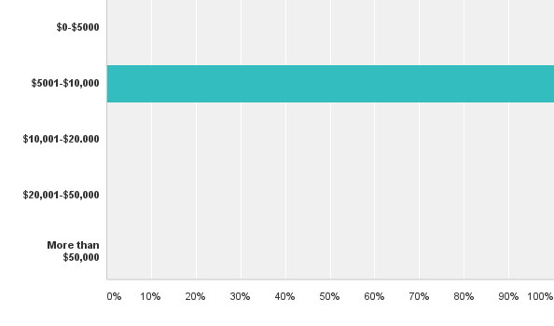
How much money does your organization have in savings or reserves?

Slide 34
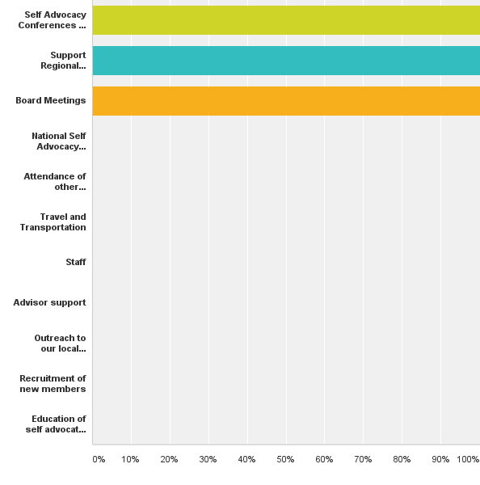
What do you use your money for?

Slide 35
Comments
Strategies that have worked
Strategies that have not worked or we have not tried

Slide 36
Notes:
You and I will do this one as North Carolina will not be present

Slide 37
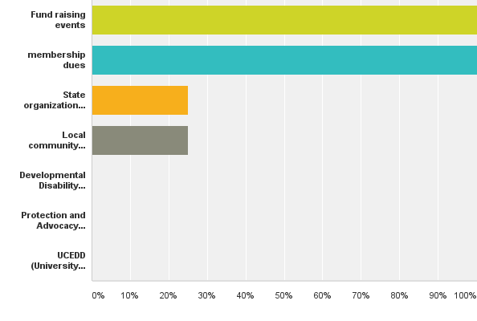
Where do you get your funding?

Slide 38
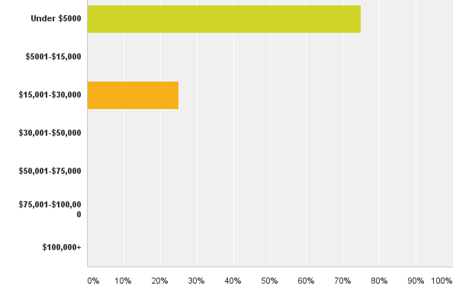
What is the annual budget for your state organization?

Slide 39
How much money does your organization have in savings or reserves?

Slide 40
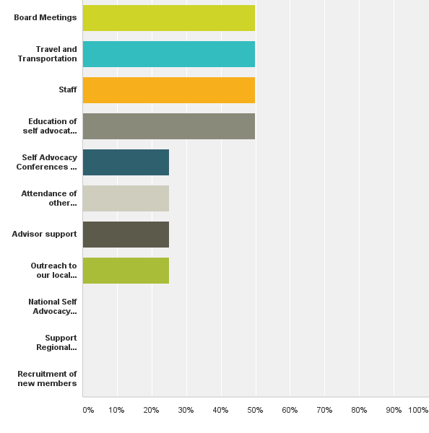
What do you use your money for?
Answered: 4 Skipped: 1

Slide 41
Comments
Strategies that have worked
Strategies that have not worked or we have not tried

Slide 42
Notes:
Nancy or Lance

Slide 43
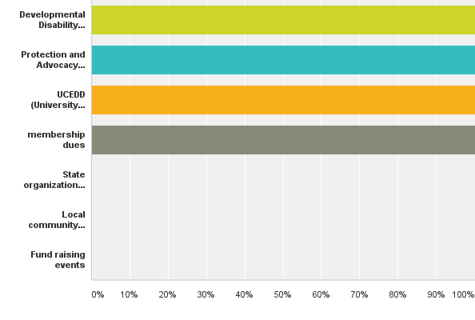
Where do you get your funding?
Answered: 1 Skipped: 1

Slide 44
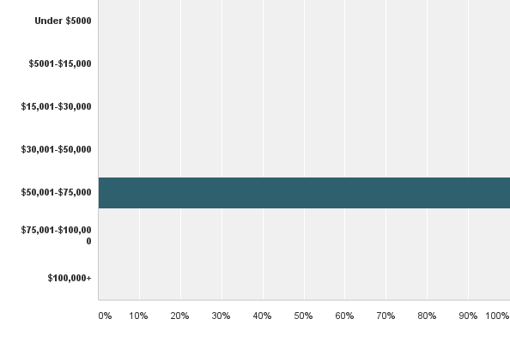
What is the annual budget for your state organization?
Answered: 1 Skipped: 1

Slide 45
How much money does your organization have in savings or reserves?

Slide 46
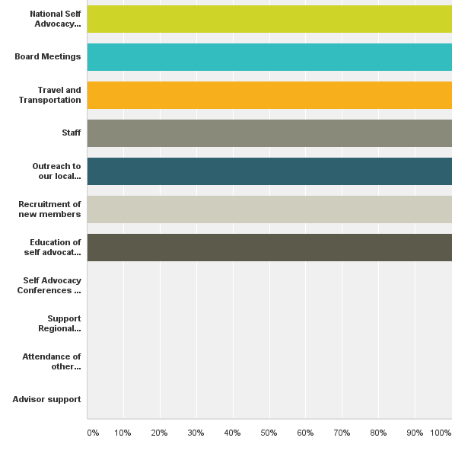
What do you use your money for?

Slide 47
Comments
Strategies that have worked
  Trust Fund from Hissom Court Case
Strategies that have not worked or we have not tried

Slide 48
Notes:
You , Connie or Ebony

Slide 49

Where do you get your funding?

Slide 50
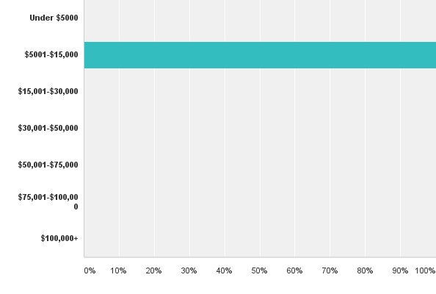
What is the annual budget for your state organization?

Slide 51
How much money does your organization have in savings or reserves?

Slide 52
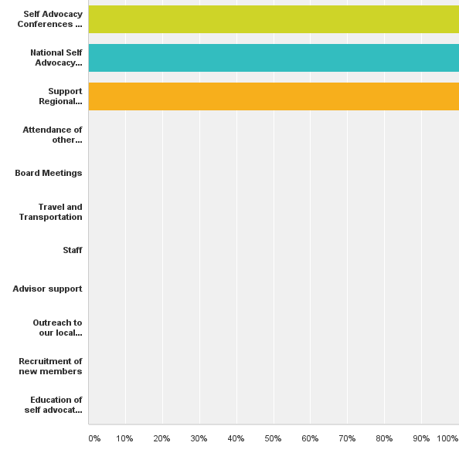
What do you use your money for?

Slide 53
Comments
Strategies that have worked
Strategies that have not worked or we have not tried

Slide 54
Notes:
Bill Gage and Gatha Logan and Ruthie

Slide 55
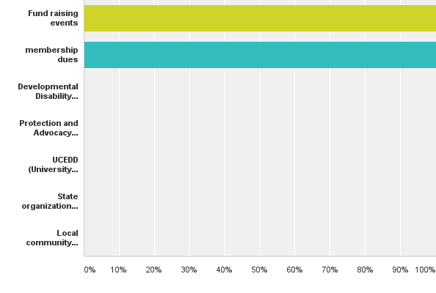
Where do you get your funding?

Slide 56
What is the annual budget for your state organization?

Slide 57
How much money does your organization have in savings or reserves?

Slide 58
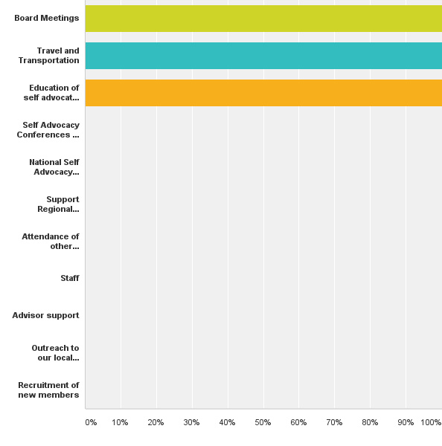
What do you use your money for?

Slide 59
Comments
Strategies that have worked
Strategies that have not worked or we have not tried

Slide 60
Summary Results of the State Demographic Survey
Notes:
I will do this series

Slide 61
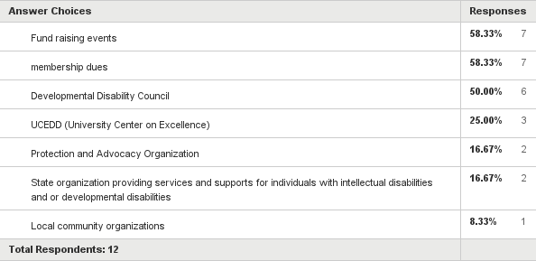
Funders for OCSS States
Notes:
Just read the number not the percentage

Slide 62
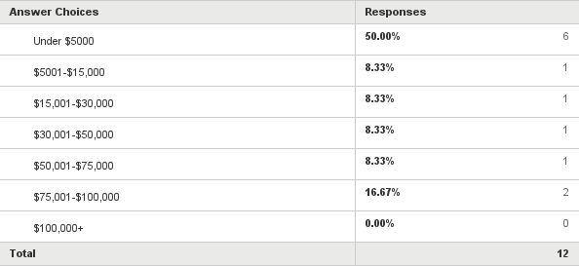
Annual Budget for OCSS States

Slide 63
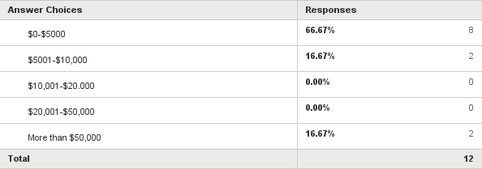
Our organizations savings or reserves

Slide 64
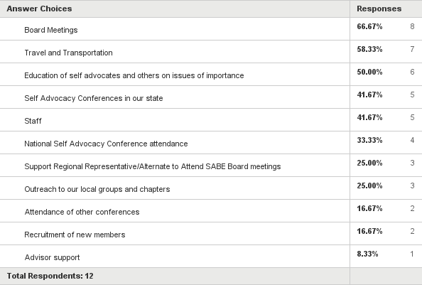
How we spend our money

Slide 65
Successful funding strategies based on our experiences
Structure must be in place to support the organization
  Staff and Volunteers
Consistent funder(s) for grassroots development and basis self advocacy outreach and education
  Oklahoma’s Trust Fund
  Alabama Department of Mental Health
Projects to support work on our issues
Notes:
Chaqueta

Slide 66
What has been successful funding strategies that OCSS states have used?
Money that is not tied to staff or projects that we can use for special events
  this is called discretionary money we called it savings or reserves)
    Corporate sponsorships
    Donations
    Outcome based contracts
    Fees from conferences

Slide 67
What has been successful funding strategies that OCSS states have used?
Well developed Strategic Plan with a Business Plan
Multiple sources of funding-state, federal fundraising, outcome based contracting
Good Relationships with your Partners
Following through with activities and doing what we say we will do
Good accounting practices
Grant writers (volunteer or paid)

Slide 68
Questions

Slide 69



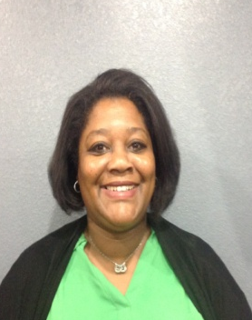
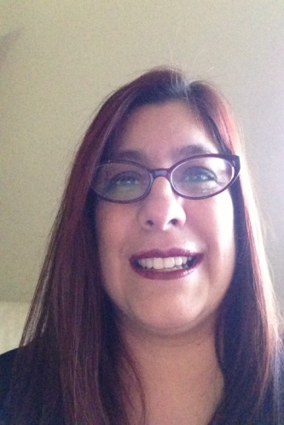
Thank you!
Regional Self Advocacy Technical Assistance Center Funded by the Administration on Intellectual and Developmental Disabilities

