Slide 1

YOUR STATE PLAN
OCSS
SOUTHERN COLLABOARTIVE

Slide 2
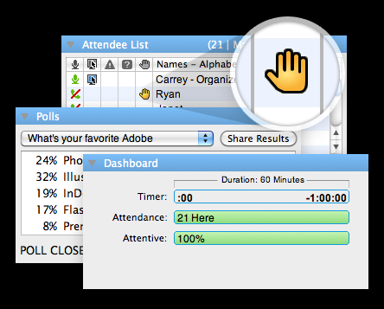
THINGS TO REMEMBER
Once you have joined put your device (computer, tablet, phone) on mute
During roll call, you may unmute your device to introduce your state members
If you have a question, raise your hand

Slide 3
Roll Call
Alabama
Arkansas
Florida
Georgia
Oklahoma
North Carolina
South Carolina
Tennessee

Slide 4
PURPOSE OF THIS WEBINAR
Overview of state planning process
To help states begin to develop your state plan for May 2014 meeting
Provide possible strategies to work with your partners for sustainability
Provide a format for your state plan

Slide 5

How do you start?
We will provide you with a format for the plan
Preview of format

Slide 6

How do you start?
Review you demographic survey from
We will send you your survey and you will insert it as the Introduction to the plan
  Here is what it will look like.
    Example Tennessee
Notes:
Juliana will put up Tennessee Survey as an example for the group. You do not have to review all of the survey

Slide 7
Next Steps:
Review your Mission Statement
A Mission Statement is the main purpose of your group
Examples
  Nothing about us, without us.
  Offering experience through Opportunities.

Slide 8

Next Steps:
YOUR HISTORY
Review your history
Examples
  We started our group in 2005
  We have 22 Chapters
  The Arc helped us get started
  We have 5 regions in our state

Slide 9
SCOTT (SWOT)Analysis
A good way is to find out what your group is good at and what you need to continue to work on is to use what we are calling a “SCOTT” Analysis. Others may call it “SWOT” Analysis.
Strengths | Challenges
Opportunities | Threats and Trends

Slide 10
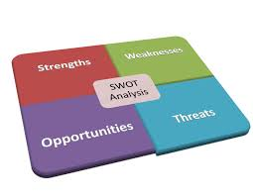
SCOTT (SWOT)Analysis
We changed this because we do not like the word weakness.
SCOTT stands for
  S- Strengths
  C-Challenges (Weaknesses don’t work for us)
  O-Opportunities
  T and T-Threats and Trends

Slide 11


S (Strengths)
Make a list of the things you are most proud of (Strengths)
Examples
  We have 22 Self Advocacy groups
  We have been in existence since 2005
  We passed a law to get rid of the “R” Word
  We have $100,000 in the bank

Slide 12

O (Opportunities)
Make a list of your resources: people, partnerships and money (Opportunities)
Examples
  DD Network partners
  Strong local chapters that are working on People to People
  We have two grants
    DD Council for a Young Emerging Leaders Project for $35,000
    DD Council Funds our state group for $20,000

Slide 13

TT (Threats and Trends)
What problems keep you from accomplishing your goals (Threats and trends)
Examples
  State budgets have decrease over the last 2 years
  Partners control supports
  DD Planning council funding has decreased
  Transportation Funding for members

Slide 14
Next:
WORK PLAN FOR PROJECT
The Work Plan includes the following:
  OCSS Goal: To Develop and Implement a State Technical Assistance Plan through peer to peer technical assistance

Slide 15
Next:
Objectives of OCSS Technical Assistance
To Develop or Enhance partnerships with DD Partners in your state
Increase connections to the grassroots to promote self advocacy efforts

Slide 16
Next:
Objectives of OCSS Technical Assistance
Enhance the state leaderships skills in providing peer to peer technical assistance in their state and the region
Establishment of state structure to maintain connections with grassroots

Slide 17
Next:
ACTION STEPS FOR PROJECT
Some action steps are required for the project this year and during the remaining two years
Actions required:
  Host a retreat to identify ways and timeframes on activities that you can work together on
  8 Grassroots events that you will work on around your issues ( 2 per quarter for the remaining quarters of the project)
  Participate in Quarterly Advisory Committee meetings for OCSS

Slide 18
Next:
ACTION STEPS FOR PROJECT
Actions required:
  Attend Face to Face Meetings and Webinars
  Present on at least one OCSS Webinar
  Submit at least 2 Blogs or Vlogs on issues of concern
  Develop a strategic plan and funding (financial plan) for a state structure that supports grassroots issues

Slide 19
Next:
ACTION STEPS FOR PROJECT
Actions you may add based on your technical assistance needs and issues identified by your state:

Slide 20
Next:
ACTION STEPS FOR PROJECT
Examples
  Work on Employment First Initiative with P and A in your state
  Host a conference with your partners
  Work on a grant with a partner(s) together

Slide 21
Next:
ACTION STEPS FOR PROJECT
Examples
  Partners participate in Advisory Meetings for project
  Partners co-present on Webinars
  UCEDD’s assist in Blogging and Vlogging events

Slide 22

TIMELINE
You will indicate when you will complete and or work on Actions by quarter (every 3 months)
Example
  If you host 2 grassroots activity with your partners per quarter, you will mark that you do this each quarter

Slide 23


Important Dates and Times
  May 1, 2014
    Turn in your 1st Blog or Vlog

Slide 24

Important Dates and Times
May 8-9, 2014 Birmingham, Alabama
What do you need to be ready?
Review your demographic survey
Review your mission statement
Be specific about your history
Begin your SCOTT Analysis
Meet with your partners to identify action steps and timelines

Slide 25
Important Dates and Times
  May 31, 2014
    Complete your 150 surveys on

Slide 26
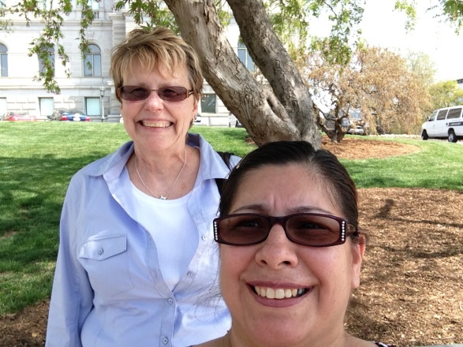
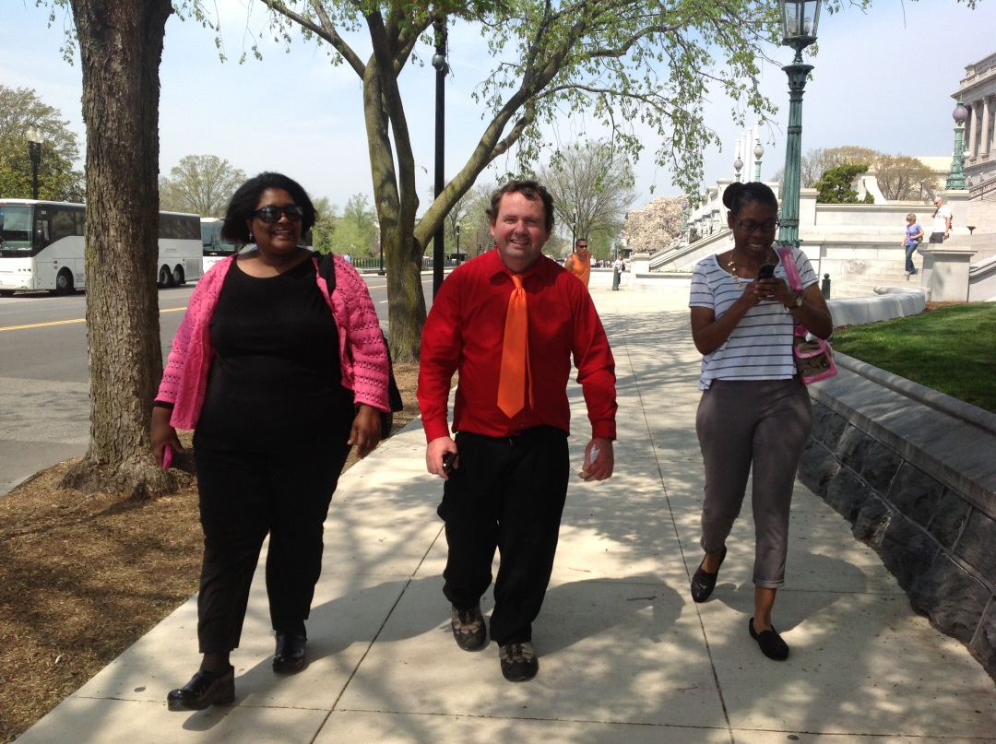

Thank you!
Funded by AIDD

